Slide 1
How do I find cool science?
Online
Notes:
Finding interesting and readable science is one of the most challenging tasks for many park guides, interpretive and education rangers. I hope this slideshow and the accompanying worksheets and homework prompts will help you feel confident in your ability to find and use science content relevant to your park and/or current job.
This was written by a scientist (Louise Allen), if you have comments and feedback from a non-scientist’s perspective, she would greatly appreciate your viewpoint.

Slide 2
How do I find cool science?
IRMA
Research Learning Centers - Research Briefs
Google Scholar
Contact the researcher
Other?
Notes:
I am aware of several ways to get information about science that is either happening in your park or is relevant to your park. If you know of other sources, please comment in the topic thread for Module 1 and they can be added to this document.

Slide 3
IRMA (https://irma.nps.gov/Portal/)
Notes:
IRMA is number one, mostly because it will allow you to find reports based on science that is happening at your specific park. Before working on iSWOOP, I only used IRMA to report out the findings from my research in national parks. I never used it to look for what others were doing. It is certainly a finicky program, so if you run into a dead end, don’t give up. Start from the last successful step and move forward again. If you are still having trouble ask for help.

Slide 4
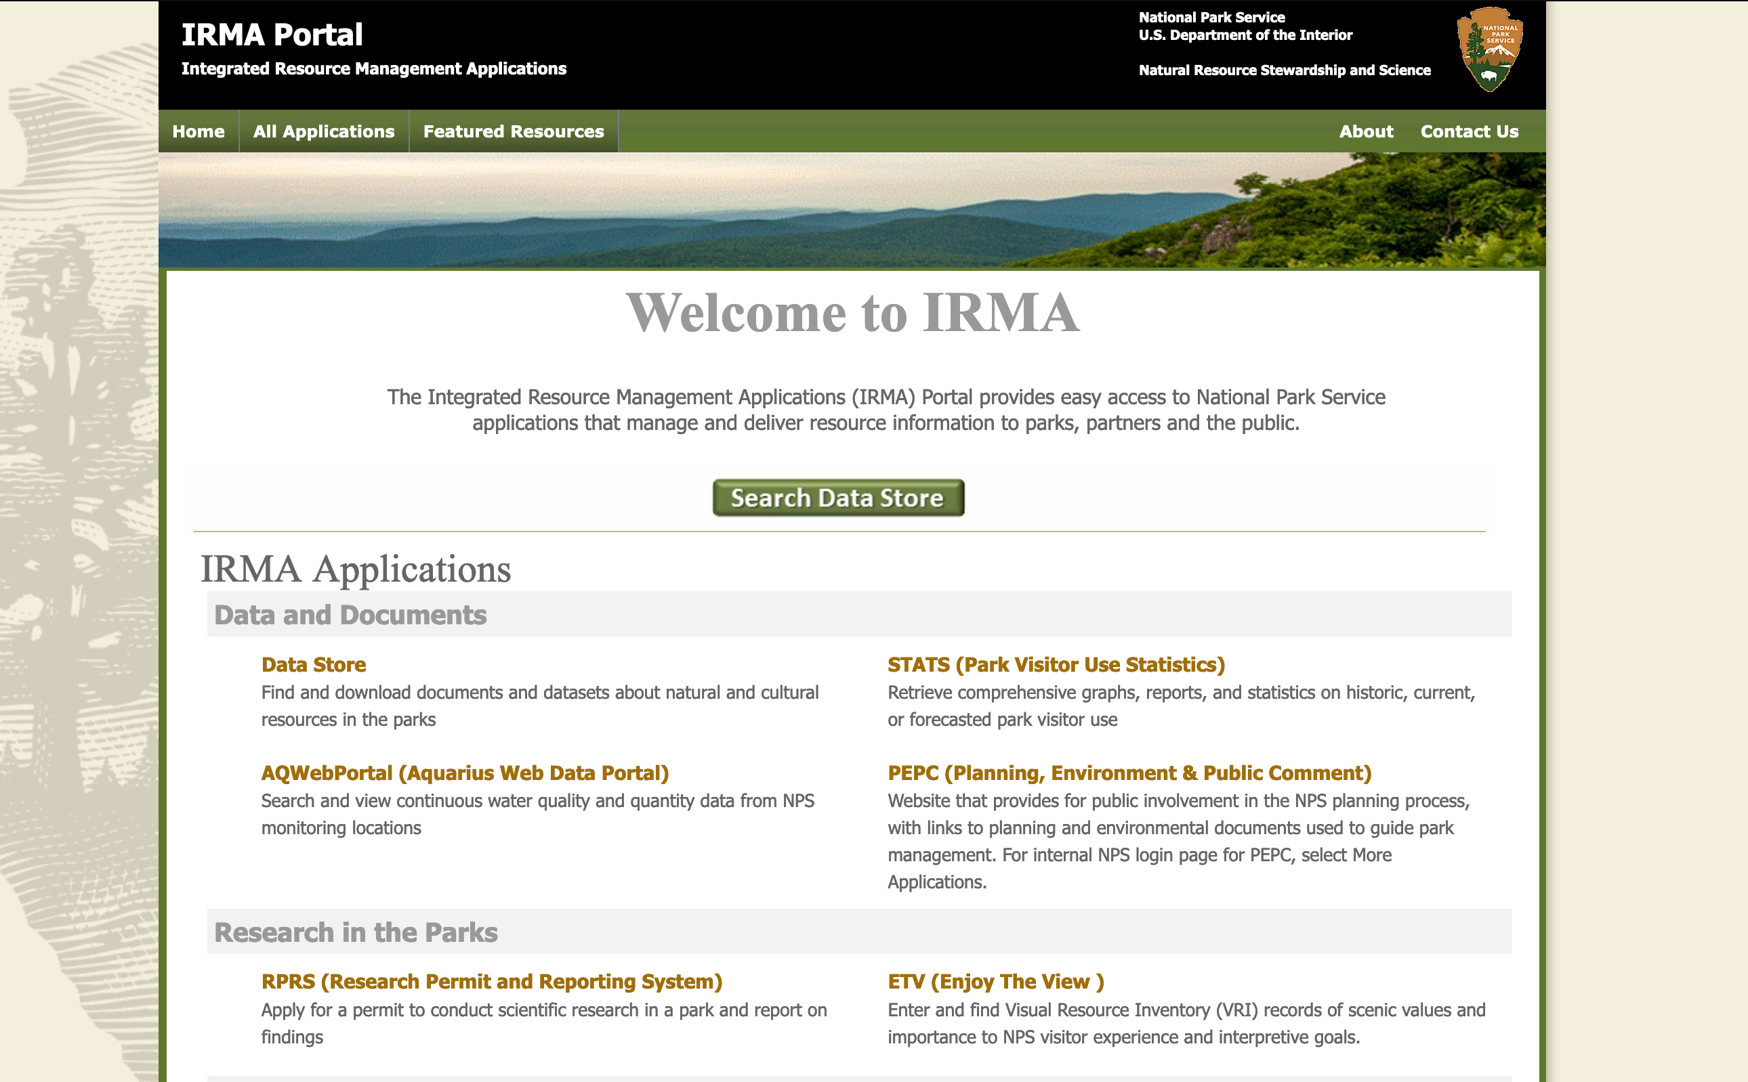
Reports
Notes:
At the top of the page is a search tab. Annual reports are a good place to start. Keep in mind, usually investigators (aka researchers) often throw all the information they have collected no matter how interesting or not interesting it may be into an annual report. So I have always found them to be the least reader friendly, but you can get through them, or at least glean enough from them to get useful information.

Slide 5
Login
Notes:
I’m honestly not 100% sure you need to log in to the Research Permit and Reporting System (RPRS) where IRMA is house in order to use it… You may be able to save searches that would make it worth while to create an account.

Slide 6
Annual Reports

Slide 7
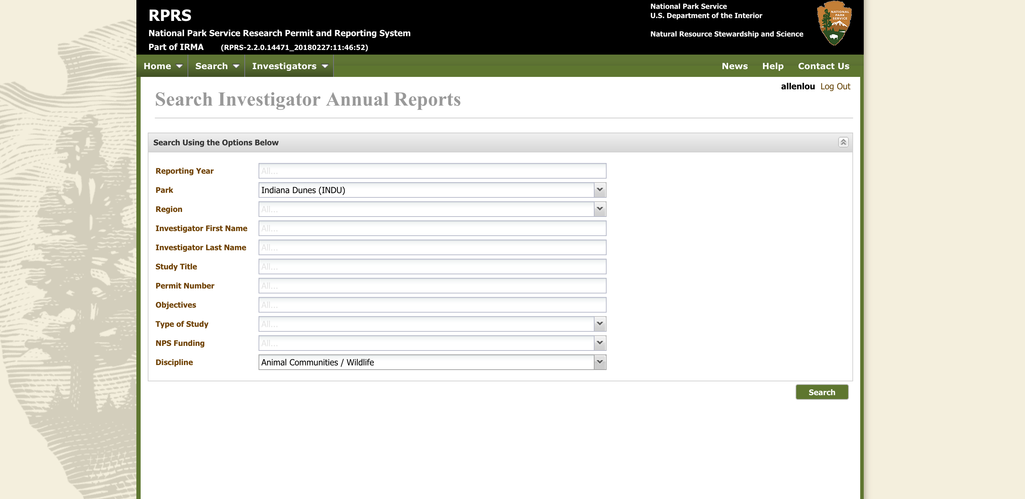
There are a number of search areas to fill
Notes:
I would skip reporting year and investigator, unless you are looking for a specific researcher. You will like also not want to include things like title, permit number or funding. Using these will unnecessarily reduce your search results. I guess the more you know about what you are looking for the more choosy you should be…. In the example to follow, I will not be choosy!

Slide 8
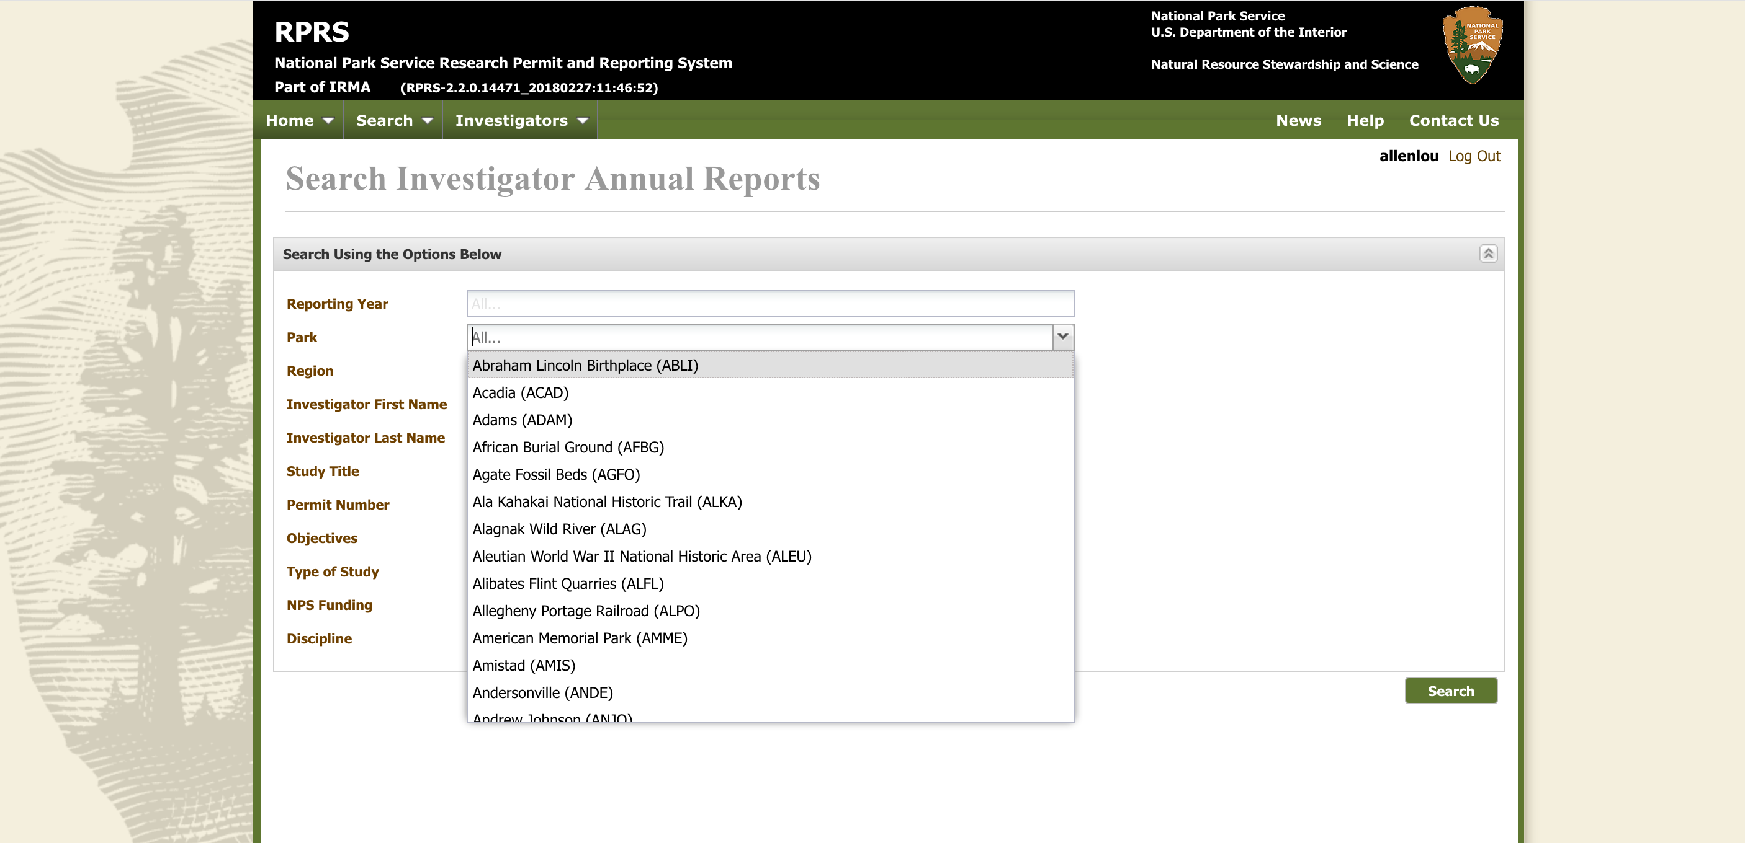
Search Parameters
Notes:
You can search your park or region! I’m going to choose, one of the parks where iSWOOP has been.

Slide 9
I’ve selected Wildlife at INDU
Notes:
So I know I want to learn about amphibian research at Indiana Dunes National Park, so I know I need to search for Wildlife.

Slide 10
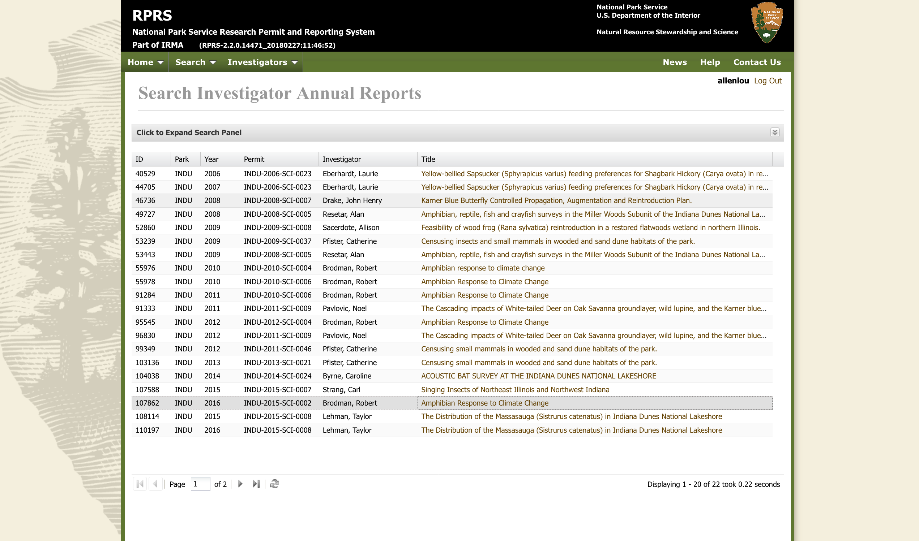
Sounds interesting
Notes:
This seems like a cool topic that will be good to get some more science information about. I also recognize the investigator name as someone who I know works at the park and interacts with the park guides, etc.

Slide 11
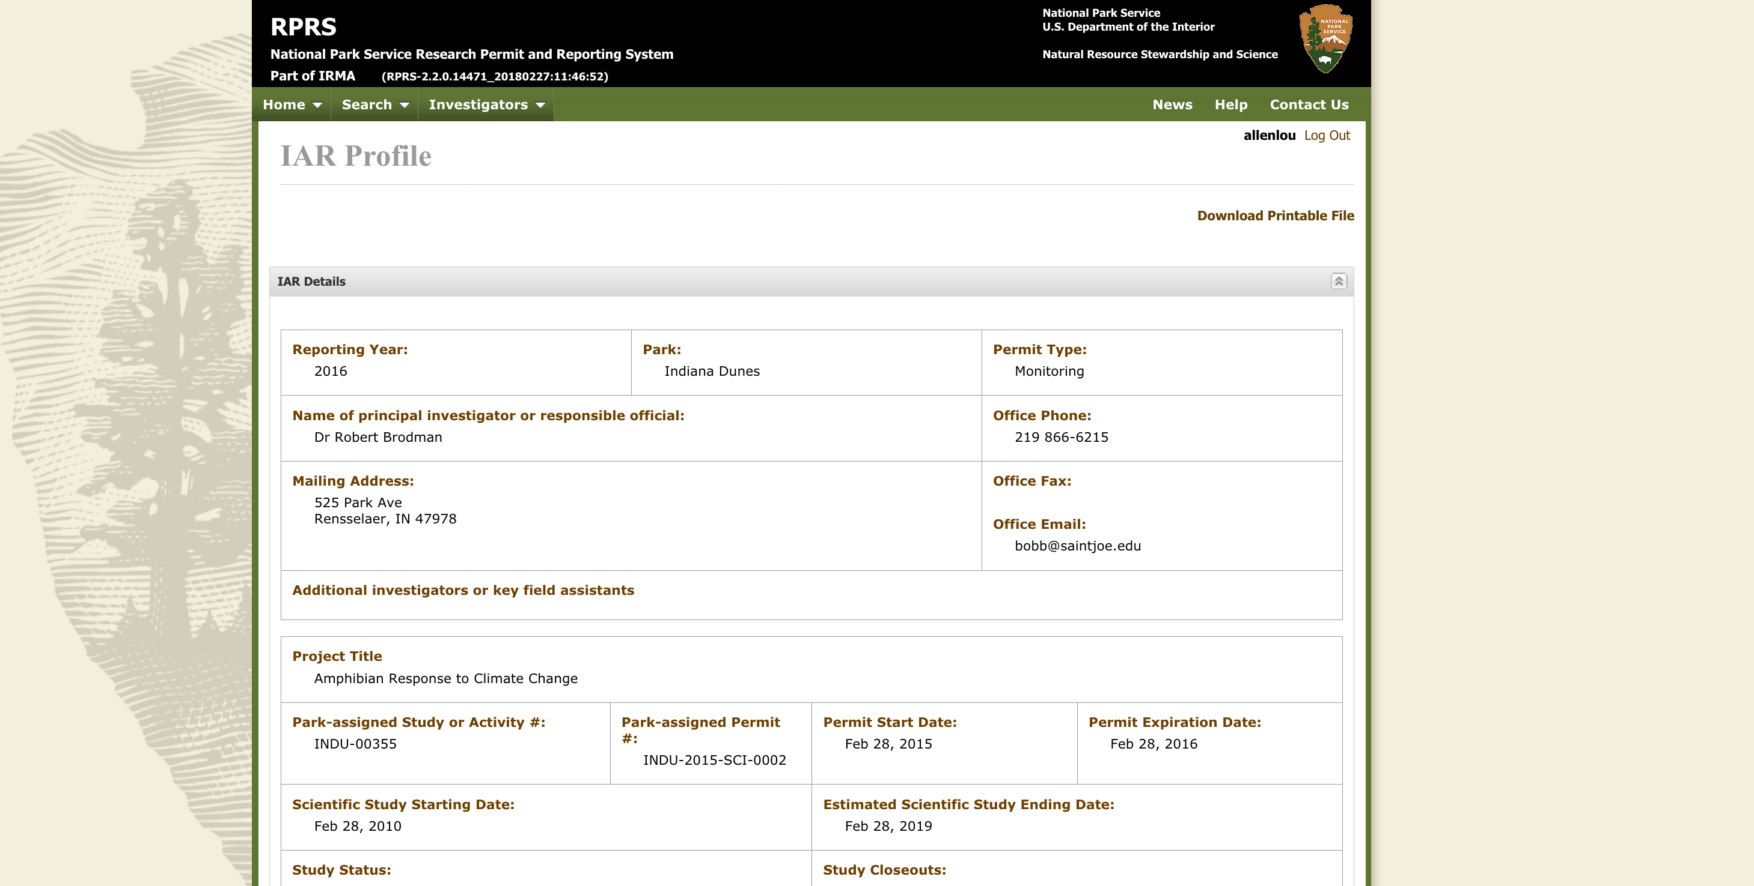
There is an attachment at the bottom!
Notes:
You want to look for attachments. That is where you are going to get the most information from these reports. I wish that was a search option, but I don’t think it is… (not yet).

Slide 12
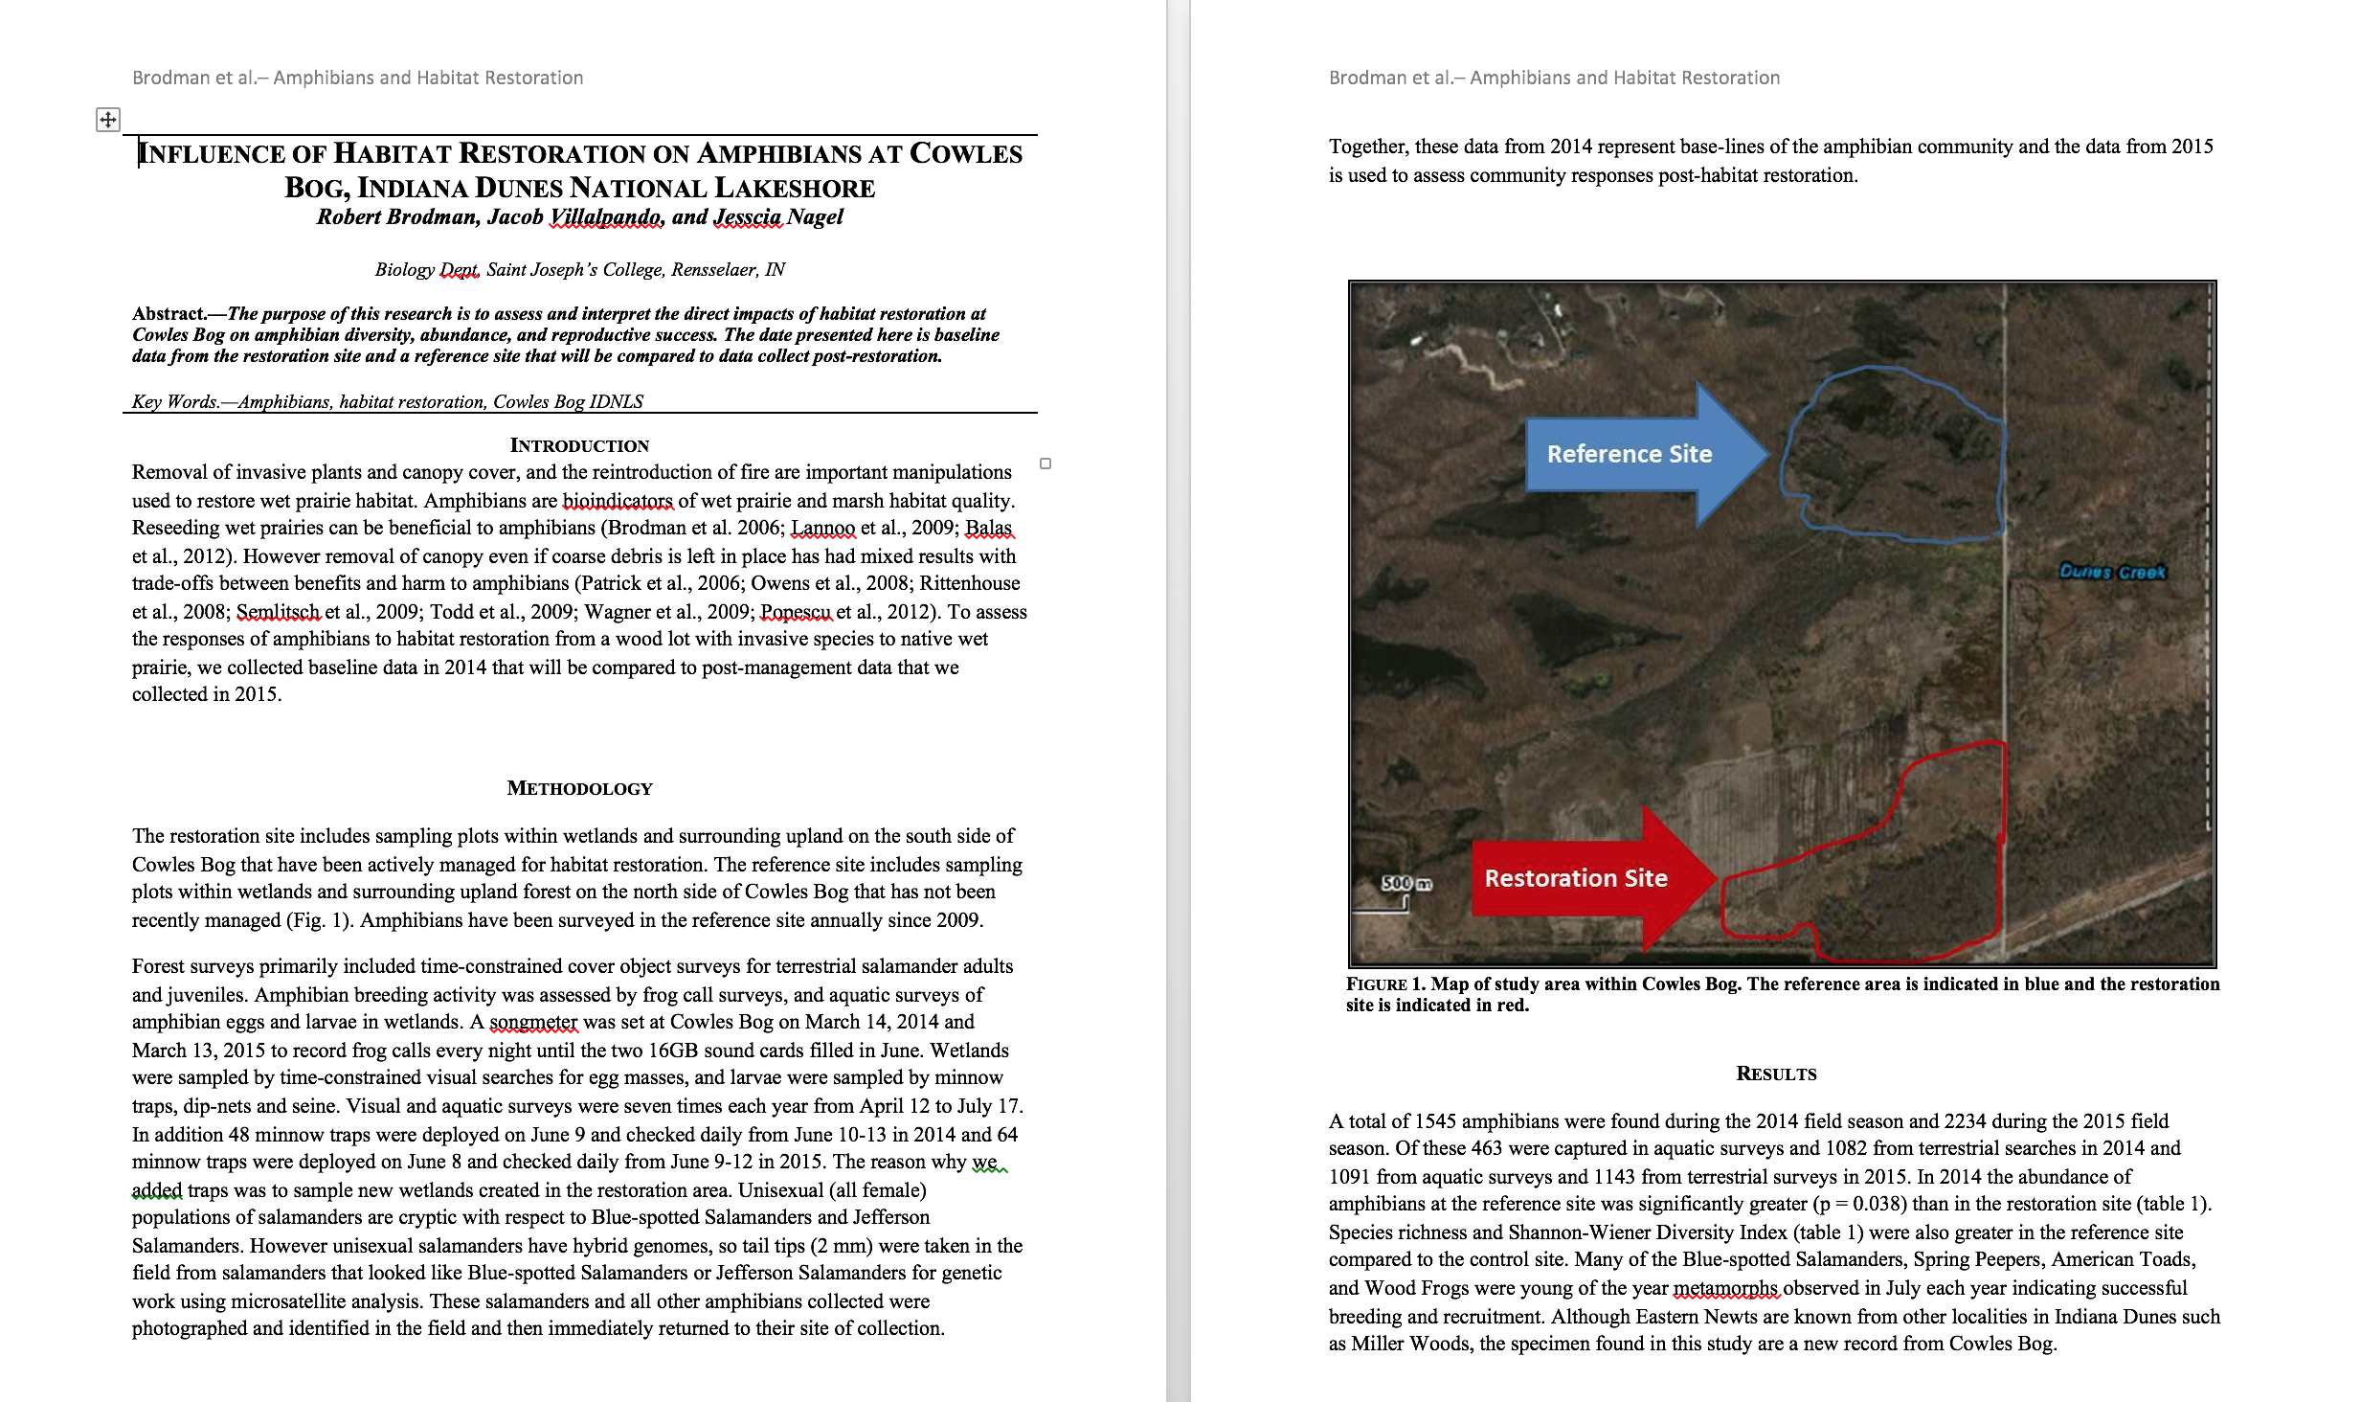
If there is an attachment, look at it! Read it.. Find out more.
Notes:
Even better when an attachment contains figures/pictures or any visuals! After the abstract these are what I look at first when reading articles anyway! I highly recommend downloading the articles, but reading them pretty quickly after finding them… otherwise you might never get to it. Read the abstract first. Is it still interesting/relevant/useful? If you answered yes, you should look at the whole thing… you can also see what articles they have cited and go track those down!

Slide 13
How do I find cool science?
IRMA
Research Learning Centers - Research Briefs
Google Scholar
Contact the researcher
Other?
Notes:
The next place to look is to find a research brief from a RLC. If this applies to your park, you are in luck, because the research briefs have already done the job of translating an annual report or a scholarly article for you.

Slide 14
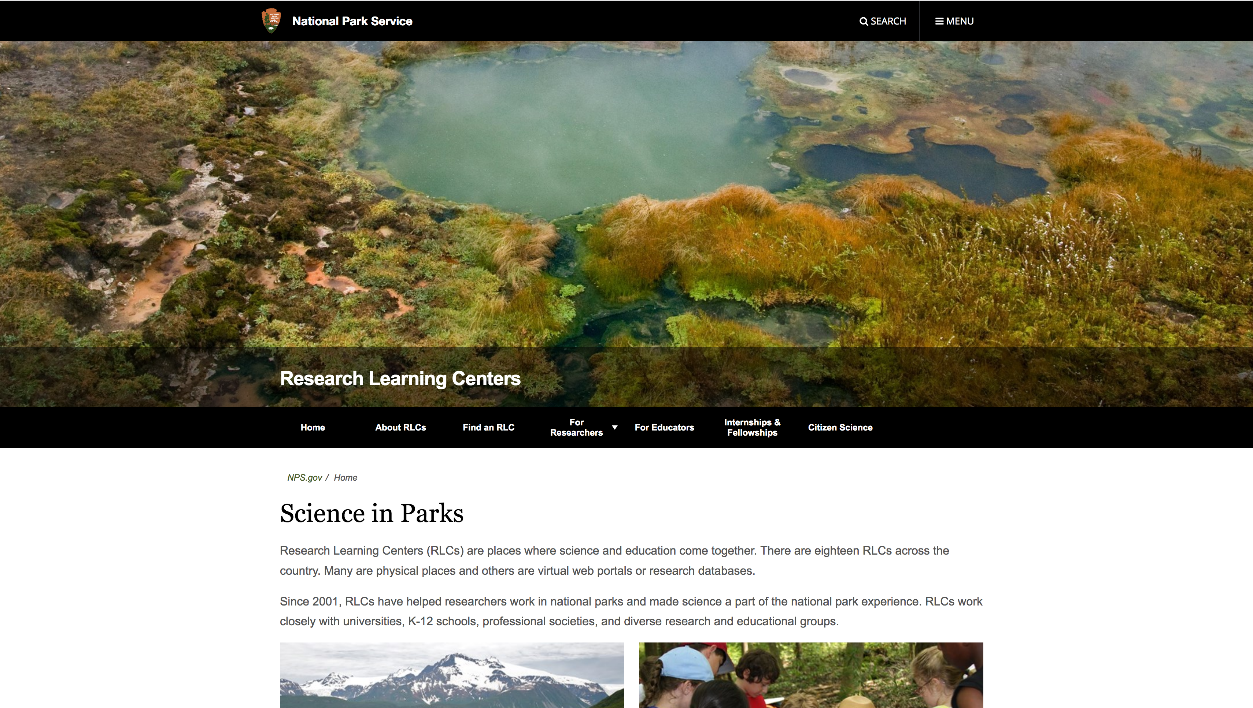
Research Learning Centers (www.nps.gov/rlc/index.htm)
Notes:
Go to the webpage above!

Slide 15
Find an RLC
Notes:
Click on ”find an RLC”

Slide 16
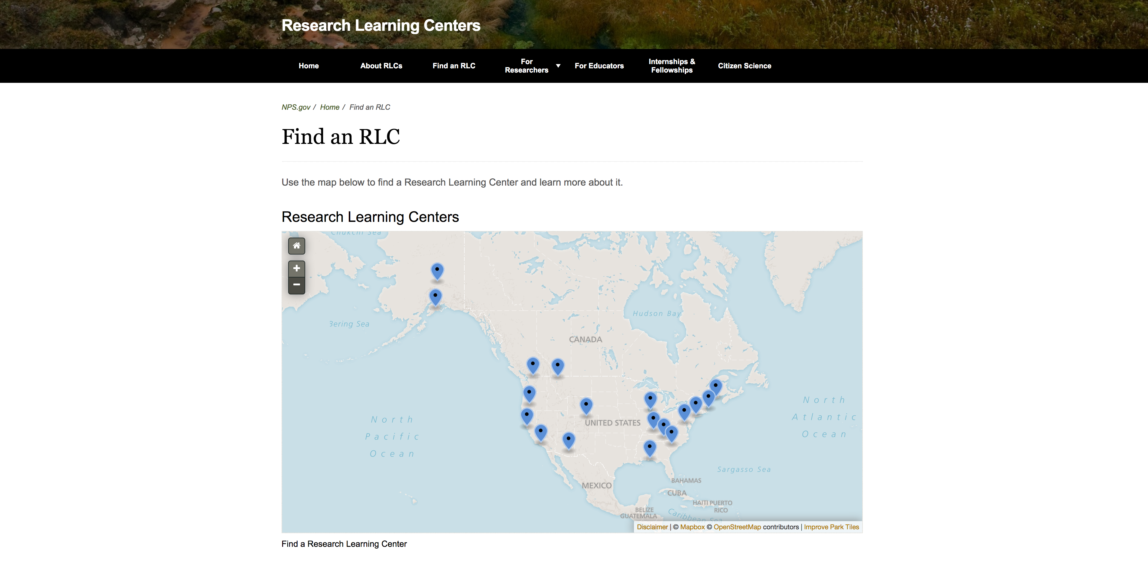
Notes:
There are a good number, so even if you park doesn’t have one, perhaps there is a relevant one in your region!

Slide 17
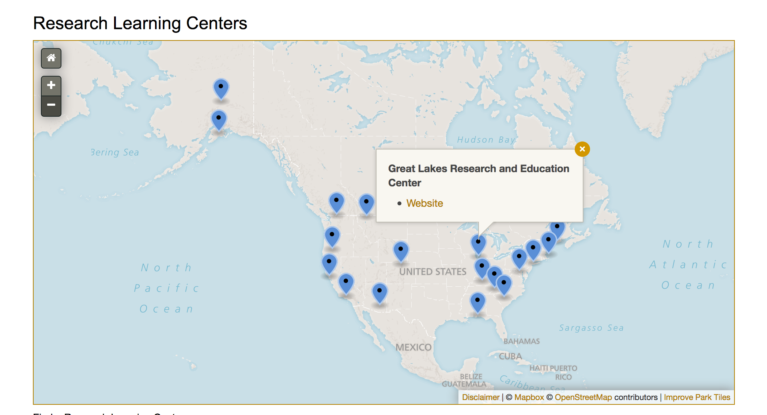
Find the one closest to you or within a similar biome
Notes:
Again, I’m going to walk you through with the example from Indiana Dunes. Click on the website link

Slide 18
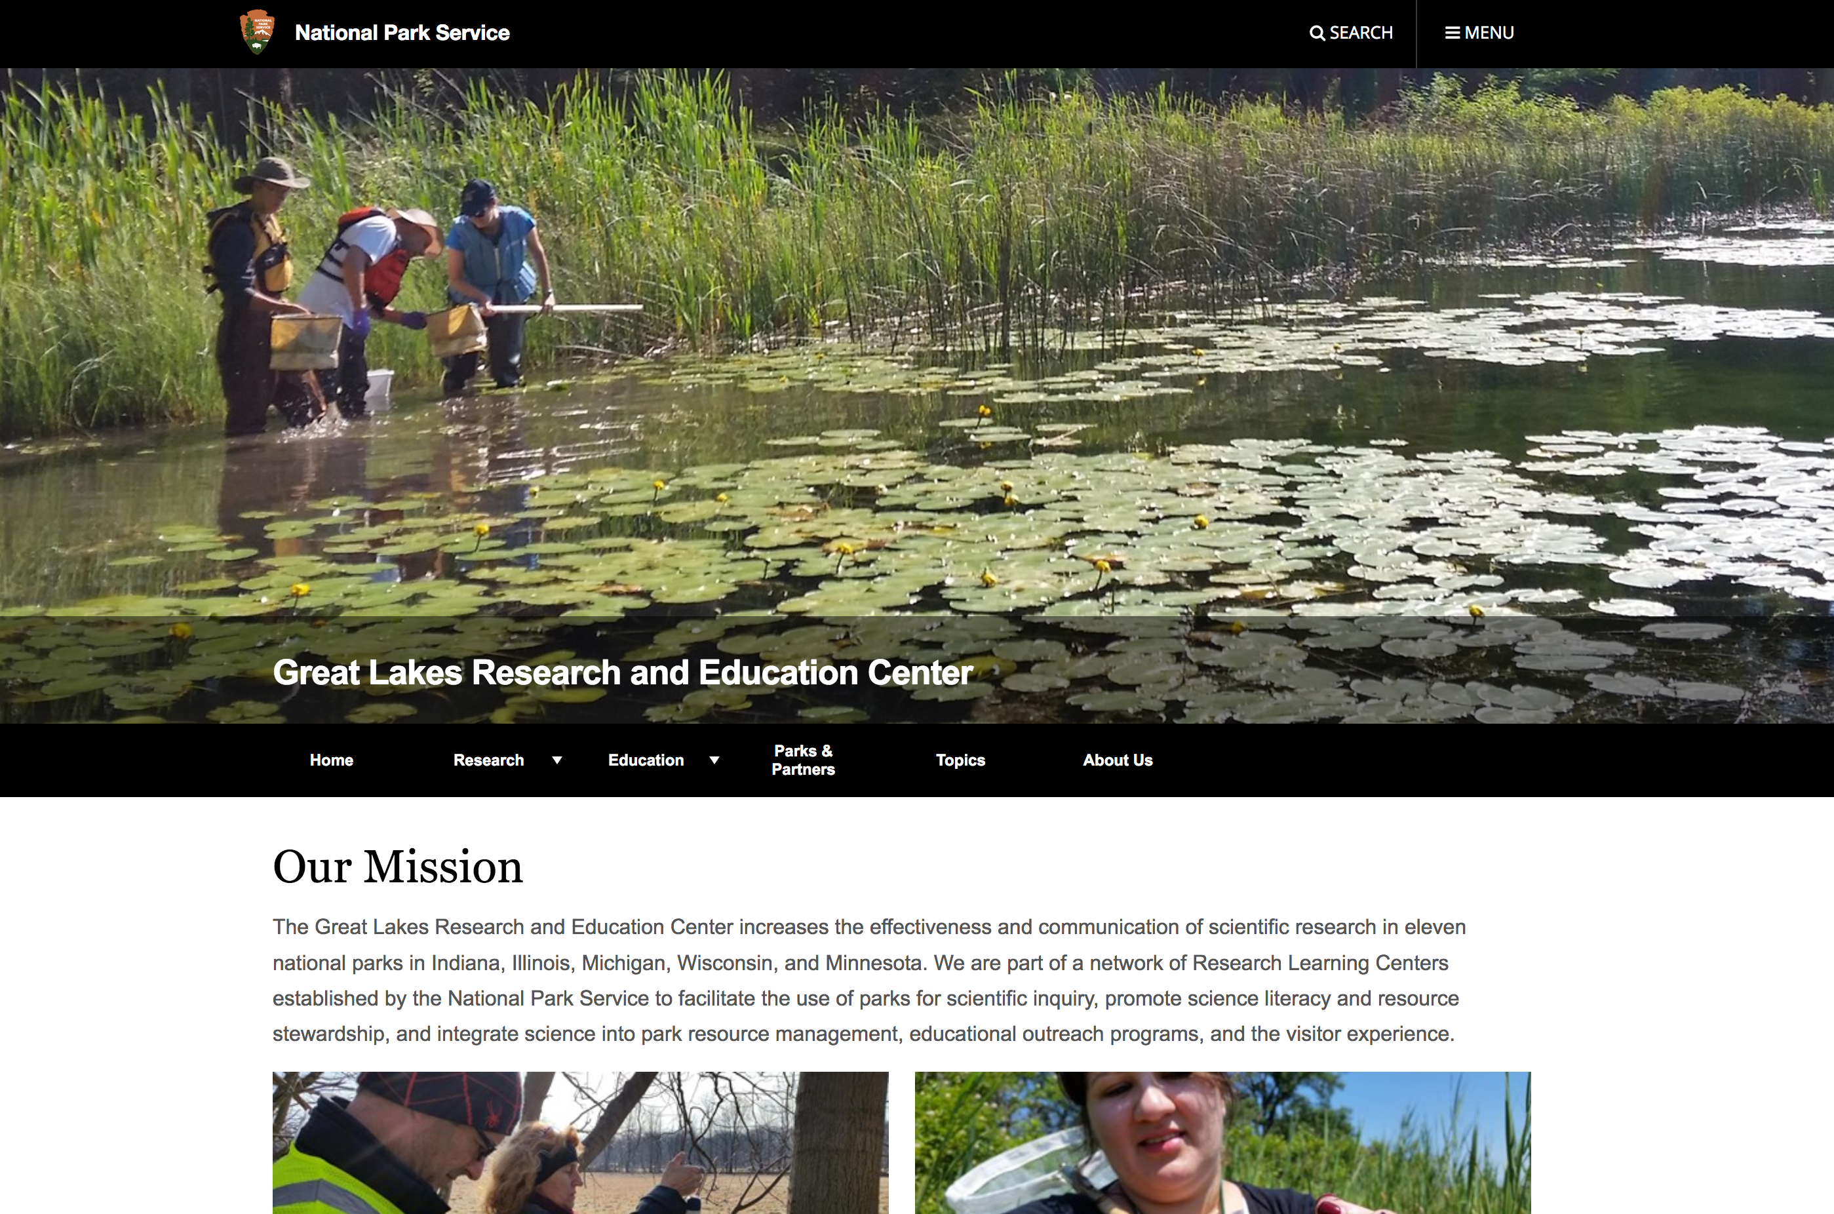
Search topics
Notes:
You can then find the “Topics” tab

Slide 19
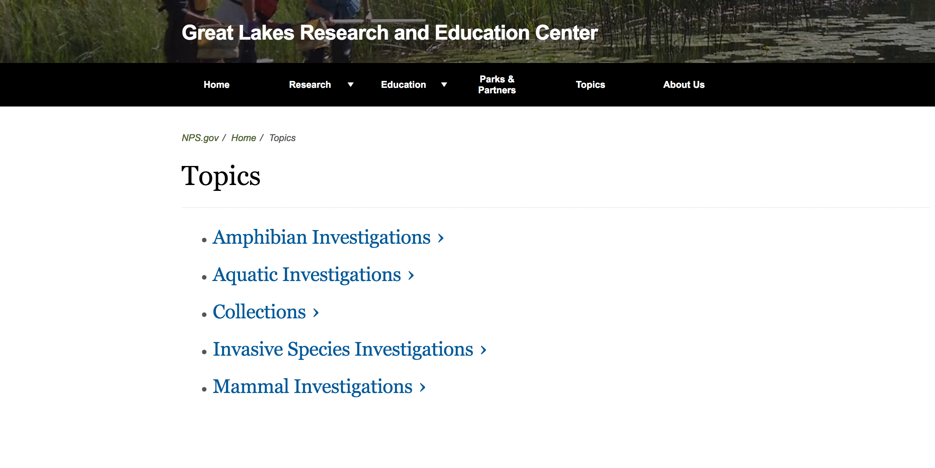
Select a topic
Notes:
They will have a smaller selection of topics to choose from. Which might be a good thing! You could also use this to plan your next program, since these topics are available.

Slide 20
Select a topic
Notes:
I’m going to click on Amphibian Investigations.

Slide 21
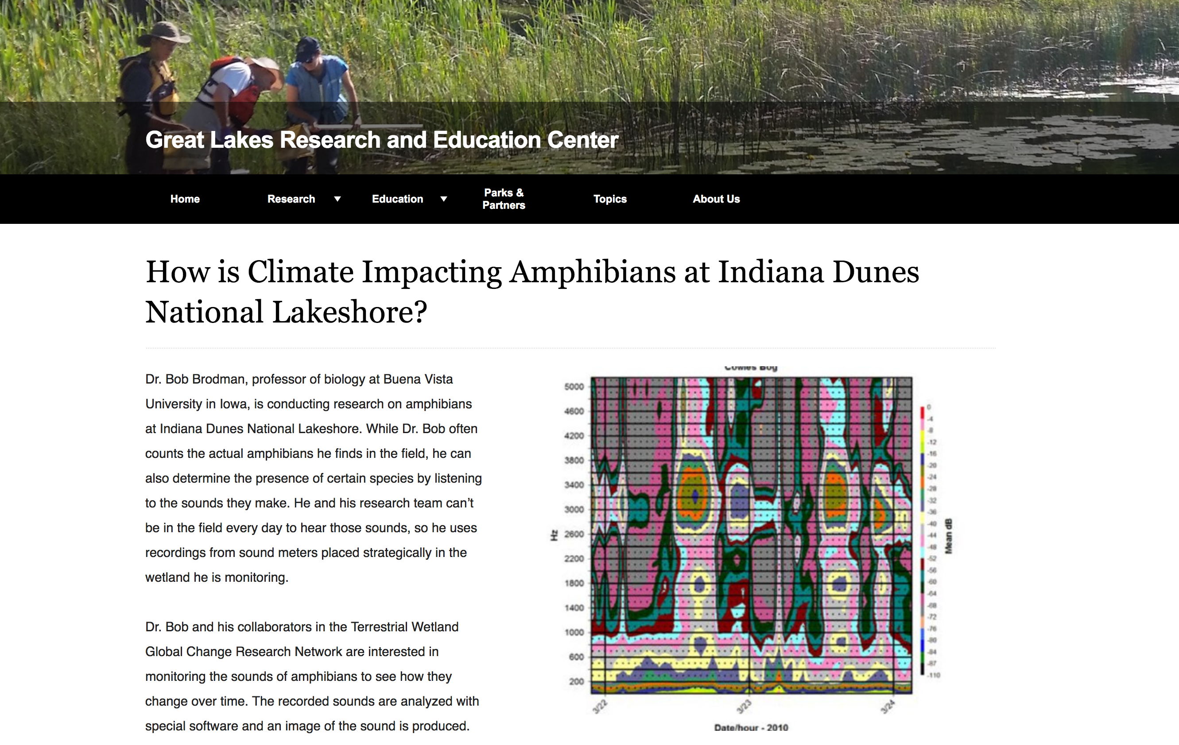
Read it.. Find out more.
Notes:
So that will pull up a virtual research brief about a specific topic. It might not be what you were looking for, but if not you may have to look elsewhere.

Slide 22
How do I find cool science?
IRMA
Research Learning Centers - Research Briefs
Google Scholar
Contact the researcher
Other?
Notes:
Google Scholar is amazing. It will help you find articles, maybe not the full article, but the abstract for millions of articles. Knowing how to harness that is important to help you reduce your search effort.

Slide 23
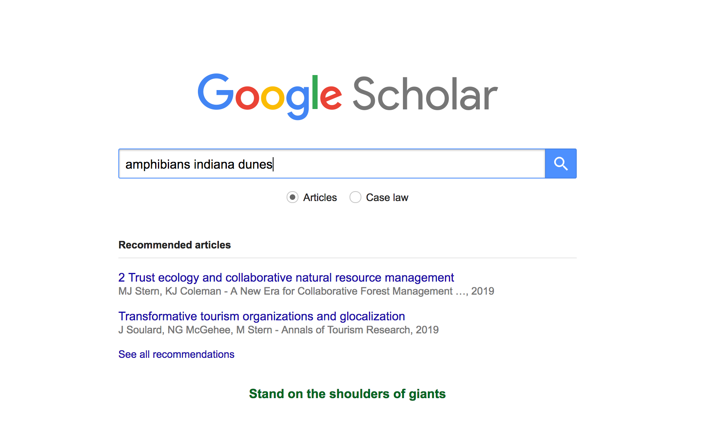
Google Scholar (scholar.google.com/)

Slide 24
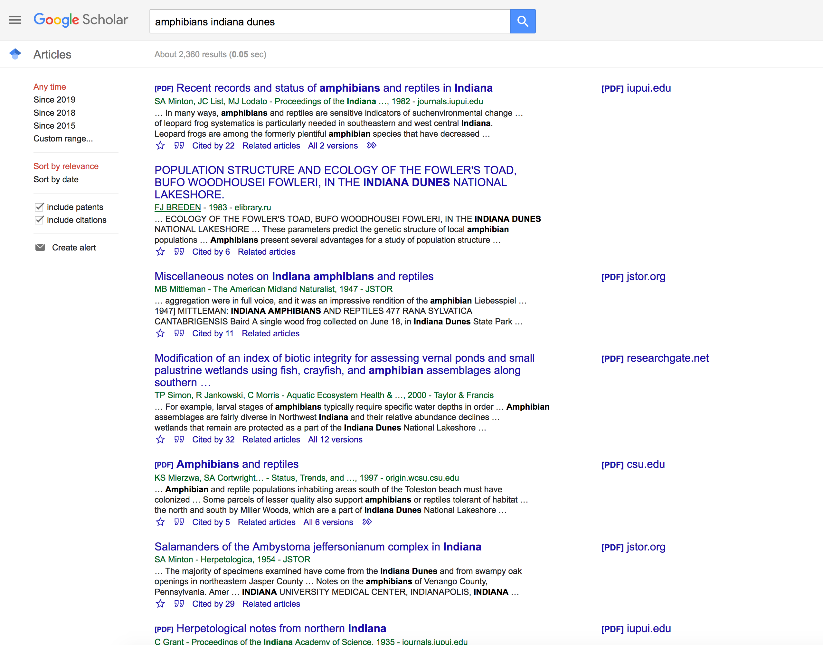
Google Scholar (scholar.google.com/)
OMG
Notes:
So I thought that was reasonably specific, but I still got over 2000 results.

Slide 25
Google Scholar (scholar.google.com/)
Narrow the search
Notes:
Well, lets reduce the years that we are looking for, we don’t want 30 year old research, but more current stuff. Keep in mind, often science that is currently happening at your park will not be published yet, so you wont find it here. We will go over contacting the scientist in a few slides… you might also need to go back and look for annual reports, since those have to be submitted as the name suggests each year.

Slide 26
Google Scholar (scholar.google.com/)
Narrow the search
Notes:
You could also add new search terms… like if you really only care about frogs, then add the word frog.

Slide 27
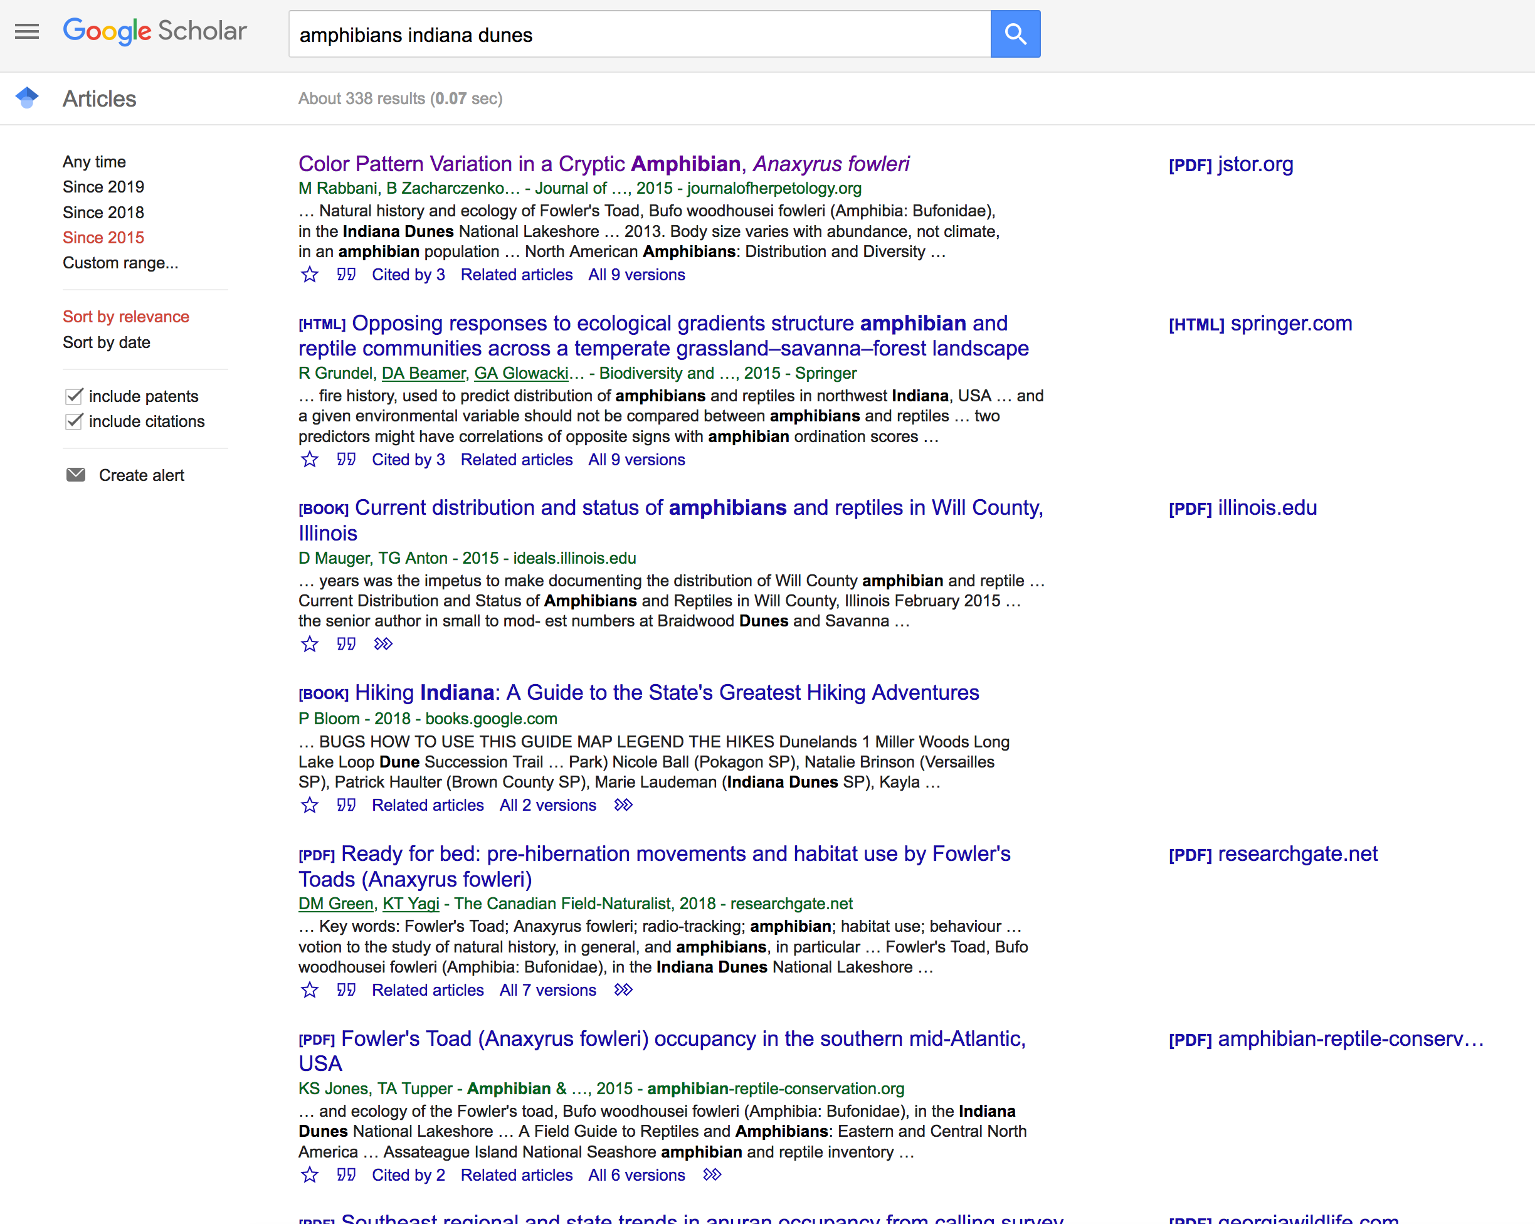
Narrow the search
This sounds cool!
Notes:
So if you find something relevant and interesting, go ahead and click on it..

Slide 28
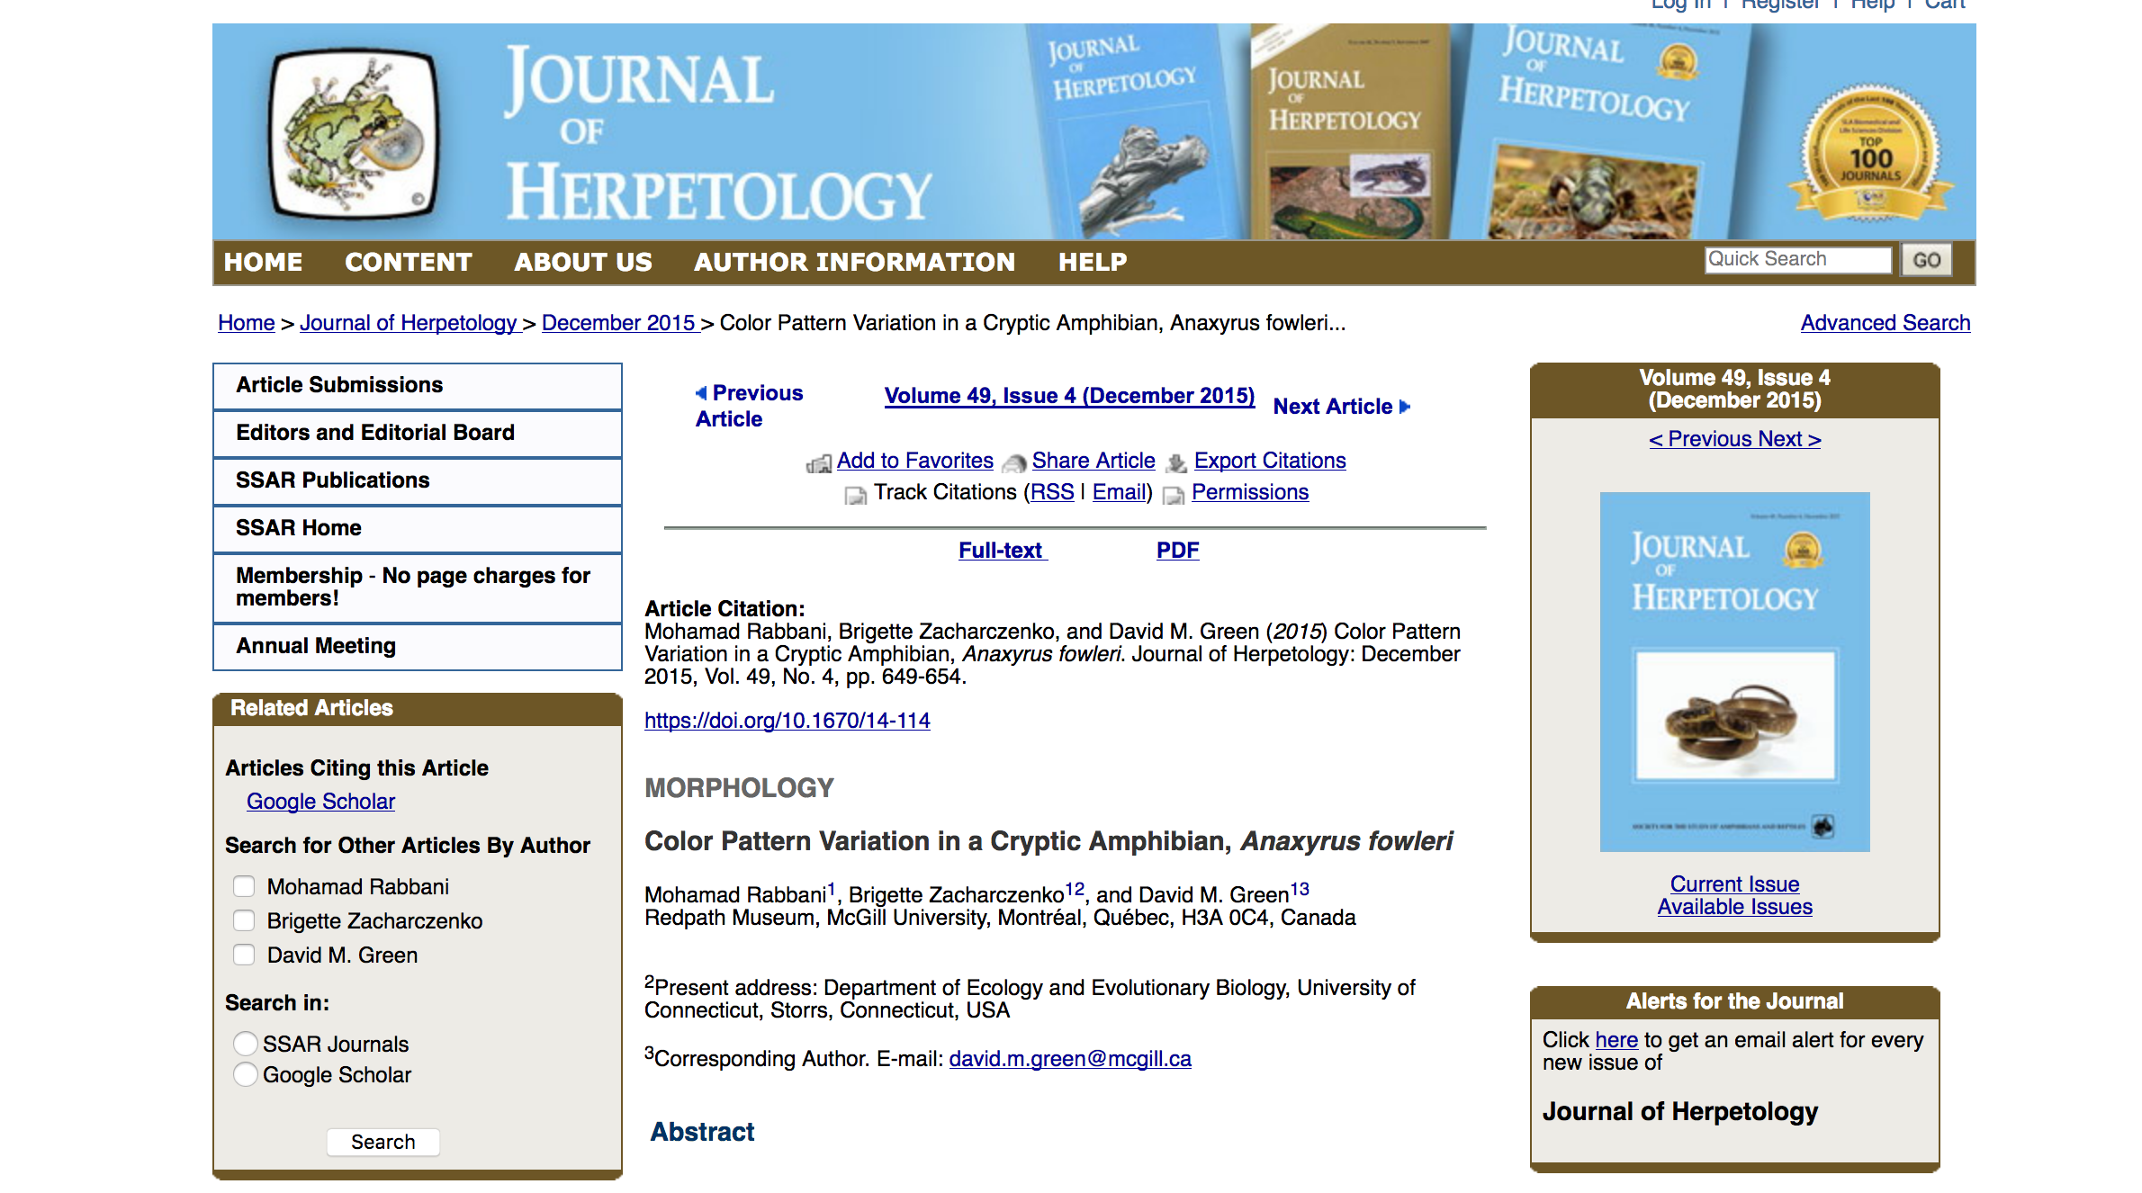
Narrow the search
This sounds cool!
Notes:
You are now on the journal page, and you can read the abstract before going further. When you finish the abstract you should look for a PDF download link!

Slide 29
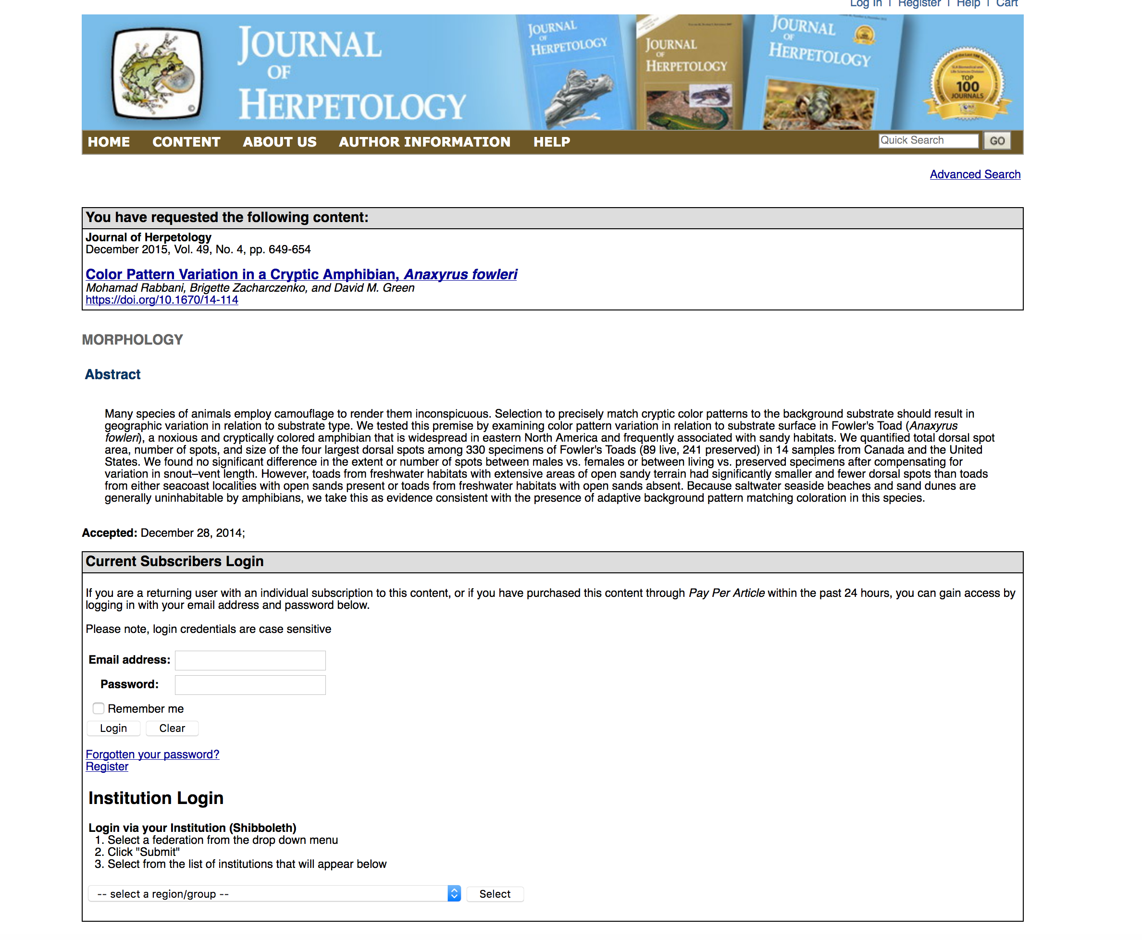
Two options:
PAYWALL
Pick another article
Find it elsewhere
Notes:
This is what a lot of us run into… While my University pays a lot of money for subscriptions to the journals that are relevant to my work, they are not always available, or worse, if I’m working from home, I can’t access them. So you have two options… Either pick another article, or find it somewhere else.

Slide 30
Option 1
Notes:
If you decide to pick another article, cause tracking down a full pdf for free is too much hassle, you will want to look for links that start with [PDF], so that you know you will have access to the full text.

Slide 31
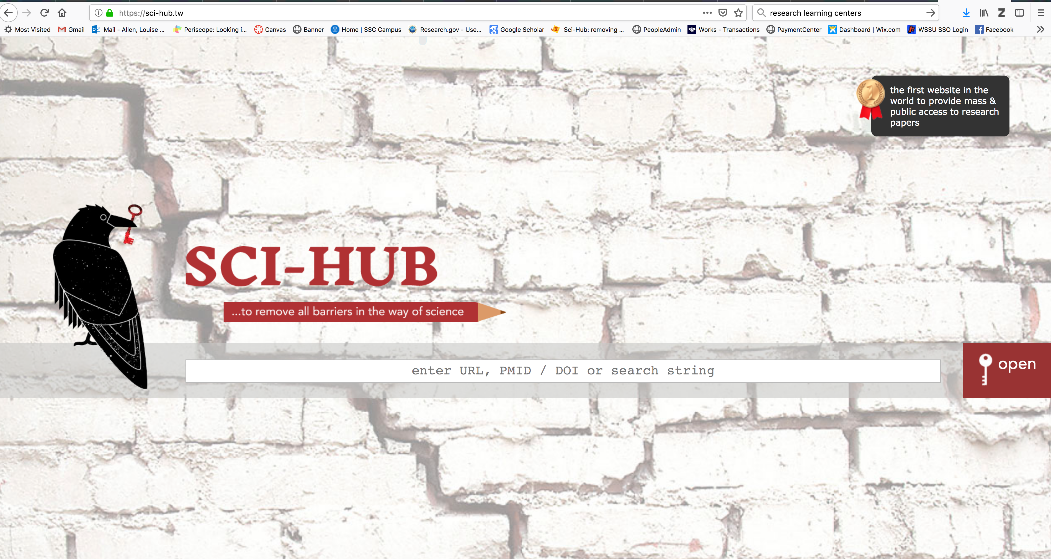
Option 2
Notes:
Or if you really want that particular article you will need to be a little resourceful. One site you can use is called SCI-HUB.
You will need to google Sci-hub every time you want to use it. Why? Because its not technically legal, since they have busted through the paywall of academic publishing and provide all visitors with free access to published science.

Slide 32
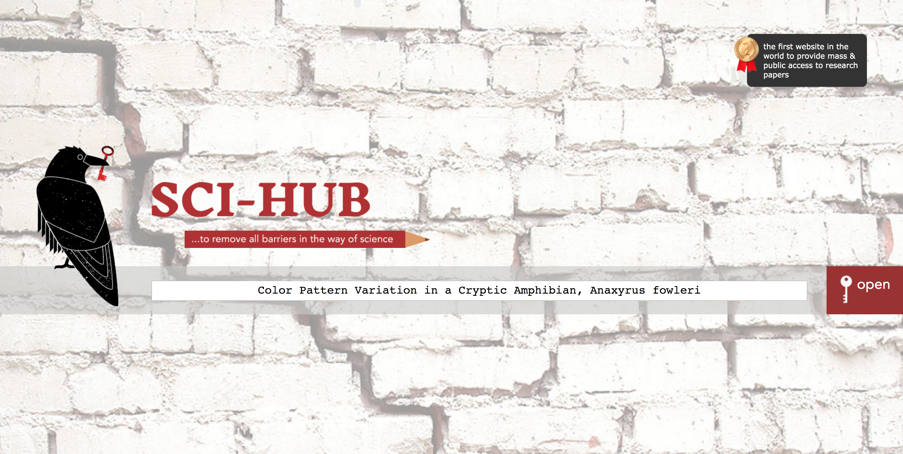
Option 2
Notes:
Copy and paste the full title into the search bar and hit the enter button. You are hoping to get lucky the first time, cause if you need to navigate the site, a lot of it is in Rusian.

Slide 33
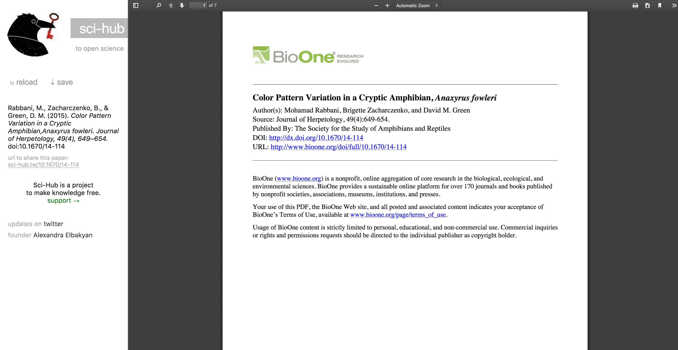
Shhhh!
Notes:
Jackpot! Now you can download it. But do this knowing that technically this is not 100% legit.

Slide 34
How do I find cool science?
IRMA
Research Learning Centers - Research Briefs
Google Scholar
Contact the researcher
Other?
Notes:
Ok… another way to find cool science is through contacting the researcher directly.
I will tell you that most of us are cool and super excited if you are interested in our research and about sharing our research with the public. You should not be nervous about sending an unsolicited email to a researcher. A warning though, some of us are HORRIBLE at responding to emails. I don’t think anyone would mind a follow up email if you haven’t heard back in a couple weeks or more… I wish I was better about returning these emails, but essentially just like at most jobs, your thing might not be the thing that is currently on fire, and so it will elicit less of a response in my brain!

Slide 35
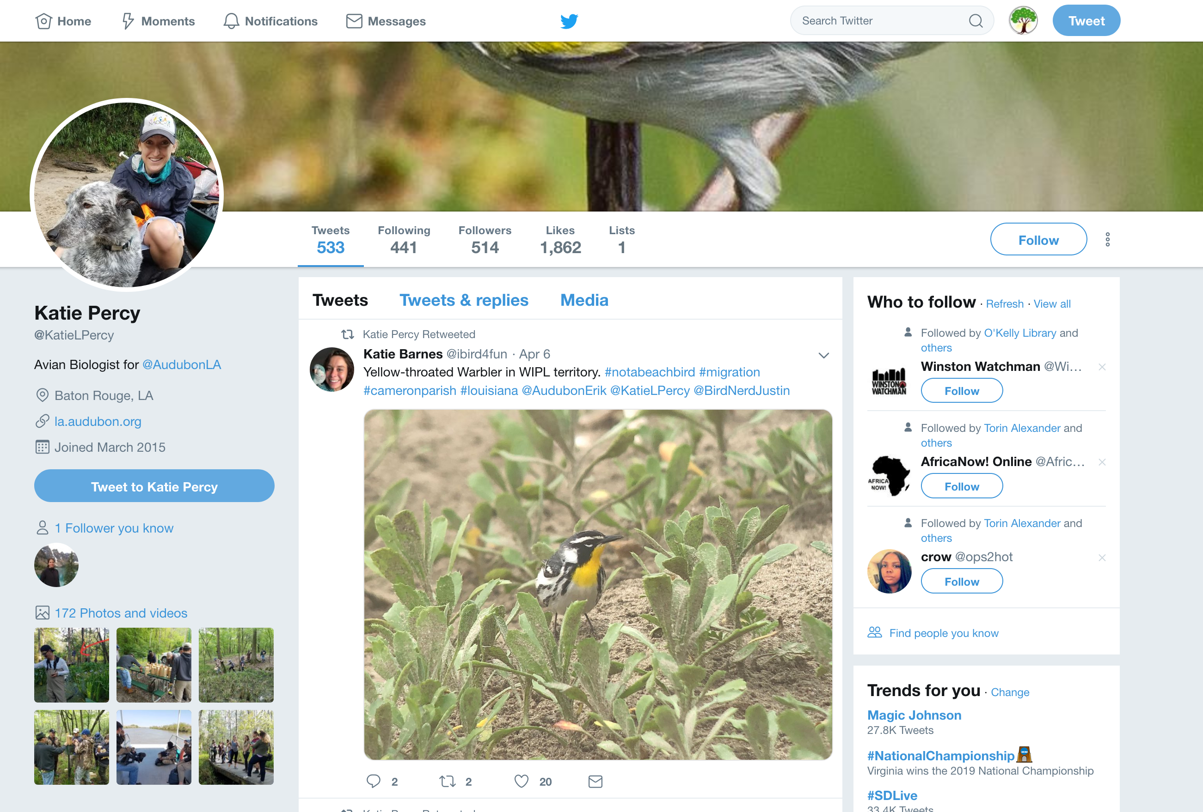
Follow the Research on Social Media
Notes:
Other option is to see if the researcher is on social media. Twitter is especially popular among researchers (age 20’s-40’s), the younger investigators also prefer Instagram and some of the older investigators and organizations use Facebook, just like everyone else ☺

Slide 36
Other options?
Notes:
Where else can you find cool science? Again if you have ideas, please leave a comment in the topic thread for Module 1. That way I can add it to this slide show.

Slide 37
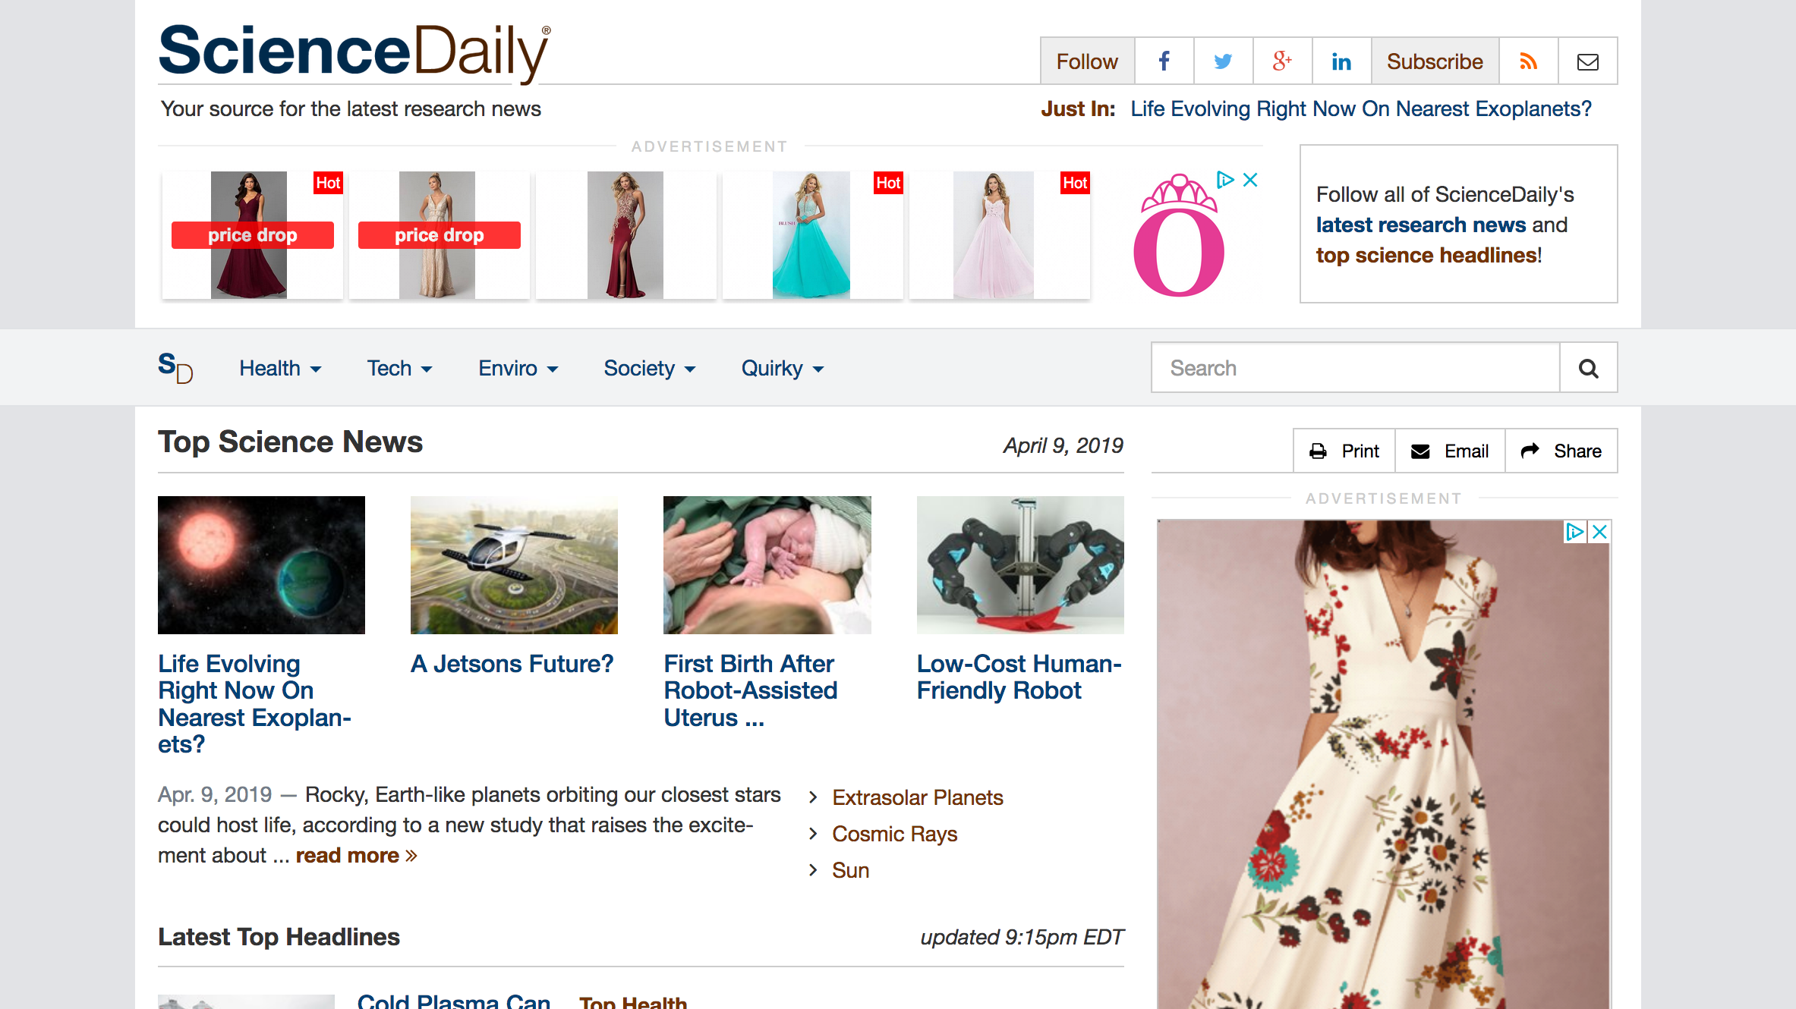
Science Daily & other popular science sites
Notes:
One option is using popular science sites. Science daily is one I use with my University students.
There is a search box, just like most sites, but this will bring you already translated articles about cutting edge science that might be of interest.

Slide 38
So now what?
Martha sent a worksheet to help you read primary articles for understanding. She also sent an article.
We will all work on the same article and fill in the worksheet together.

