Slide 1
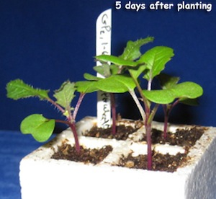
Lesson 9 – Variability
What is the capacity of different species to adapt in the face of rapid climate change?
Using Fast Plants to see how variations are characteristic of populations, and how they change across generations under selection pressure - at the population level.

Slide 2
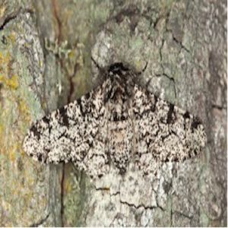
One of the fundamental characteristics of life is that distinctive variations are found among the individuals of every species. What causes these variations and how are they expressed through individuals' development? How do they change across generations?

Slide 3
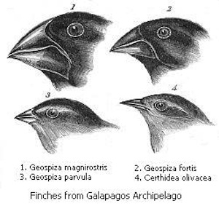
In this lesson, you will interpret data from a Fast Plants artificial selection experiment to help you explore and make sense of population variability - the basis of how populations change as a result of natural selection.

