Slide 1
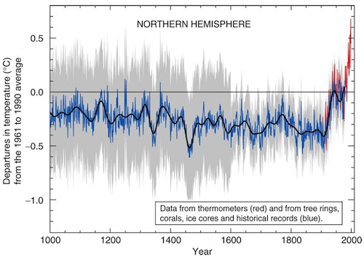
Lesson 8 – Projected Changes in the Arctic
Can changes in various physical aspects of the arctic environment to date be interpreted to give us an idea about changes in the future?Investigating changes in sea ice extent, precipitation and permafrost in the Arctic.

Slide 2
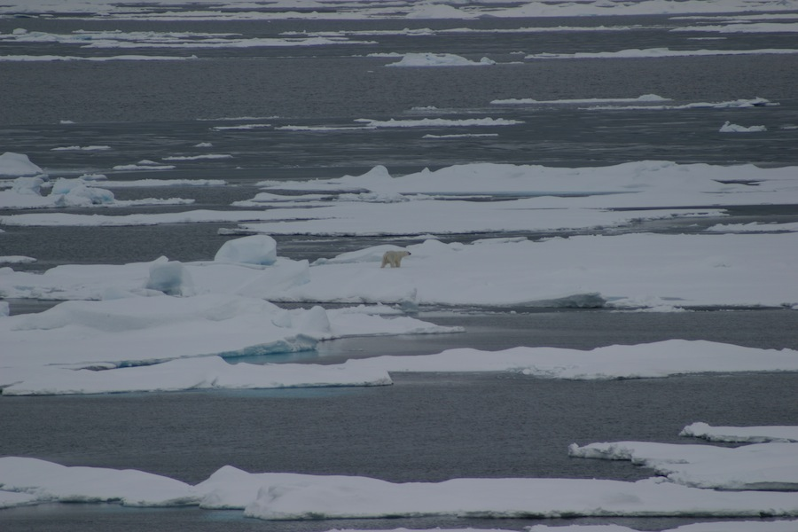
Small increases in air or water temperature in the future will undoubtedly lead to more extensive melting of sea ice, increased sea surface temperatures, and more variable climatic conditions. In this lesson, you will investigate projected changes that are being generated by climate change models.

Slide 3
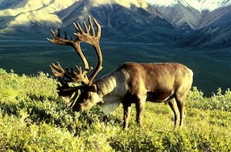
But what impact will these changes have on the biota? How will your focal species be affected by these changes? You will begin to to estimate their impact on your focal species based on what you already know about the species.

