Slide 1
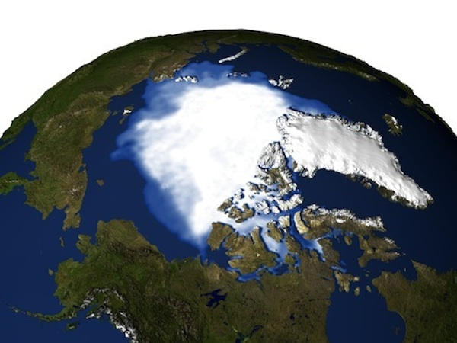
Lesson 7 – Global Climate Change and the Greenhouse Effect
Using a NetLogo simulation to investigate global warming

Slide 2
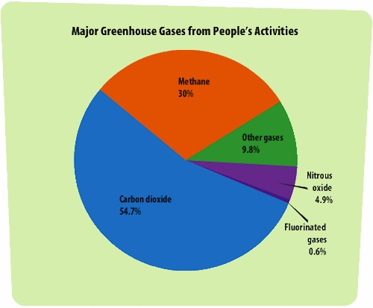
The release of carbon into the atmosphere through the burning of fossil fuels and other human activities has greatly increased the amount of heat being absorbed in the atmosphere. This process is often referred to as the greenhouse effect. How is heat trapped in the Earth’s atmosphere through the greenhouse effect?

Slide 3
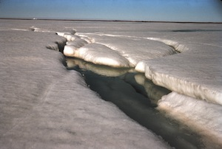
In this lesson, you will explore some of the processes involved in the greenhouse effect. In understanding some of the physical factors that are the underlying drivers of climate change…you will be able to better understand how projected changes in temperature will affect your focal species.

