Slide 1
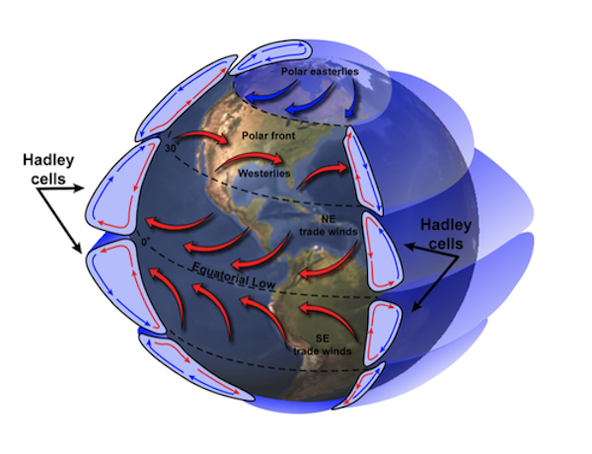
Lesson 6 – Global Climate Systems
Using animations and interactives to analyze models related to global climate systems and their connections to the arctic climate system.

Slide 2
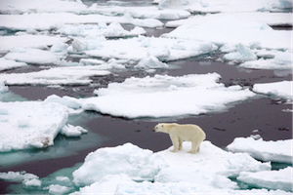
Uneven heating of Earth's surface distributes heat around the globe through the atmosphere and oceans, resulting in the different climate patterns found around Earth.
How does this uneven heating of Earth cause these climate patterns?

Slide 3
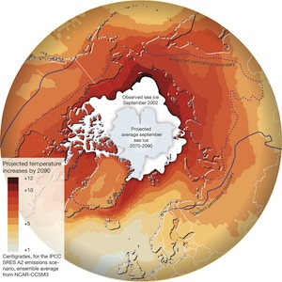
Permafrost areas in the Arctic are particularly sensitive to changes in temperature. How have arctic permafrost patterns been altered due to climate change?

Slide 4
In this lesson, you will discuss and analyze models related to global climate systems and then explore connections between global and arctic climate systems.

