Slide 1
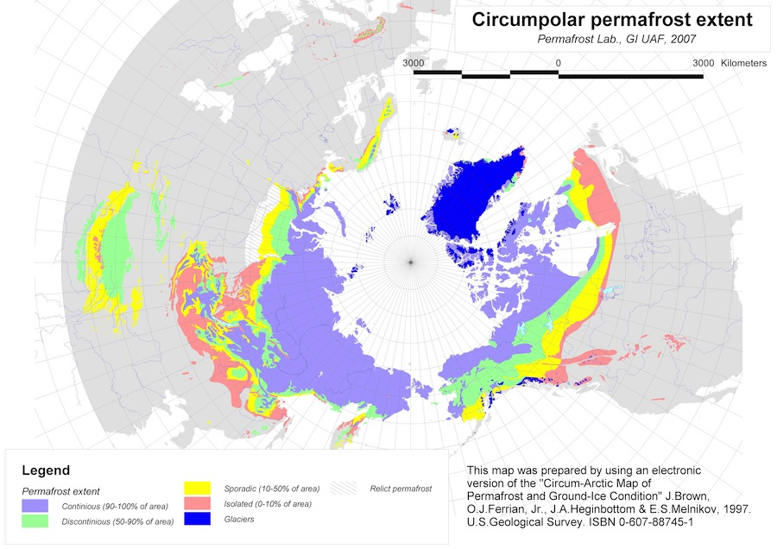
Lesson 5 – Sea Surface Temperature, Precipitation, and Permafrost
Using animations and graphs to investigate sea surface temperatures, precipitation, and permafrost in the Arctic.

Slide 2
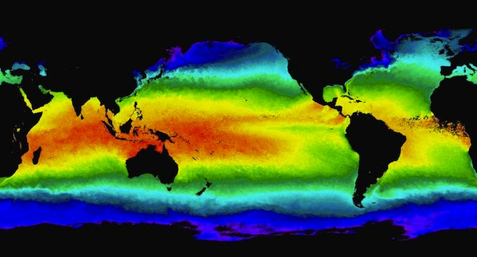
Understanding the role of ocean water on Earth's surface helps us understand a major mechanism for the transfer of heat energy in the biosphere. How is this circulation of heat reflected in patterns of sea surface temperatures?

Slide 3
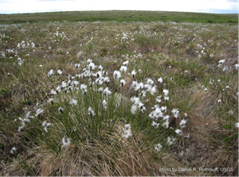
What impact does the changing heat/energy flow of the Arctic have on precipitation patterns and the amount of permafrost in this region? What effect might these changes have on your focal species?

Slide 4
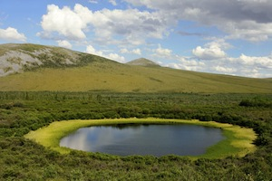
In this lesson, you will investigate some other abiotic factors in the Arctic: sea surface temperatures (SST), precipitation, and permafrost. This will prepare you to place these dynamic features in the context of global climate change as you proceed through the unit.

Slide 5
Credits
Slide 1 – arctic_009a.jpg NEED TO REPLACE THIS ONE!!!
Slide 2 – arctic_019.jpg
Slide 3 – arctic_184.jpg
Slide 3 – arctic177.jpg

