Slide 1
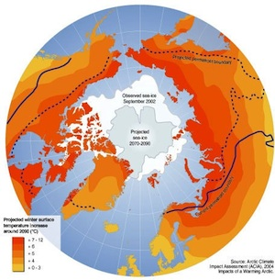
Lesson 4 – Arctic Geography, Arctic Ecosystems, and Sea Ice
Now that you understand your focal species, what dimensions of Arctic habitats and physical geography do you need to know about?
In the next few lessons, you explore:
Basic geography
Arctic ecosystems
Sea ice
Precipitation
Sea surface temperatures
Permafrost

Slide 2
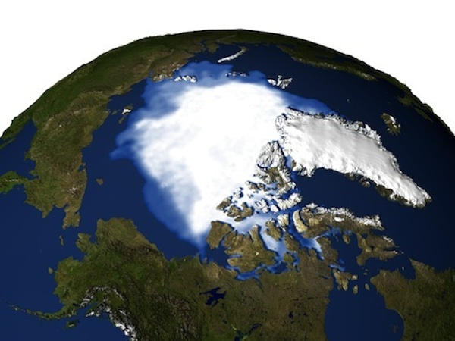
Looking down on the Arctic from space, we see vast expanses of ice and snow pack but only 75% of this region is covered with ice. What other types of terrain are present? What aspects of the physical geography are critical to your species?

Slide 3
Lesson 4 – Arctic Geography, Arctic Ecosystems, and Sea Ice
In the next few lessons, you explore:
Basic geography, and ecosystems
Sea ice, and sea surface temperatures
Precipitation
Permafrost
Couplings between arctic and global climate systems
Projected changes in physical geography over the next few decades
NEED NEW IMAGE

Slide 4
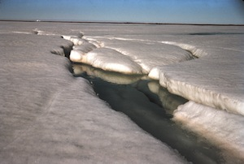
In this lesson, you will study the unique geography of the Arctic and also explore the yearly changes in sea ice using satellite data. These will be important to consider as you construct your conservation plan.

