Slide 1
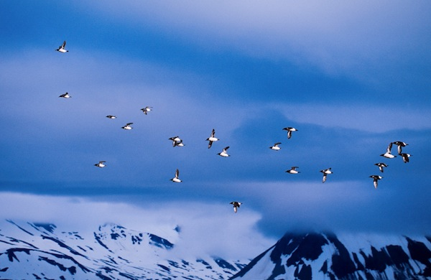
Lesson 3 – Introduction to the Natural History of Arctic Species Assemblages
Before biologists can make conservation plans for a particular species, they need to study its natural history deeply enough to know what abiotic and biotic factors affect it and understand how its life “works.”

Slide 2
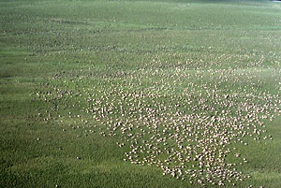
They ask such questions as:
What habitat does the species occupy?
What are its preferred food items?
How does it interact with other species?

Slide 3
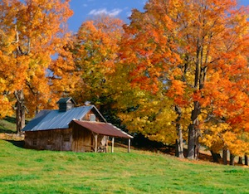
In sum, they ask:
• What is its niche?
A niche summarizes everything about the species food, habitat, relationships, etc, important to understand in order to predict how it will respond to disturbance, environmental changes such as climate change.

Slide 4
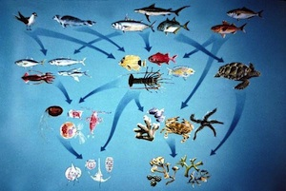
And, of course, important for being able to construct a sound conservation plan for the species.
In this lesson, you will review information about your focal species in order to understand its niche. You will construct a food web diagram for your focal species and decide whether it is a specialist or generalist species.

