Slide 1
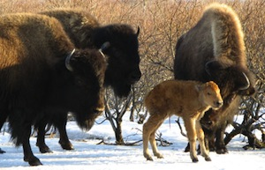
Lesson 2 – Should the wood bison return to Alaska – A conservation case
Natural and human drivers are causing major changes in the Arctic. How do biologists begin to take into account all the factors necessary to develop a sound conservation plan?

Slide 2
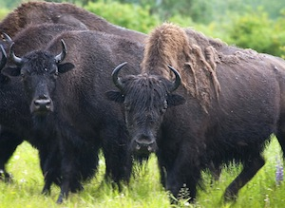
In this lesson you will examine a controversial case related to wood bison, and address the following questions:
How do scientific, cultural, and economic decisions factor into a sound conservation plan?
How does “biocomplexity” relate to conservation strategies?

Slide 3
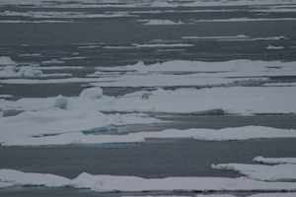
It often helps to look at how other conservationists address conservation issues to understand the issues in your own case, and to help you formulate your conservation plan.

