Slide 1
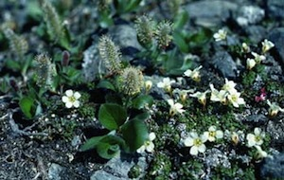
Lesson 1 – The Challenge
The effects of coupling between human activities and Earth system processes shows most dramatically in the Arctic.
You will explore these connections through the lives of 5 arctic species.

Slide 2
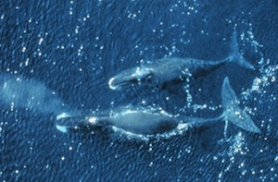
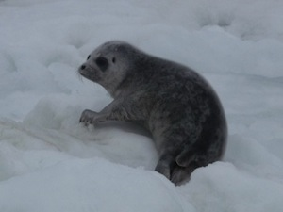
The Arctic is a unique ecosystem with organisms adapted to extreme conditions. It is biologically productive, supporting many large fisheries and huge populations of migratory birds that come to the Arctic for the summer to breed.
Yet it is also extremely fragile.

Slide 3
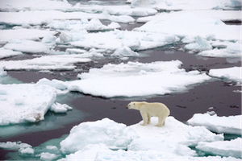
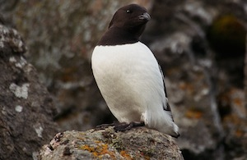
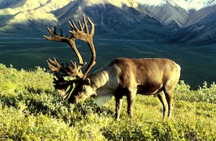
Small changes in abiotic or biotic factors can have serious impacts on the species that inhabit the biome.
Small changes in abiotic factors elsewhere can also have serious impacts on these species.

Slide 4
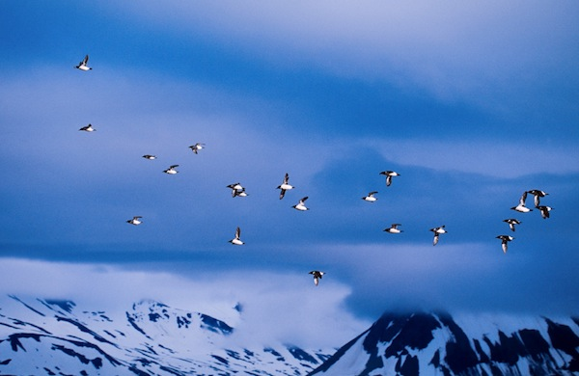
To investigate the dynamics of these changes, you will work in small groups to study one of five Arctic species. Your group will ultimately create a plan for conservation of the species, necessary because of projected changes in the Arctic.

Slide 5
In this lesson, you begin by becoming acquainted with the basic natural history of one of the five species:
Red knot
Little auk
Polar bears
Caribou
Bowhead whales.

