Slide 1
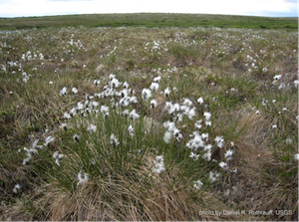
Lesson 16 – Create Your Own Conservation Strategy
Showtime! Constructing your argument in support of your focal species conservation plan

Slide 2
Prepare and present your case
• Create a presentation about 20 minutes long—a PowerPoint, a video, a poster, or other means--drawing on all the materials that you have assembled on your species.
• Use visuals - use text sparingly, but ensure that your argument and presentation are well constructed and supported by scientific evidence.

Slide 3
Critiquing each other’s work
Data: Are they accurate? Presented clearly? Appropriate to the argument?
Arguments: Are they coherent? Is the reasoning sound?
The case: Clear? Persuasive? Supported by strong arguments? Are the weakest arguments rebutted?
Modeling: Are models (visual or mathematical) used to represent data? To make predictions about future impacts
Technical: Is the oral presentation clear? Concise? Are all the points relevant? Are materials clear and legible?

