Slide 1
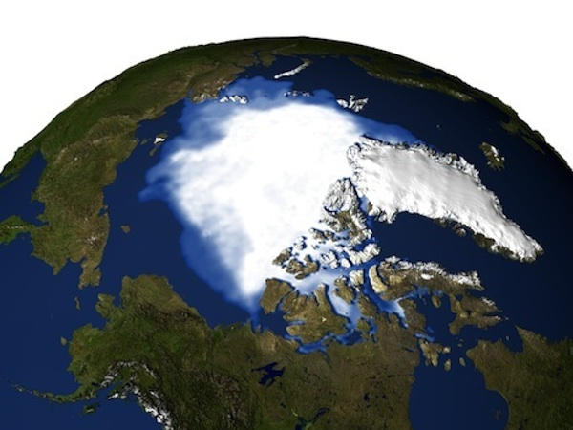
Lesson 15 – Stakeholders and Conservation Strategies
The science of biocomplexity links each species and all the factors relevant to its survival that can possibly be be relevant. You will need to consider many factors and influences that are interwoven in sometimes complex ways. How can you represent this complexity to think about it systematically?

Slide 2
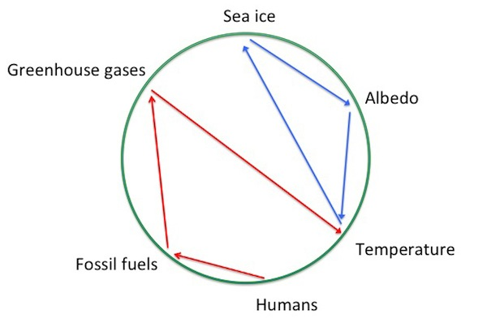
A connection circle attempts to display many interconnected biocomplex relationships in a simple way. What story is this graphic telling us?

Slide 3
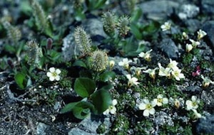
In the same way, in this lesson you will use a connection circle to model all the possible biotic and abiotic factors (including humans) that you think are relevant to your case. This summary will help you organize your thoughts about the conservation challenge.

Slide 4
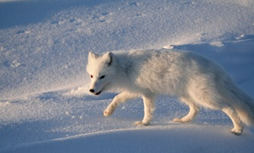
Finally, you review the couplings between local and global systems as you learn more about conservation in the Arctic, and begin to review the pros and cons of different conservation strategies for your species.

