Slide 1
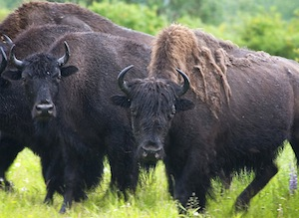
Lesson 14 – Conservation Planning
Now that you know something about the population dynamics of your species, and about the trends in arctic changes now and in the future, you can return to focus on your conservation plan. You will use the wood bison case and some conservation biology principles to identify human social, cultural and economic factors relevant to your focal species and your conservation plan.

Slide 2
The ethical principles that form the foundation of conservation biology are that:
Diversity of species and biological communities should be preserved
Untimely extinction of populations and species should be prevented
Ecological complexity should be maintained
Evolution should continue
Biological diversity has intrinsic value.

Slide 3
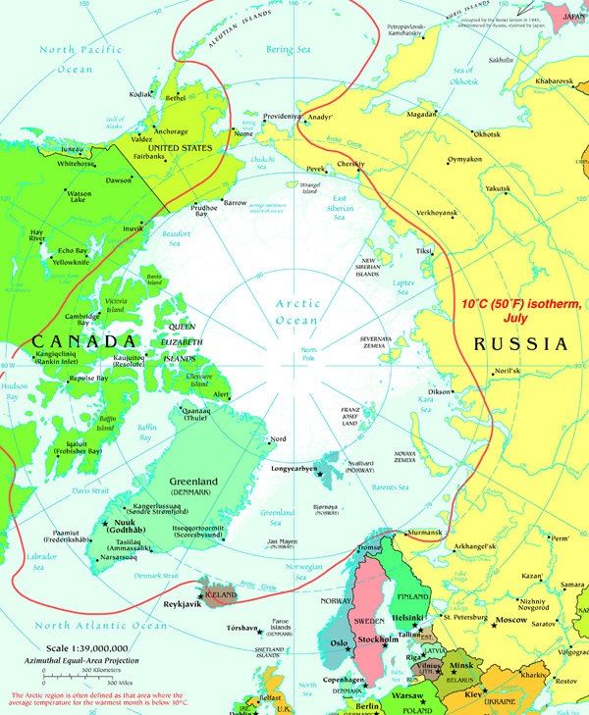
To apply these principles, what are important factors that conservationists consider when setting aside protected areas for wildlife?
What strategies might be appropriate ones for your focal species?

Slide 4
In this lesson, you will return to the wood bison case to think about the challenges the species face, the conservation strategies used, and what the future may hold for wood bison.
You will apply what you’ve learned from the case to your own species, thinking about:
Human factors in the Arctic
Relationships between arctic humans and species
What strategies described in the reading might be the right ones for your species.

