Slide 1
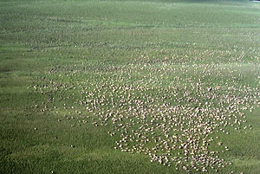
Lesson 13 – Modeling Focal Species Populations
You've made estimates of population-level impacts on your focal species previously, but what if you could model the impacts? If, for example, you could model a decline in the reproductive rate of polar bears, what could you learn about the long-term persistence of the Hudson Bay population?

Slide 2
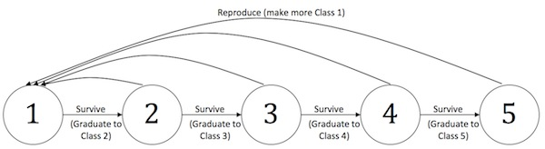
Lesson 13 – Modeling Focal Species Populations
Using an Excel population model to explore the impact of different dynamic rate functions in your focal species.

Slide 3
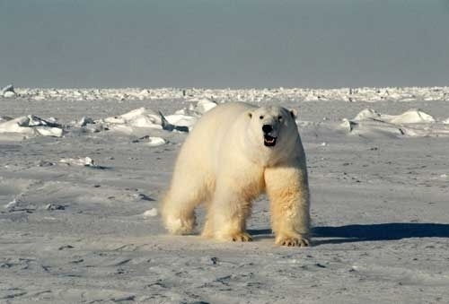
In this lesson, you will model the population of your focal species in order to predict how it will change in the future under projected arctic conditions, and to predict its population size in 2050 and 2080.

