Slide 1
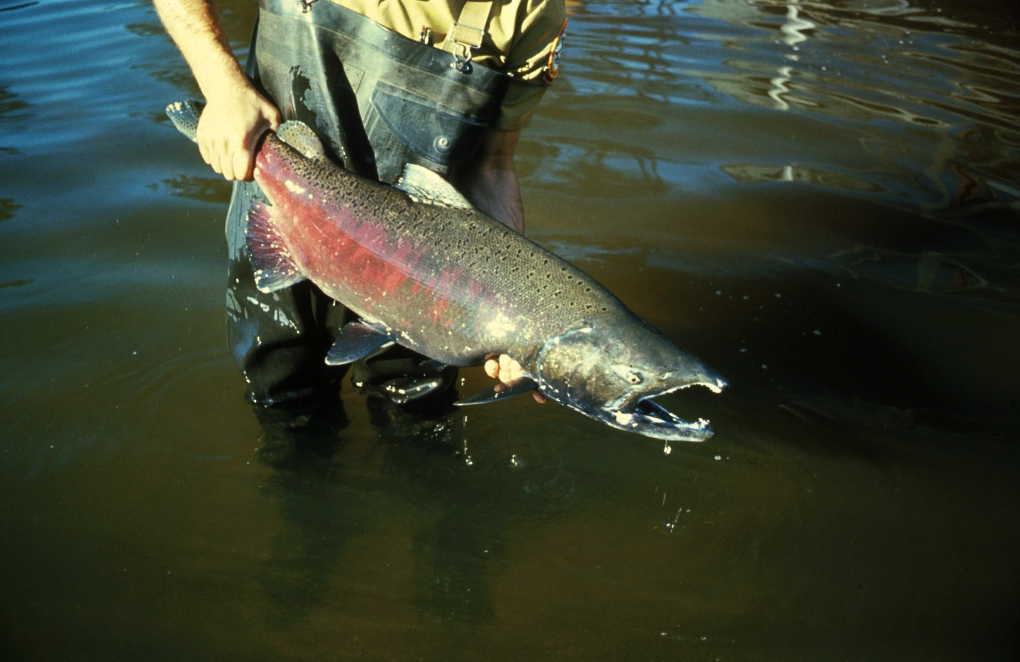
Lesson 12 – Structured Population Models
What else do you need to know to begin to make a conservation plan?
Population biologists work with conservation biologists to build models of populations. These enable them to predict how populations will behave under future conditions or disruptions.

Slide 2
The fundamental population biology model is this simple expression:
N2 = N1 + births - deaths + immigrants - emigrants
This states a commonsense idea:
Suppose you count a population of an organism at one point in time, and call this number of individuals N1.
You take another census at a later time, and find the new population size, N2.
It will have changed because births, deaths, immigrations and emigrations have occurred since you counted to get N1.

Slide 3
Each of the terms (birth, death, immigration, and emigration) includes a lot of ecology.
How many births per reproductive individual?
How often do the organisms reproduce?
What conditions affect survival between an individual’s birth and the time it reproduces?
What is the typical life expectancy of an individual?
How mobile are these organisms? (Do they immigrate and emigrate?)

Slide 4
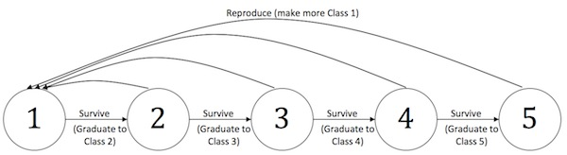
Once the birth, death, immigration, and emigration rates are known, they can be expressed as proportions, and then used in population models. These proportions are also known as “dynamic rate functions,” represented by the arrows in the following “life stage diagram.”

Slide 5
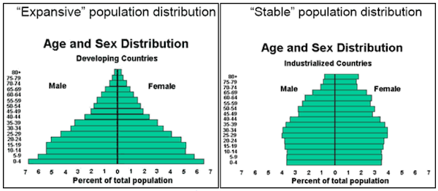
In this lesson, you will use an Excel population model based on the life stages of Chinook salmon to explore how different survival and reproductive rates can affect a population of that fish. You will investigate what life stage(s) might be the most important in conservation, and what predictions you can make about the population when disrupted by climate change.

Slide 6
Credits
Slide 1 – US Fish and Wildlife Service DONT THINK WE CAN USE THIS ONE

