Slide 1
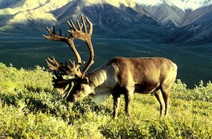
Lesson 11 – The Focal Species Story
All data tell a story. What can a detailed exploration of the data on your focal species tell you about changes that are already evident as a result of changes in the Arctic?

Slide 2
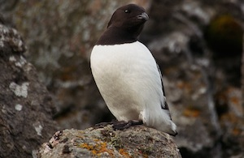
In the last lesson, you discovered that climate change has resulted in more extensive melting of sea ice, increased sea surface temperatures, and more variable climatic conditions generally. But what is happening to the organisms living in the Arctic? How are they responding? How will they continue to respond in the future?

Slide 3
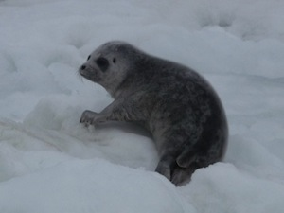
In this lesson, you will work through the data tables and graphs that make up your Focal Species data. You will either write a brief narrative that “tells the story” of each graph and table, or annotate each as you group works through them, to refine the predictions you made earlier about the possible responses of your species in the face of abiotic changes.

Slide 4
Before you go on to look at your predictions, be sure you discuss and understand:
The main features of the life cycle of your species
Any interactions between predators and prey
Any changes in the population possibly due to variation or natural selection
The impact of human activities on your species
The abiotic factors that appear to have the most impact on your species.

Slide 5
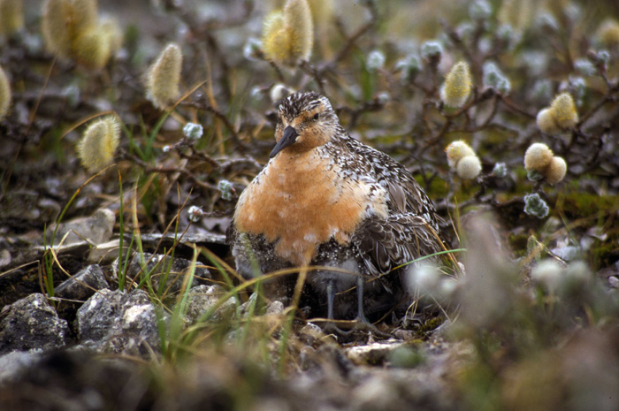
What are the possible responses of your species in the face of abiotic changes?
Changes in phenology
Ecological disruptions
Range shifts
Evolution/Extinction

