Slide 1
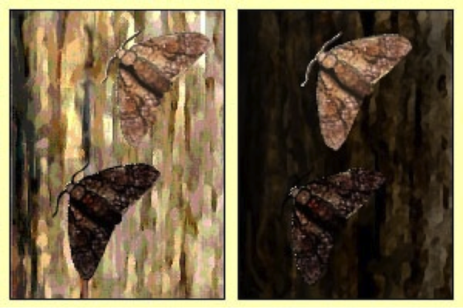
Lesson 10 – Natural Selection
In the previous lesson, you saw how population-level variation changed under the influence of artificial selection. Could changes of this nature lead to natural selection in the wild?

Slide 2
The Fast Plants data only represented short-term change over four generations. How can this help us understand the mechanism of natural selection? We can use a NetLogo simulation to run the experiment over as many generations as we want…

Slide 3
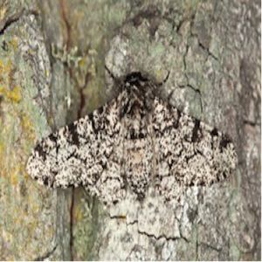
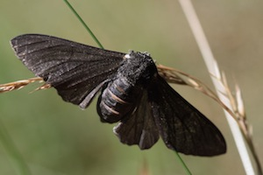
In this investigation, you will run simulations on a Netlogo model designed to imitate the dynamics of a population of peppered moths under selection pressure.

Slide 4
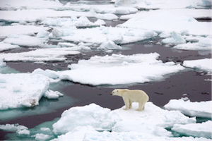
How are the outputs of the peppered moth model relevant to your focal species? In what ways do you think it needs to adapt to improve its chances for surviving the impacts of global warming?

