Slide 1

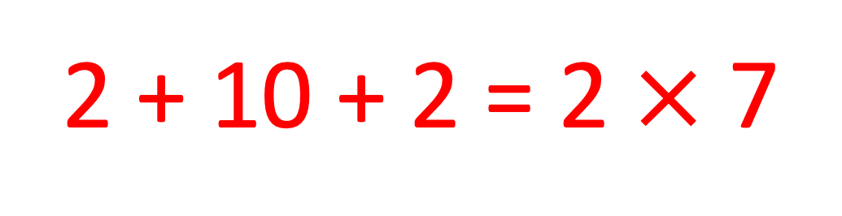
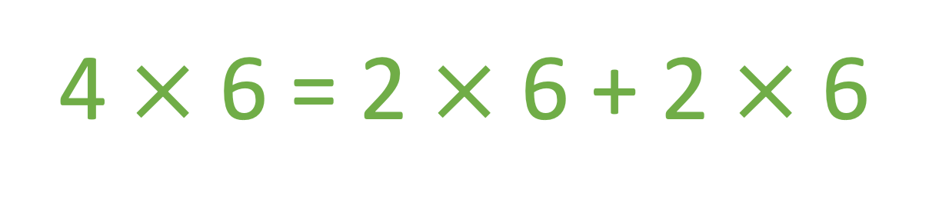
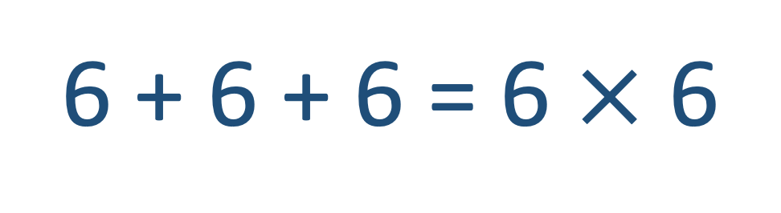
Two Truths and a Lie
Think time…
no answers out loud.
A)
2 + 10 + 2 = 2 $×$ 7
B)
6 + 6 + 6 = 6 $×$ 6
C)
4 $×$ 6 = 2 $×$ 6 + 2 $×$ 6

Slide 2
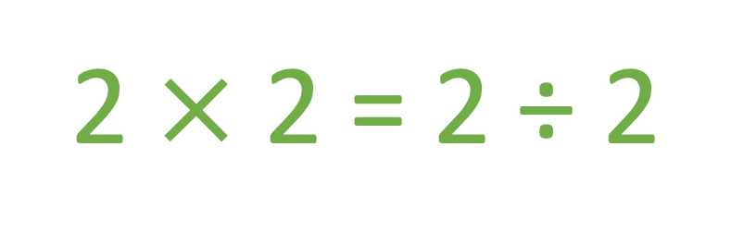
Two Truths and a Lie 2
Think time…
no answers out loud.
Two Truths and a Lie
A)
6 ÷ 3 = 4 – 2
B)
8 ÷ 2 = 0 + 4
C)
2 $×$ 2 = 2 ÷ 2

Slide 3
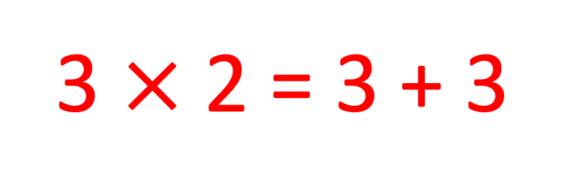
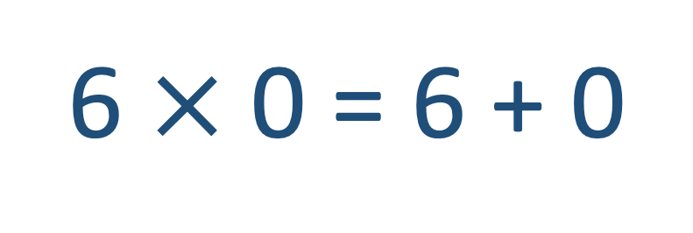
Two Truths and a Lie 3
Think time…
no answers out loud.
Two Truths and a Lie
A)
3 $×$ 2 = 3 + 3
B)
6 $×$ 0 = 6 + 0
C)
12 ÷ 4 = 6 ÷ 2

Slide 4
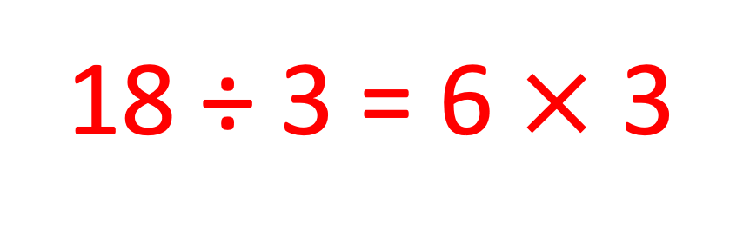
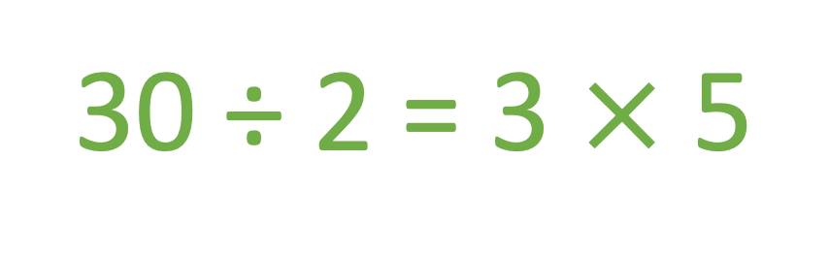
Two Truths and a Lie 4
Think time…
no answers out loud.
Two Truths and a Lie
A)
18 ÷ 3 = 6 $×$ 3
B)
20 ÷ 4 = 5 ÷ 1
C)
30 ÷ 2 = 3 $×$ 5

Slide 5
The following include inequalities
(Unit 2)

Slide 6
Two Truths and a Lie 5
Think time…
no answers out loud.
Two Truths and a Lie
A)
15 ÷ 3 = 20 ÷ 4
B)
12 ÷ 2 < 18 ÷ 2
C)
25 ÷ 5 < 24 ÷ 6

Slide 7
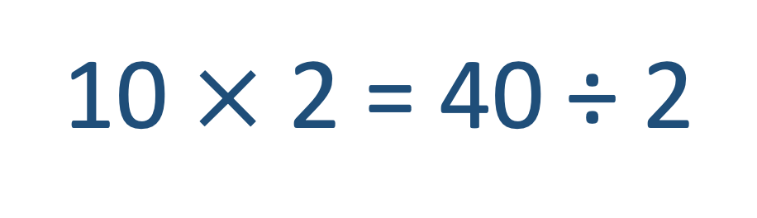
Two Truths and a Lie 6
Think time…
no answers out loud.
Two Truths and a Lie
A)
26 ÷ 2 < 10 + 4
B)
10 $×$ 2 = 40 ÷ 2
C)
16 ÷ 4 = 28 ÷ 4

Slide 8
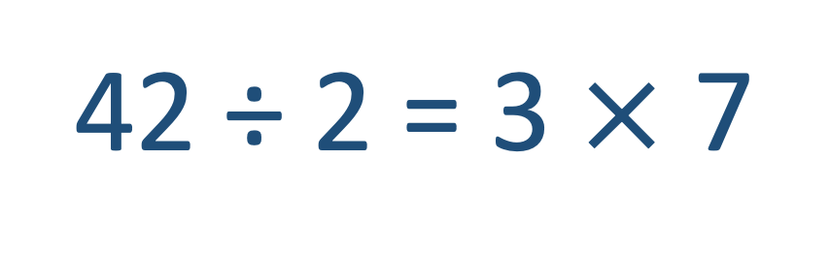
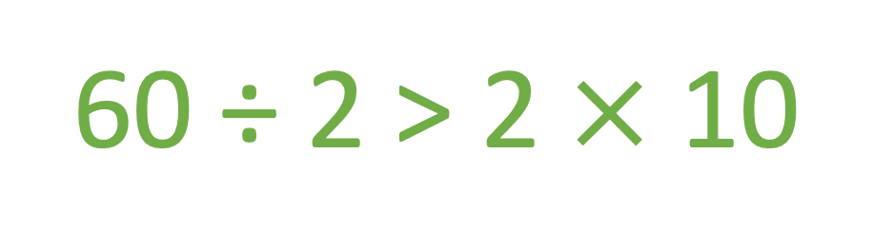
Two Truths and a Lie 7
Think time…
no answers out loud.
Two Truths and a Lie
A)
23 ÷ 1 < 30 ÷ 2
B)
42 ÷ 2 = 3 $×$ 7
C)
60 ÷ 2 > 2 $×$ 10

Slide 9
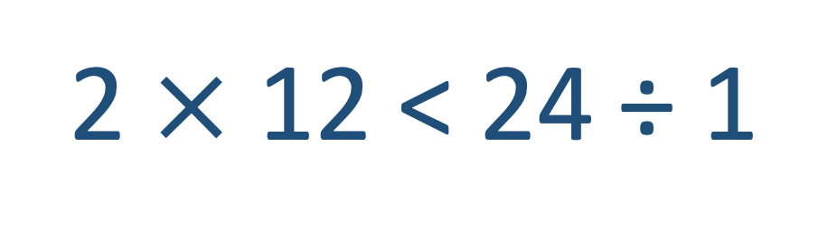
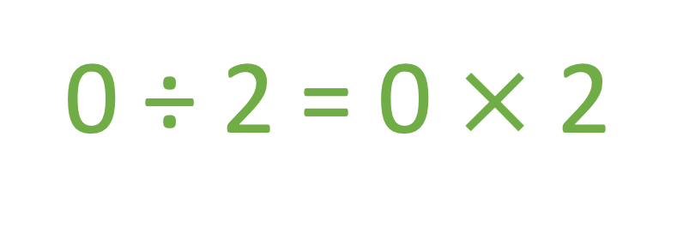
Two Truths and a Lie 8
Think time…
no answers out loud.
Two Truths and a Lie
A)
30 ÷ 3 = 40 ÷ 4
B)
2 $×$ 12 < 24 ÷ 1
C)
0 ÷ 2 = 0 $×$ 2

Slide 10
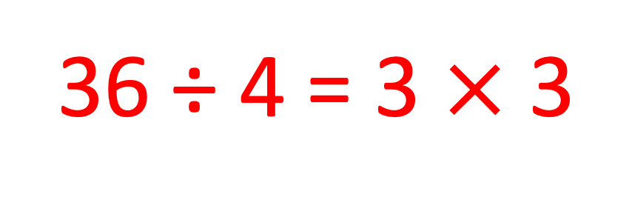
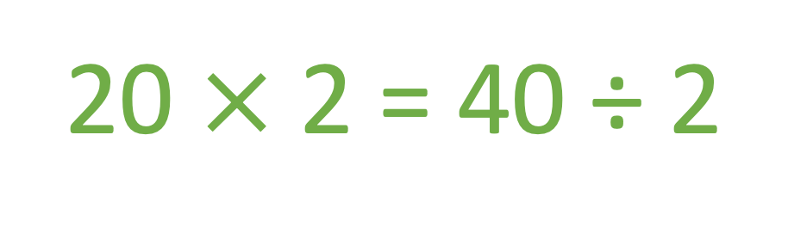
Two Truths and a Lie 9
Think time…
no answers out loud.
Two Truths and a Lie
A)
36 ÷ 4 = 3 $×$ 3
B)
36 ÷ 4 > 36 ÷ 6
C)
20 $×$ 2 = 40 ÷ 2

Slide 11
The following use larger divisors (Unit 3)

Slide 12
Two Truths and a Lie 10
Think time…
no answers out loud.
Two Truths and a Lie
A)
24 ÷ 12 < 36 ÷ 12
B)
32 ÷ 8 = 28 ÷ 7
C)
8 ÷ 8 > 8 ÷ 1

Slide 13
Two Truths and a Lie 11
Think time…
no answers out loud.
Two Truths and a Lie
A)
26 ÷ 13 = 14 ÷ 7
B)
60 ÷ 10 < 60 ÷ 20
C)
50 ÷ 25 = 100 ÷ 50

Slide 14
Two Truths and a Lie 12
Think time…
no answers out loud.
Two Truths and a Lie
A)
48 ÷ 12 > 60 ÷ 12
B)
0 ÷ 24 < 50 ÷ 50
C)
48 ÷ 8 = 18 ÷ 3

