Slide 1

Slides 2–4 use
“____ is ½ of ____. ”

Slide 2
Two Truths and a Lie 2
Think time…
no answers out loud.
Two Truths and a Lie
A) 13 is ½ of 26.
B) 25 is ½ of 50.
C) 30 is ½ of 15.
Notes:
C is false.

Slide 3
Two Truths and a Lie 3
Think time…
no answers out loud.
Two Truths and a Lie
A) 12 is ½ of 22.
B) 21 is ½ of 42.
C) 100 is ½ of 200.
Notes:
A is false.

Slide 4
Two Truths and a Lie 4
Think time…
no answers out loud.
Two Truths and a Lie
A) 70 is ½ of 140.
B) 75 is ½ of 150.
C) 4 is ½ of 2.
Notes:
C is false.

Slide 5
Two Truths and a Lie 5
Slides 6–8 use
“ ___ is ½ of ___.”
and
“½ of ___ is ___.”

Slide 6
Two Truths and a Lie 6
Think time…
no answers out loud.
Two Truths and a Lie
A) 120 is ½ of 240.
B) ½ of 42 is 21.
C) ½ of 230 is 120.
Notes:
C is false.

Slide 7
Two Truths and a Lie 7
Think time…
no answers out loud.
Two Truths and a Lie
A) ½ of 84 is 48.
B) 9 is ½ of 18.
C) ½ of 110 is 55.
Notes:
A is false.

Slide 8
Two Truths and a Lie 8
Think time…
no answers out loud.
Two Truths and a Lie
A) ½ of 56 is 28.
B) 34 is ½ of 17.
C) ½ of 290 is 145.
Notes:
B is false.

Slide 9
Two Truths and a Lie 9
Slides 10–12 use ½, 50% and common measurement units.

Slide 10
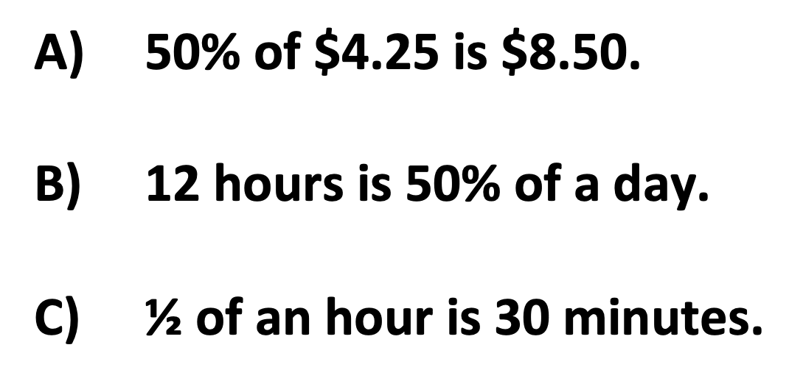
Two Truths and a Lie 10
Think time…
no answers out loud.
Two Truths and a Lie
A) 50% of $4.25 is $8.50.
B) 12 hours is 50% of a day.
C) ½ $\text{of} \text{an} \text{hour} \text{is}\text{ 30 }\text{minutes}\text{.}$
Notes:
A is false.

Slide 11
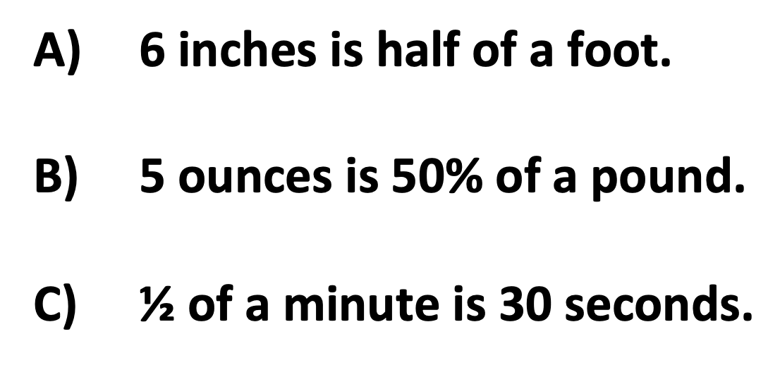
Two Truths and a Lie 11
Think time…
no answers out loud.
Two Truths and a Lie
A) 6 inches is half of a foot.
B) 5 ounces is 50% of a pound.
C) ½$\text{of} \text{a} \text{minute} \text{is}\text{ 30 }\text{seconds}\text{.}$
Notes:
B is false.

Slide 12
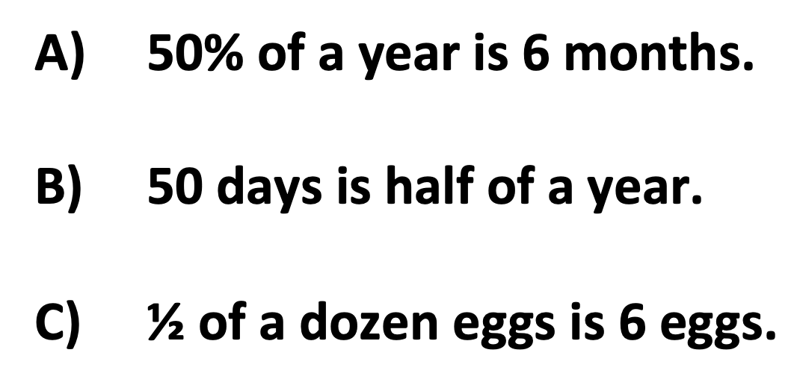
Two Truths and a Lie 12
Think time…
no answers out loud.
Two Truths and a Lie
A) 50% of a year is 6 months.
B) 50 days is half of a year.
C) ½$\text{of} \text{a} \text{dozen} \text{eggs} \text{is}\text{ 6 }\text{eggs}\text{.}$
Notes:
B is false.

Slide 13
Two Truths and a Lie 13
Slides 14–16 involve using benchmarks from Unit 2 to compare.

Slide 14
Two Truths and a Lie 14
Two Truths and a Lie
The class has 40 students.
A) Half of the class is 20 students.
B) 32 students is more than 50% of the class.
C) 22 students is less than half of the class.
Notes:
C is false.

Slide 15
Two Truths and a Lie 15
Two Truths and a Lie
The cost is $120.
A) 50% of the cost is $60.
B) $24 is less than half of the cost.
C) 100% of the cost is $100.
Notes:
C is false.

Slide 16
Two Truths and a Lie 16
Two Truths and a Lie
There are about 86,000 people in Dorchester.
A) 20,000 is more than half of the people in Dorchester.
B) 43,000 is 50% of the people in Dorchester.
C) 85,000 is almost all of the people in Dorcehster.
Notes:
A is false.

Slide 17
Two Truths and a Lie 17
Slides 18–20 use ¼, ¾, and decimal/fraction equivalents.

Slide 18
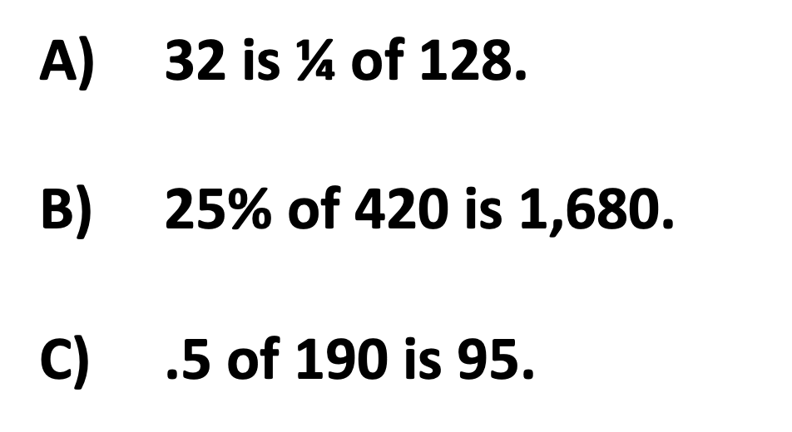
Two Truths and a Lie 18
Think time…
no answers out loud.
Two Truths and a Lie
A) 32 is ¼ of 128.
B) 25% of 420 is 1,680.
C) $\text{.5 }\text{of}\text{ 190 }\text{is}\text{ 95.}$
Notes:
B is false.

Slide 19
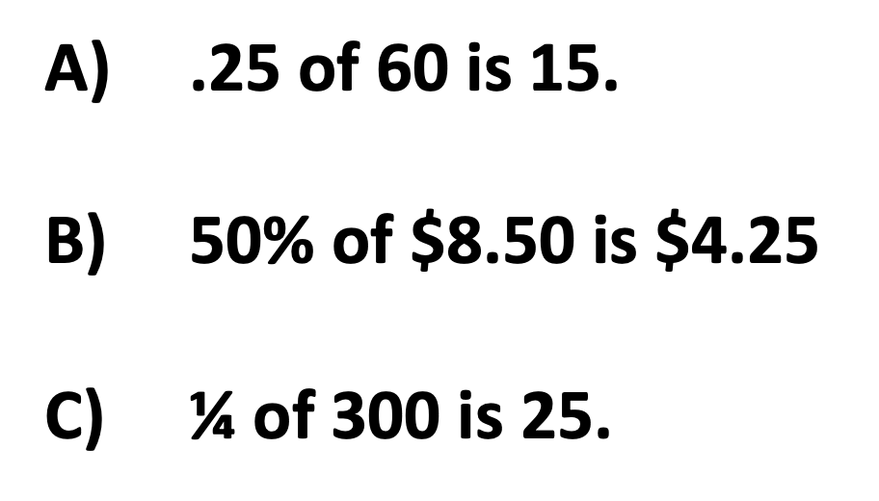
Two Truths and a Lie 19
Think time…
no answers out loud.
Two Truths and a Lie
A) .25 of 60 is 15.
B) 50% of $8.50 is $4.25
C) ¼ $\text{of}\text{ 300 }\text{is}\text{ 25}$.
Notes:
C is false.

Slide 20
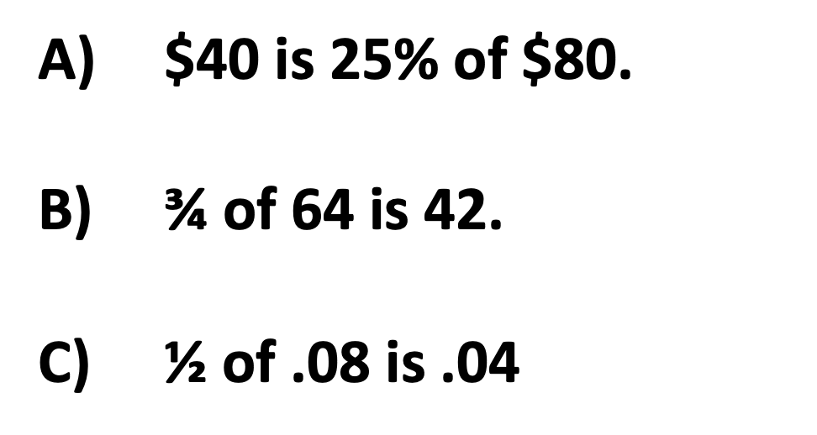
Two Truths and a Lie 20
Think time…
no answers out loud.
Two Truths and a Lie
A) $40 is 25% of $80.
B) ¾ of 64 is 42.
C) ½ $\text{of}\text{ .08 }\text{is}\text{ .04}$
Notes:
A is false.

Slide 21
Two Truths and a Lie 21
Slides 22–24 use
all benchmarks from
Units 1–3 for comparison.

Slide 22
Two Truths and a Lie 22
Two Truths and a Lie
The class has 40 students.
A) 75% of the class is 35 students.
B) 8 students is less than 25% of the class.
C) 22 students is more than half of the class.
Notes:
A is false.

Slide 23
Two Truths and a Lie 23
Two Truths and a Lie
The cost is $120.
A) 75% of the cost is $90.
B) $55 is more than half of the cost.
C) $25 is less than ¼ of the cost.
Notes:
B is false.

Slide 24
Two Truths and a Lie 24
Two Truths and a Lie
There are about 86,000 people in Dorchester.
A) 20,000 is less than ¼ of the people in Dorchester.
B) 43,000 is .5 of the people in Dorchester.
C) 75,000 is ¾ of the people in Dorchester.
Notes:
C is false.

