Slide 1
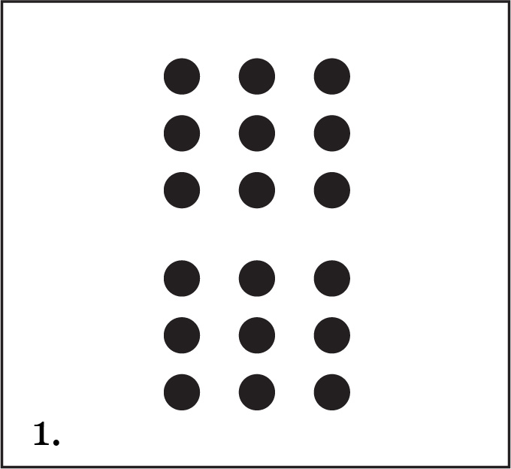
Quick Image Dot Pattern 1
From Investigations Grade 3: Curriculum Unit: "FROM PACES TO FEET" © 1993 by Savvas Learning Company LLC, or its affiliates.
Used by permission. All Rights Reserved.
[NOTE: The presented content is for example only, and may not appear in the same format (or order) as the original publication.]
Notes:
From Investigations Grade 3: Curriculum Unit: "FROM PACES TO FEET" © 1993 by Savvas Learning Company LLC, or its affiliates. Used by permission. All Rights Reserved.
[NOTE: The presented content is for example only, and may not appear in the same format (or order) as the original publication.]

Slide 2
Blank page 1

Slide 3
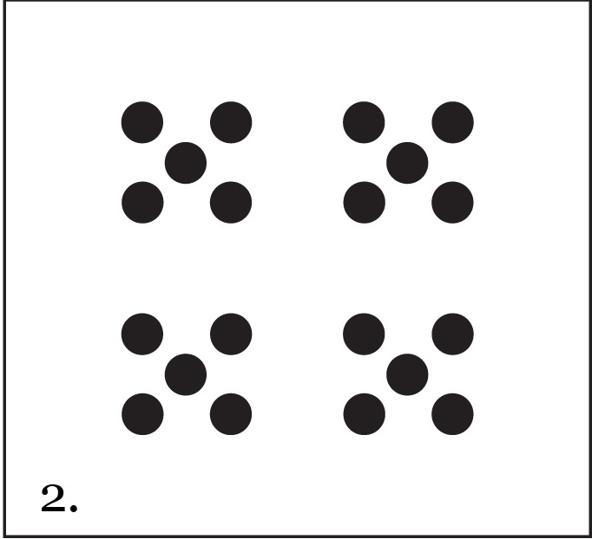
Quick Image Dot Pattern 2
From Investigations Grade 3: Curriculum Unit: "FROM PACES TO FEET" © 1993 by Savvas Learning Company LLC, or its affiliates.
Used by permission. All Rights Reserved.
[NOTE: The presented content is for example only, and may not appear in the same format (or order) as the original publication.]
Notes:
From Investigations Grade 3: Curriculum Unit: "FROM PACES TO FEET" © 1993 by Savvas Learning Company LLC, or its affiliates. Used by permission. All Rights Reserved.
[NOTE: The presented content is for example only, and may not appear in the same format (or order) as the original publication.]

Slide 4
Blank page 2

Slide 5
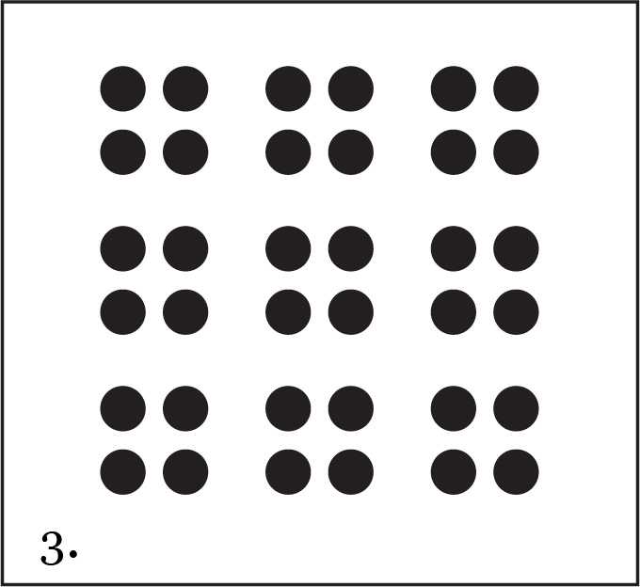
Quick Image Dot Pattern 3
From Investigations Grade 3: Curriculum Unit: "FROM PACES TO FEET" © 1993 by Savvas Learning Company LLC, or its affiliates.
Used by permission. All Rights Reserved.
[NOTE: The presented content is for example only, and may not appear in the same format (or order) as the original publication.]
Notes:
From Investigations Grade 3: Curriculum Unit: "FROM PACES TO FEET" © 1993 by Savvas Learning Company LLC, or its affiliates. Used by permission. All Rights Reserved.
[NOTE: The presented content is for example only, and may not appear in the same format (or order) as the original publication.]

Slide 6
Blank page 3

Slide 7
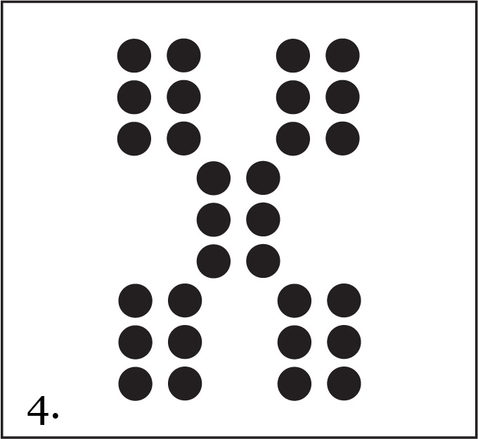
Quick Image Dot Pattern 4
From Investigations Grade 3: Curriculum Unit: "FROM PACES TO FEET" © 1993 by Savvas Learning Company LLC, or its affiliates.
Used by permission. All Rights Reserved.
[NOTE: The presented content is for example only, and may not appear in the same format (or order) as the original publication.]
Notes:
From Investigations Grade 3: Curriculum Unit: "FROM PACES TO FEET" © 1993 by Savvas Learning Company LLC, or its affiliates. Used by permission. All Rights Reserved.
[NOTE: The presented content is for example only, and may not appear in the same format (or order) as the original publication.]

Slide 8
Blank page 4

Slide 9

Quick Image Dot Pattern 5
From Investigations Grade 3: Curriculum Unit: "FROM PACES TO FEET" © 1993 by Savvas Learning Company LLC, or its affiliates.
Used by permission. All Rights Reserved.
[NOTE: The presented content is for example only, and may not appear in the same format (or order) as the original publication.]
Notes:
From Investigations Grade 3: Curriculum Unit: "FROM PACES TO FEET" © 1993 by Savvas Learning Company LLC, or its affiliates. Used by permission. All Rights Reserved.
[NOTE: The presented content is for example only, and may not appear in the same format (or order) as the original publication.]

Slide 10
Blank page 5

Slide 11

Quick Image Dot Pattern 6
From Investigations Grade 3: Curriculum Unit: "FROM PACES TO FEET" © 1993 by Savvas Learning Company LLC, or its affiliates.
Used by permission. All Rights Reserved.
[NOTE: The presented content is for example only, and may not appear in the same format (or order) as the original publication.]
Notes:
From Investigations Grade 3: Curriculum Unit: "FROM PACES TO FEET" © 1993 by Savvas Learning Company LLC, or its affiliates. Used by permission. All Rights Reserved.
[NOTE: The presented content is for example only, and may not appear in the same format (or order) as the original publication.]

Slide 12
Blank page 6

