Slide 1

Measurement Stations
Unit 4 Application Project for Remote Classroom

Slide 2

Station 1: Feet and Inches
12 in. = 1 ft.
(12 inches = 1 foot)
Marta is 68 inches tall.
Her arm span is 62 inches.

Slide 3
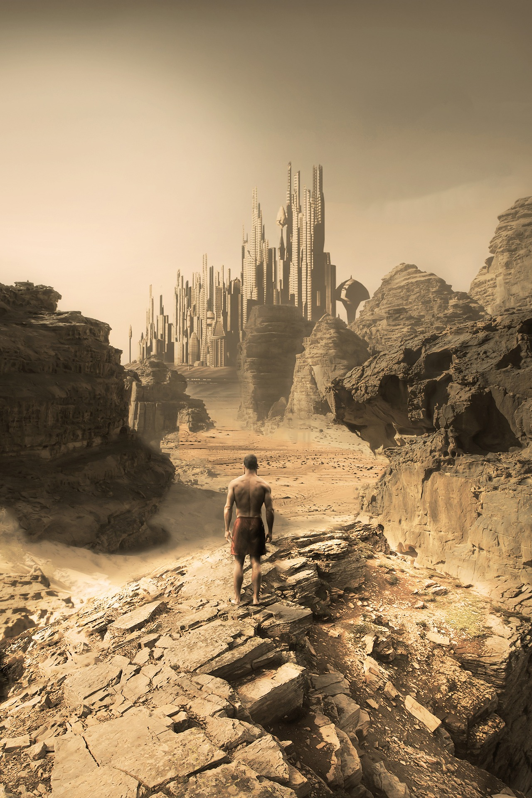

Station 2: Hours and Minutes
60 min. = 1 hr.
(60 minutes = 1 hour)
The Ruins
Run time: 185 mins
Boston Invasion
Run time: 133 mins

Slide 4
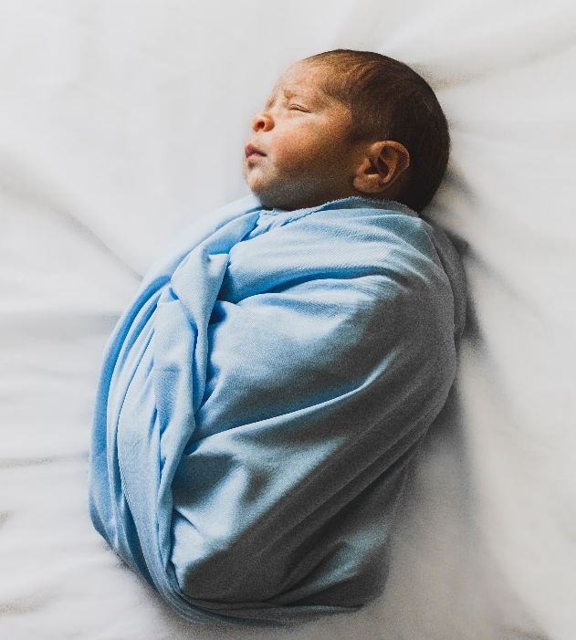

Station 3: Pounds and Ounces
16 oz. = 1 lb.
(16 ounces = 1 pound)
116 oz
Alicia
138 oz
Marc

Slide 5

Station 4: Cups and Quarts
4 C = 1 qt
(4 cups = 1 quart)
Tia Amaya’s Spicy Chicken Soup
Ingredients:
14 C chicken broth
1 lb carrots
2 large onions
6 celery stalks
1 C broccoli, chopped
½ C butter
3 lbs chicken thighs
Adobo

