Slide 1
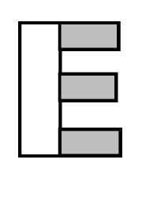
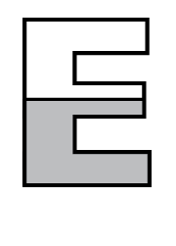

Is it half?
Is it half?
Notes:
Left: Shows one-half of a shape through a line of symmetry
Right: Not one-half

Slide 2
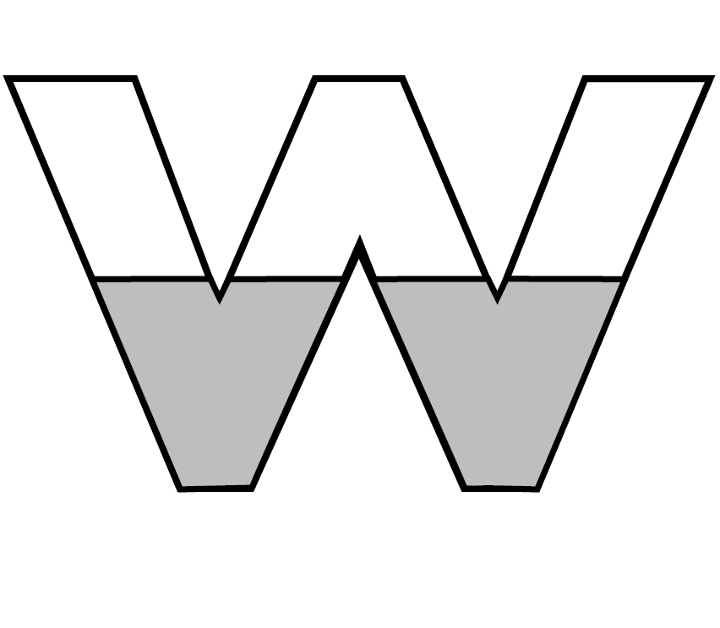
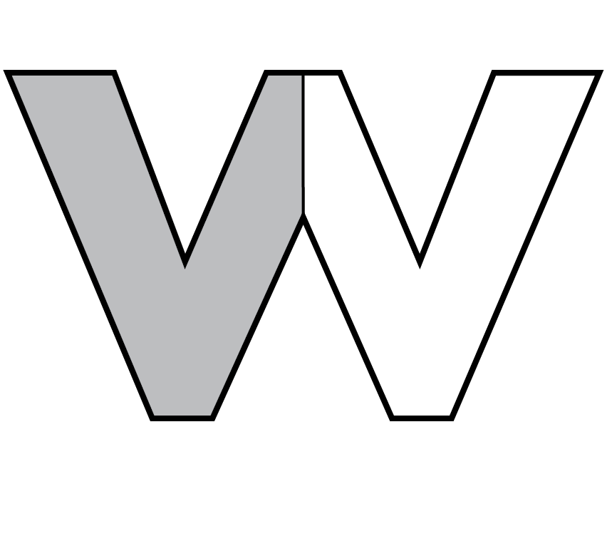
Is it half 2?
Is it half?
Is it half?
Notes:
Left: Not one-half.
Right: Shows one half of a shape through a line of symmetry.

Slide 3
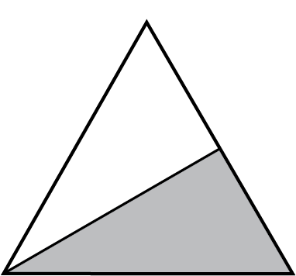
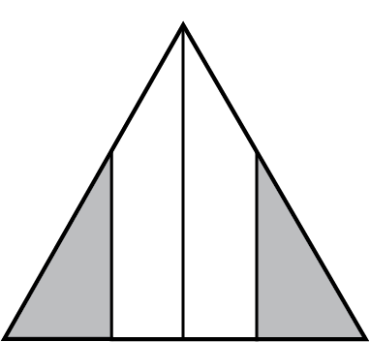
Is it half 3?
Is it half?
Is it half?
Notes:
Left: Shows one-half of a shape with a line of symmetry at an angle.
Right: Not one-half. Although two out of four parts are shaded, the parts are not equal.

Slide 4
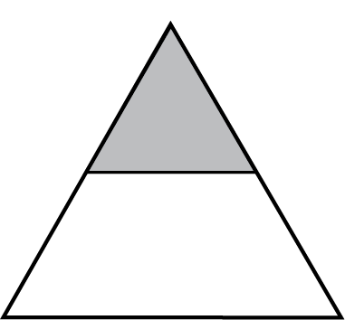
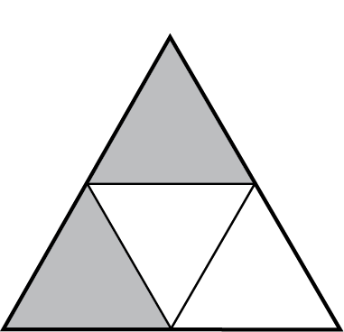
Is it half ?4
Is it half?
Is it half?
Notes:
Left: Not one-half.
Right: Shows two fourths which is equivalent to one-half.

Slide 5
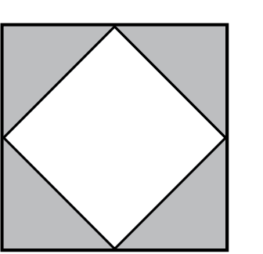
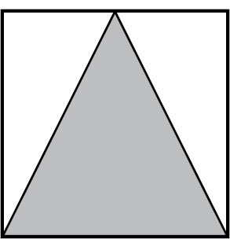
Is it half ?5
Is it half?
Is it half?
Notes:
Left: Shows one-half. The gray and white areas are equal, which can be seen if the center square is cut through the diagonals. Four out of eight equal triangles are shaded.
Right. Shows one-half. The gray and white areas are equal, which can be seen if the center triangle is cut vertically through the center. Two out of four equal triangles are shaded.

Slide 6
Is it half ?6
Is it half?
Is it half?
Notes:
Left: Shows one-half of a set where all the blue stars are all on one side.
Right: Shows one-half of a set where the blue and white stars are mixed together.

Slide 7
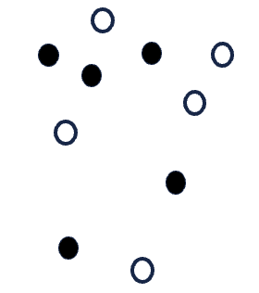

Is it half ?7
Is it half?
Is it half?
Notes:
Left: Shows one half of a set where black and white circles are randomly arranged.
Right: Not one-half, easier to see because of the symmetrical arrangement.

Slide 8
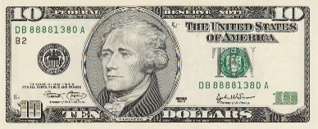
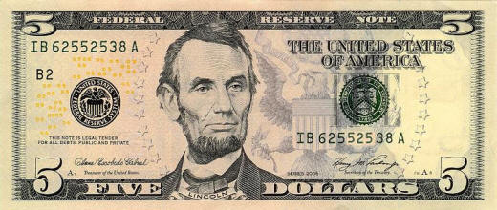
Is it half ?8
Is it half?
Notes:
Not one half. Students must recognize that the value of the bills are not the same.

Slide 9
Is it half 9?
Is it half?
Notes:
Shows one-half, since both parts are worth $25

Slide 10
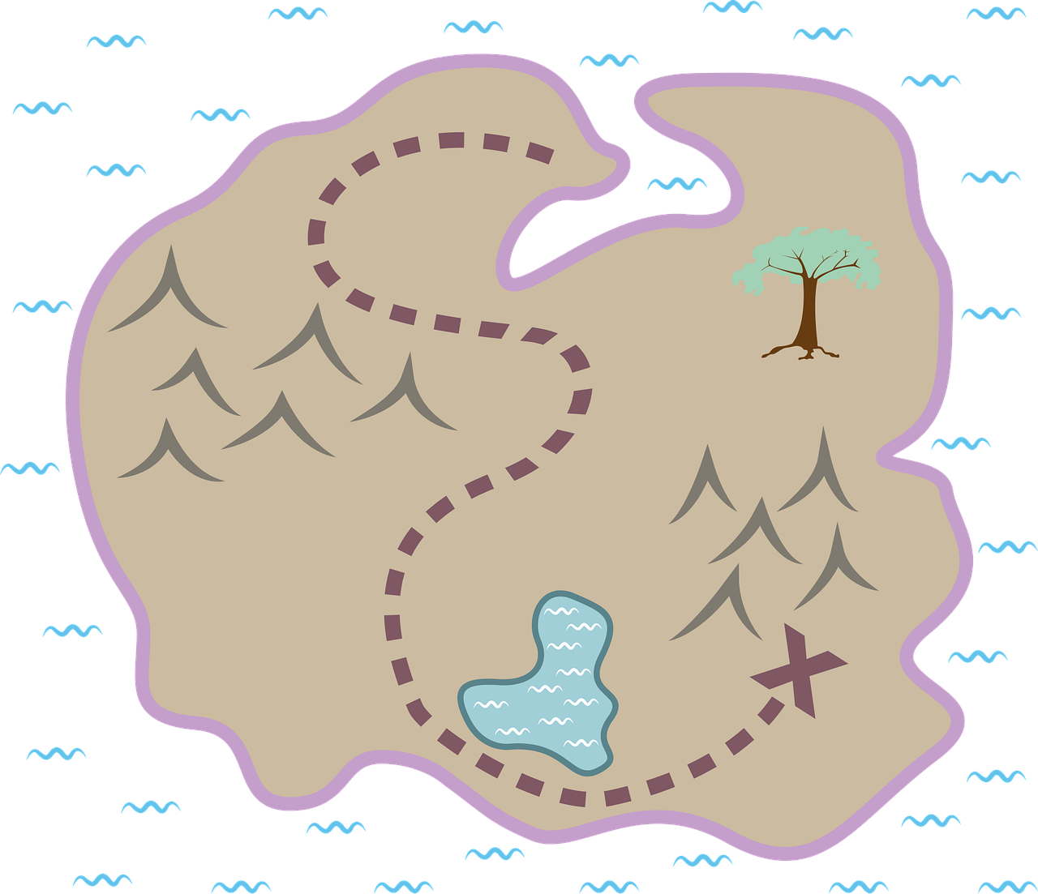
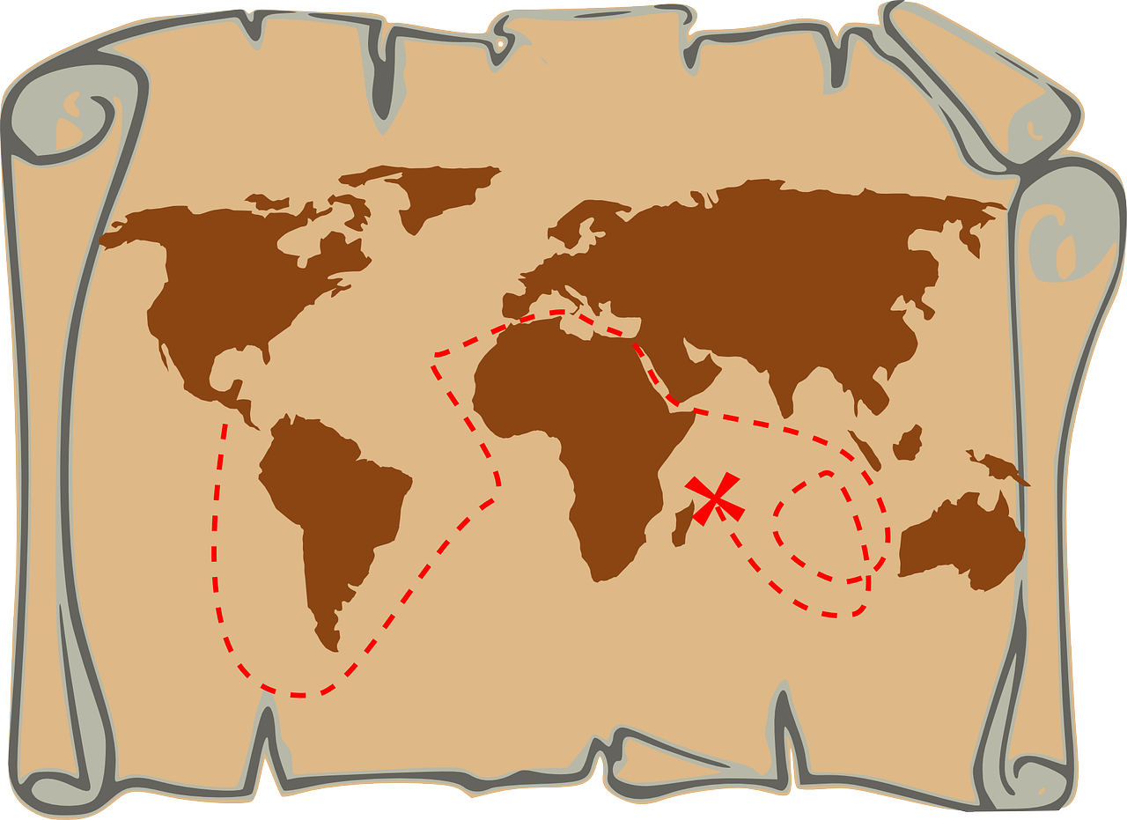
Is it half 10?
Is it half?
Is it half?
Notes:
Left: Shows a star approximately one-half of the distance along the path. Encourage discussion about how to compare the lengths of curved lines! (Strings can help.)
Right: Shows a star that is less than one-half of the distance along the path.
Image from https://pixabay.com/vectors/map-island-treasure-map-path-7367482/
https://pixabay.com/vectors/map-parchment-pirates-scroll-148263/
No attribution required.

Slide 11
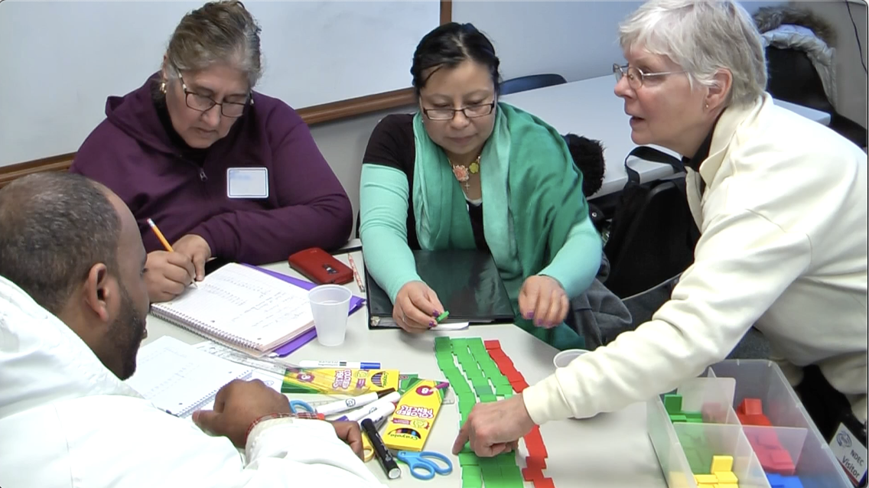
Is it half ?11
Is it half?
Is it half?
12 out of 24 students were in class today.
7 out of 13 students were in class today.
Notes:
Left: One-half of a set in context.
Right: Not one-half.

Slide 12

Is it half 12?
Is it half?
Is it half?
32 out of 64 accounts paid.
49 out of 100 accounts paid.
Notes:
Left: Equal to one half.
Right: Not one-half.

Slide 13
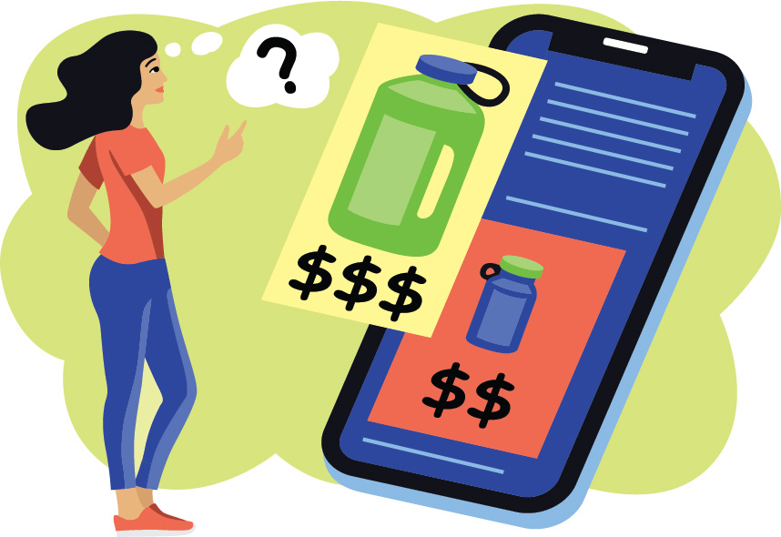
Is it half 13?
Is it half?
Is it half?
18 ounces vs. 32 ounces
$2.50 vs. $5.00
Notes:
Left: Not one-half
Right: Equal to one-half, leverages knowledge of money.

Slide 14
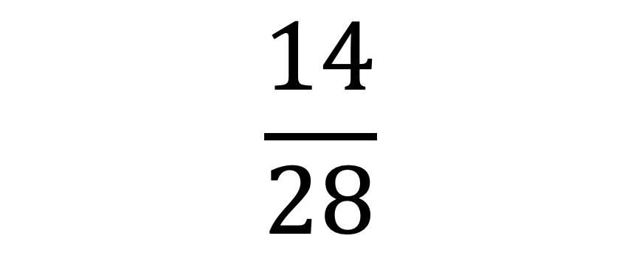
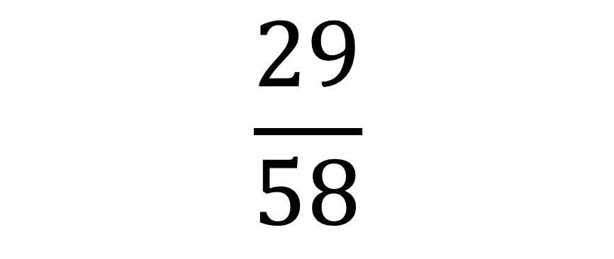
Is it half 14?
Is it half?
Is it half?
$$\frac{14}{28}$$
$$\frac{29}{58}$$
Notes:
Left: Symbolic, equal to one-half.
Right: Symbolic, equal to one-half.

Slide 15
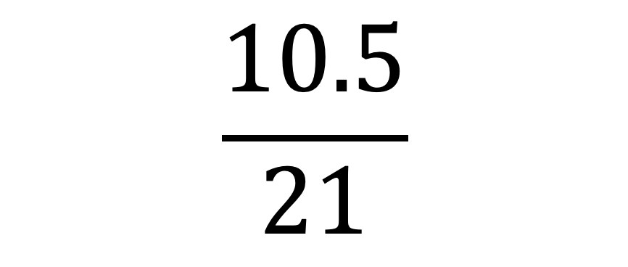

Is it half 15?
Is it half?
Is it half?
$$\frac{10.5}{21}$$
$$\frac{11}{20}$$
Notes:
Left: Symbolic with decimal, equal to one-half.
Right: Not one-half.

