Slide 1


Find three things…
…that are about the same length as your forearm.
Notes:
Image from pixabay, no attrib required. https://pixabay.com/vectors/fashion-earrings-heels-necklace-150519/

Slide 2

Find three things 2
Find three things…
…that are about the same length as the last joint on your thumb..
Notes:
Image from pixabay, no attrib required. https://pixabay.com/vectors/hand-back-part-human-body-24446/

Slide 3

Find three things 3
Find three things…
…that are about the height of your chair.
Notes:
Image from pixabay, no attrib required. https://pixabay.com/vectors/chair-red-metal-school-office-308101/

Slide 4
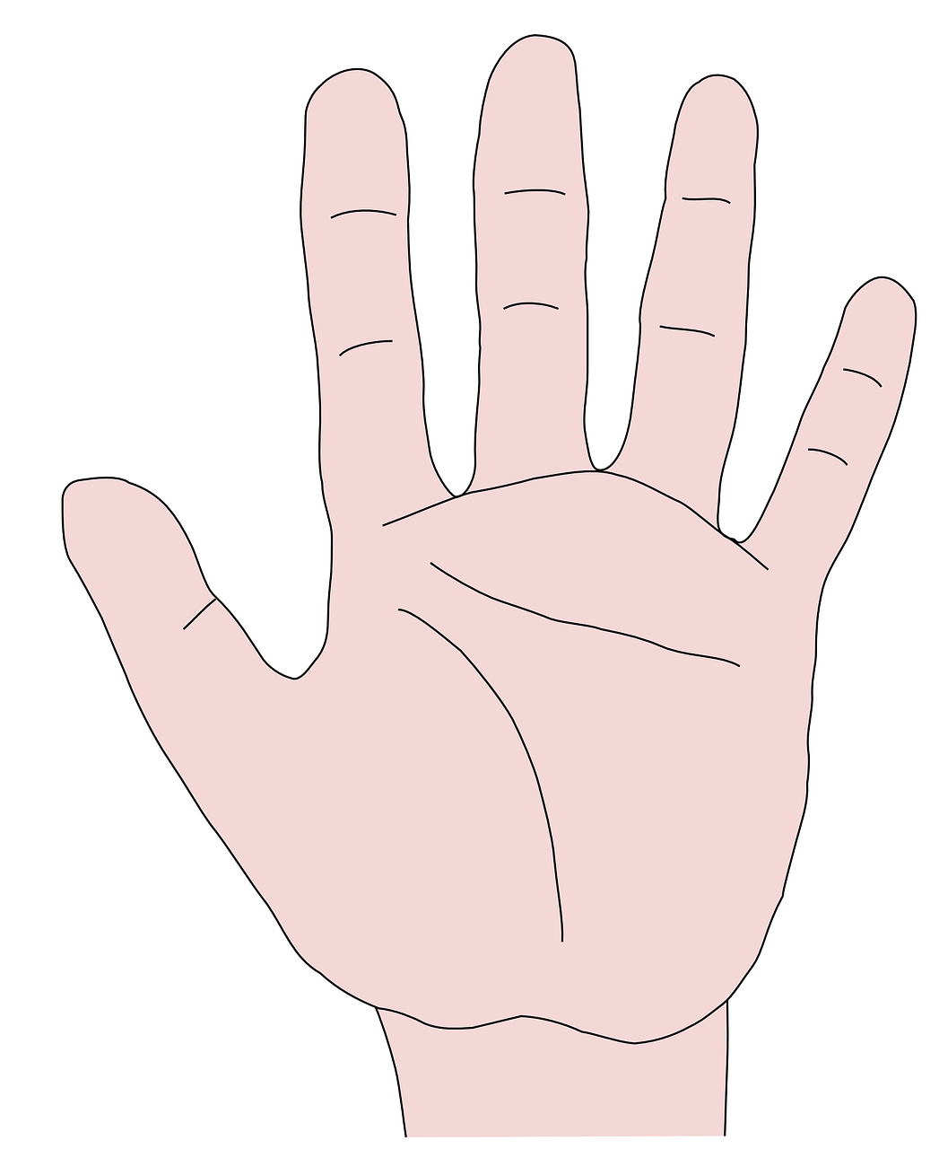
Find three things 4
Find three things…
…that are about the width of your pinkie finger.
Notes:
Image from pixabay, no attrib required. https://pixabay.com/vectors/hand-fingers-palm-anatomy-hello-150172/

Slide 5
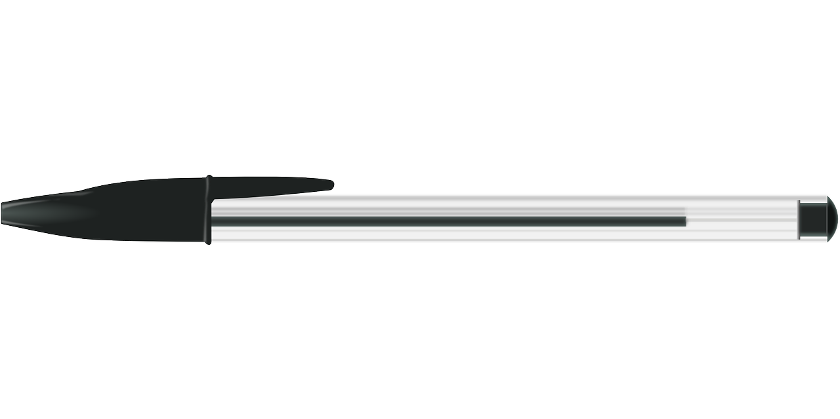
Find three things 5
Find three things…
…that are about the length of a pen.
Notes:
Image from pixabay, no attrib required. https://pixabay.com/vectors/pen-biro-bic-black-writing-office-147110/

Slide 6

Find three things 6
Find three things…
…that are about the length of a notebook.
Notes:
Image from pixabay, no attrib required. https://pixabay.com/vectors/notebook-spiral-book-binder-paper-41336/

Slide 7

Find three things 7
Find three things…
…that are about the same as your height.
Notes:
Image from pixabay, no attrib required. https://pixabay.com/vectors/business-cartoon-comic-2025814/

