Slide 1

Estimate the Length
In this warmup, you will estimate the length of something using benchmarks (no measuring tools!)

Slide 2
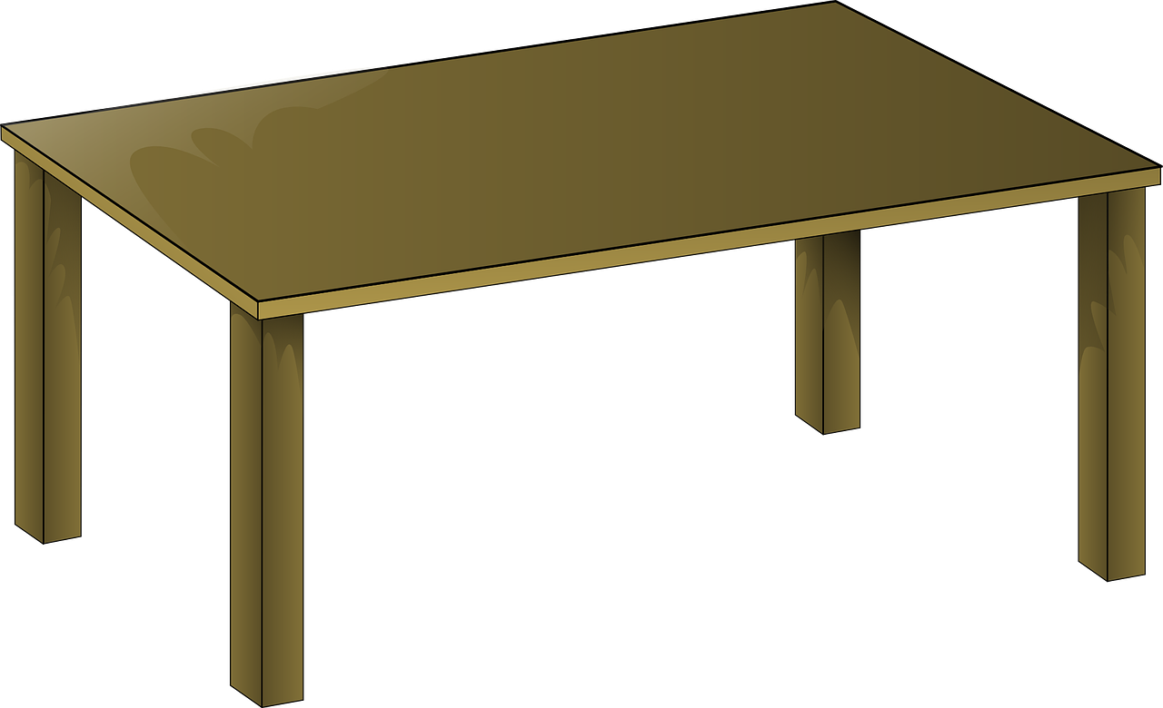
Estimate the Length 2
Common benchmarks:
Last joint of your thumb: ~ 1 inch
Forearm: ~ 1 foot
Pen: ~ 6 inches
Length of notebook: ~ 1 foot
Height of chair: ~ 1 yard / 1 meter
Estimate the length of your table.
Notes:
Image from pixabay, no attrib required. https://pixabay.com/vectors/table-wooden-desk-furniture-23627/

Slide 3

Estimate the Length 3
Common benchmarks:
Last joint of your thumb: ~ 1 inch
Forearm: ~ 1 foot
Pen: ~ 6 inches
Length of notebook: ~ 1 foot
Height of chair: ~ 1 yard / 1 meter
Estimate the length of your cell phone.
Notes:
Image from pixabay, no attrib required. https://pixabay.com/vectors/phone-iphone-cell-phone-apple-158244/

Slide 4

Estimate the Length 4
Common benchmarks:
Last joint of your thumb: ~ 1 inch
Forearm: ~ 1 foot
Pen: ~ 6 inches
Length of notebook: ~ 1 foot
Height of chair: ~ 1 yard / 1 meter
Estimate the length of your hair.
Notes:
Image from pixabay, no attrib required. https://pixabay.com/vectors/woman-beauty-african-american-black-8063749/

Slide 5

Estimate the Length 5
Common benchmarks:
Last joint of your thumb: ~ 1 inch
Forearm: ~ 1 foot
Pen: ~ 6 inches
Length of notebook: ~ 1 foot
Height of chair: ~ 1 yard / 1 meter
Estimate the width of your chair.
Notes:
Image from pixabay, no attrib required. https://pixabay.com/vectors/chair-red-metal-school-office-308101/

Slide 6

Estimate the Length 6
Common benchmarks:
Last joint of your thumb: ~ 1 inch
Forearm: ~ 1 foot
Pen: ~ 6 inches
Length of notebook: ~ 1 foot
Height of chair: ~ 1 yard / 1 meter
Estimate the width of the door.
Notes:
Image from pixabay, no attrib required. https://pixabay.com/vectors/moon-main-door-visit-entrance-exit-1133854/

Slide 7
Estimate the Length 7
Common benchmarks:
Last joint of your thumb: ~ 1 inch
Forearm: ~ 1 foot
Pen: ~ 6 inches
Length of notebook: ~ 1 foot
Height of chair: ~ 1 yard / 1 meter
Estimate the height of the door.
Notes:
Image from pixabay, no attrib required. https://pixabay.com/vectors/moon-main-door-visit-entrance-exit-1133854/

Slide 8

Estimate the Length 8
Common benchmarks:
Last joint of your thumb: ~ 1 inch
Forearm: ~ 1 foot
Pen: ~ 6 inches
Length of notebook: ~ 1 foot
Height of chair: ~ 1 yard / 1 meter
Estimate the width of a computer screen.
Notes:
Image from pixabay, no attrib required. https://pixabay.com/vectors/monitor-screen-flat-lcd-black-32743/

Slide 9
Estimate the Length 9
Common benchmarks:
Last joint of your thumb: ~ 1 inch
Forearm: ~ 1 foot
Pen: ~ 6 inches
Length of notebook: ~ 1 foot
Height of chair: ~ 1 yard / 1 meter
Estimate the height of your classroom.

