Slide 1

Data says…
First, make a guess with your pie chart maker about the portion/percentage in the statistic.
When you see the real percent, adjust your pie chart maker. Were you close? Too high? Too low?
What does the whole circle represent in this situation?
What does the other part/portion represent in this situation?

Slide 2
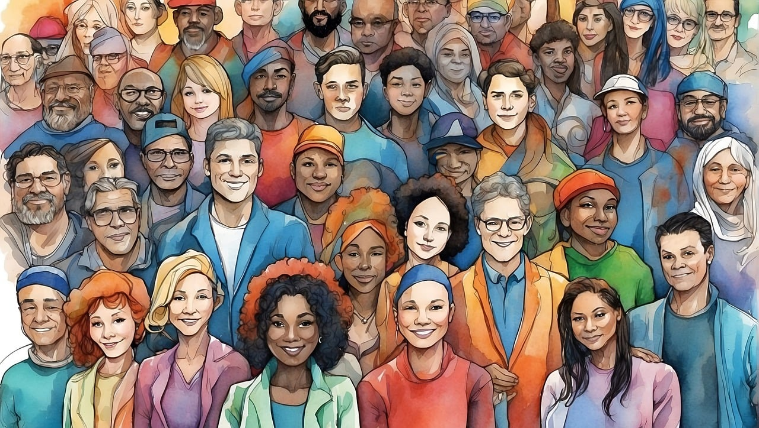
Data says 2
A
What percent of the US population was born outside of the US (foreign-born)?
Notes:
Image from: https://pixabay.com/illustrations/ai-generated-people-faces-inclusion-8570267/

Slide 3
Data says 3
A
In 2022, about 14% of the US population was foreign-born (born outside the US).
Notes:
Source: https://www.census.gov/newsroom/press-releases/2024/foreign-born-population.html

Slide 4
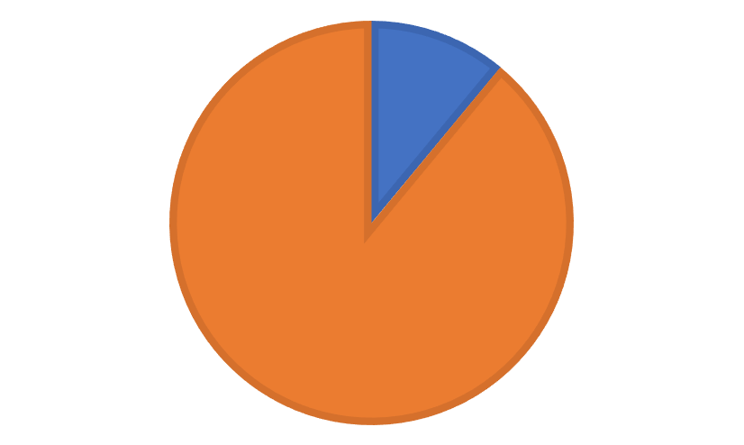
Data says 4
A
In 2022, about 14% of the US population was foreign-born (born outside the US).
Notes:
Source: https://www.census.gov/newsroom/press-releases/2024/foreign-born-population.html

Slide 5
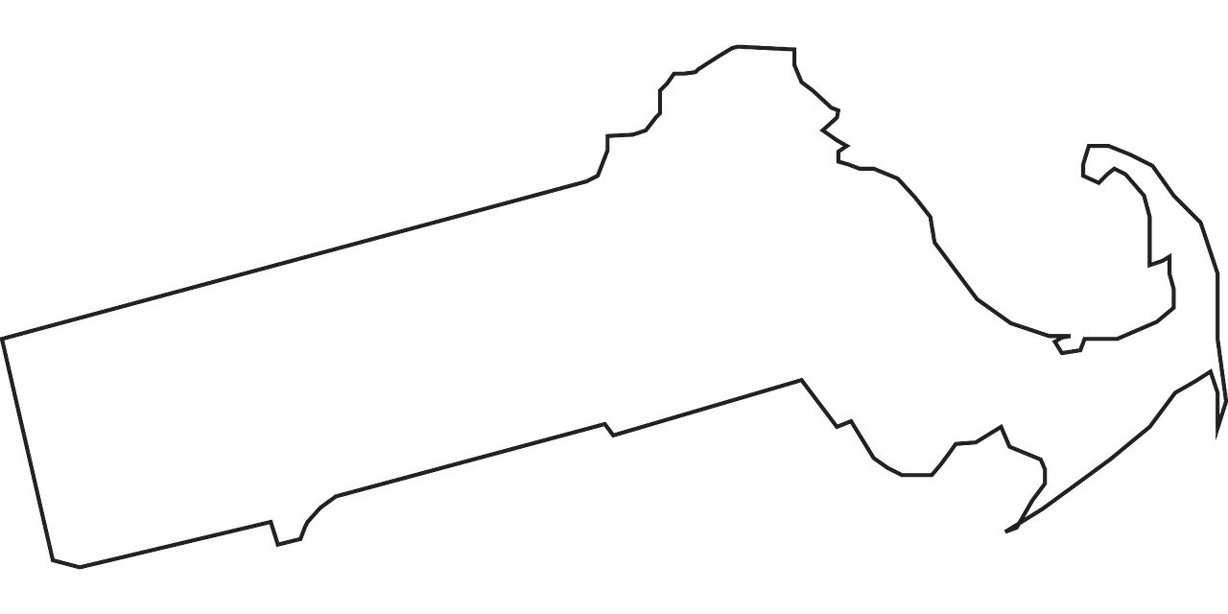
Data says 5
B
What percent of the Massachusetts population was born outside of the US (foreign-born)?
Notes:
Image from: https://pixabay.com/vectors/massachusetts-state-map-geography-43766/

Slide 6
Data says 6
B
In 2022, about 18% of the Massachusetts population was born outside of the US.
Notes:
https://www.census.gov/library/visualizations/interactive/foreign-born-population-2018-2022.html

Slide 7
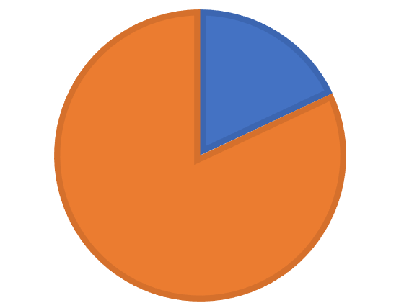
Data says 7
B
In 2022, about 18% of the Massachusetts population was born outside of the US.
Notes:
https://www.census.gov/library/visualizations/interactive/foreign-born-population-2018-2022.html

Slide 8
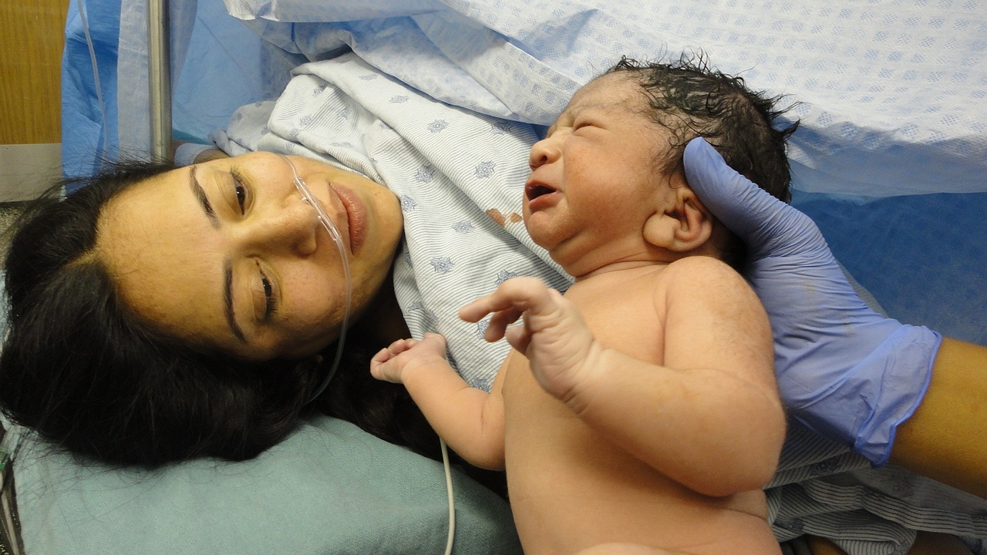
Data says 8
C
What percent of babies in the US are born in a hospital?
Notes:
Image from: https://pixabay.com/photos/baby-birth-healthy-baby-child-1531059/

Slide 9
Data says 9
C
In 2017, about 98% of the babies in the US were born in hospitals.
Notes:
https://www.ncbi.nlm.nih.gov/books/NBK555484/#:~:text=Hospitals%20are%20the%20most%20common,a%20Level%204%20maternity%20unit.

Slide 10
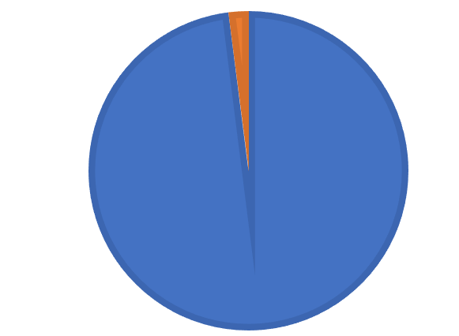
Data says 10
C
In 2017, about 98% of the babies in the US were born in hospitals.
Notes:
https://www.ncbi.nlm.nih.gov/books/NBK555484/#:~:text=Hospitals%20are%20the%20most%20common,a%20Level%204%20maternity%20unit.

Slide 11

Data says 11
D
What percent of the US population identifies as Hispanic or Latino?
Notes:
Image from: https://www.pexels.com/photo/man-standing-beside-his-wife-teaching-their-child-how-to-ride-bicycle-1128318/

Slide 12
Data says 12
D
In 2023, about 19% of the US population identified as Hispanic or Latino.
Notes:
https://www.census.gov/library/visualizations/2024/comm/hispanic-percent-county.html

Slide 13

Data says 13
D
In 2023, about 19% of the US population identified as Hispanic or Latino.
Notes:
https://www.census.gov/library/visualizations/2024/comm/hispanic-percent-county.html

Slide 14

Data says 14
E
What percent of US adults say they liked math classes when they were in school (K-12)?
Notes:
Image is owned by SABES

Slide 15
Data says 15
E
In a survey in 2017, 58% of US adults said they generally liked math classes when they were in school (K-12).
Notes:
https://www.pewresearch.org/social-trends/2018/01/09/many-americans-say-they-liked-math-and-science-in-school-thought-about-a-stem-career/

Slide 16
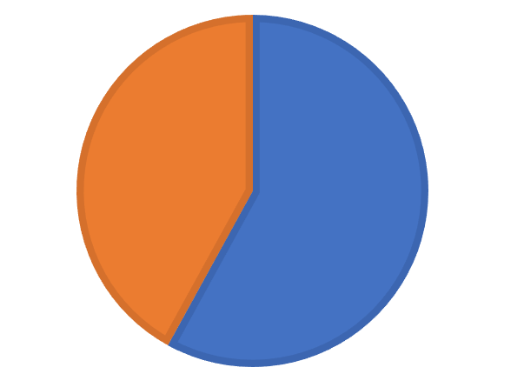
Data says 17
E
In a survey in 2017, 58% of US adults said they generally liked math classes when they were in school (K-12).
Notes:
https://www.pewresearch.org/social-trends/2018/01/09/many-americans-say-they-liked-math-and-science-in-school-thought-about-a-stem-career/

Slide 17

Data says 18
F
What percent of US children have been diagnosed with ADD/ADHD?
Notes:
Image from https://www.pexels.com/search/kid%20school%20stress/

Slide 18
Data says 19
F
In a study from 2020-2022,
about 11% of children in the US (ages 5-17) had been diagnosed with ADD/ADHD.
Notes:
https://www.cdc.gov/mmwr/volumes/73/wr/mm7305a6.htm

Slide 19
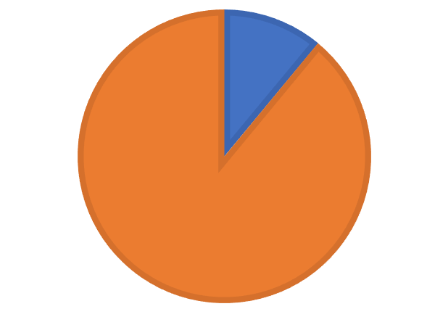
Data says 20
F
In a study from 2020-2022,
about 11% of children in the US (ages 5-17) had been diagnosed with ADD/ADHD.
Notes:
https://www.cdc.gov/mmwr/volumes/73/wr/mm7305a6.htm

Slide 20

Data says 21
G
What percent of children in the US are homeschooled?
Notes:
Image from: https://www.pexels.com/photo/a-boy-painting-7104384/

Slide 21
Data says 22
G
About 5% of children in the US were homeschooled in 2020.
Notes:
https://nces.ed.gov/programs/coe/indicator/tgk/homeschooled-children

Slide 22
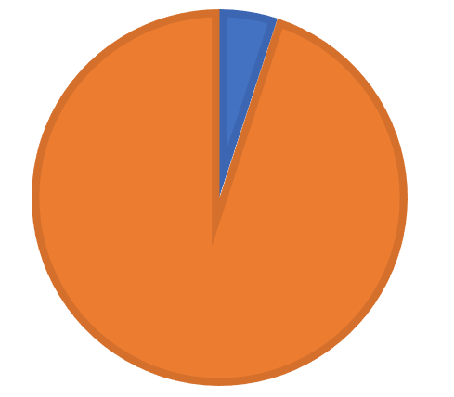
Data says 23
G
About 5% of children in the US were homeschooled in 2020.
Notes:
https://nces.ed.gov/programs/coe/indicator/tgk/homeschooled-children

Slide 23

Data says 24
H
What percent of Massachusetts’ population is 65 years or older?
Notes:
Image from: https://www.pexels.com/photo/elderly-man-giving-colorful-flowers-to-his-wife-5637842/

Slide 24
Data says 25
H
In 2022,
18% of the Massachusetts population was 65 years and older.
Notes:
https://www.census.gov/library/visualizations/interactive/population-65-and-over-2022.html

Slide 25
Data says 26
H
In 2022,
18% of the Massachusetts population was 65 years and older.
Notes:
https://www.census.gov/library/visualizations/interactive/population-65-and-over-2022.html

Slide 26
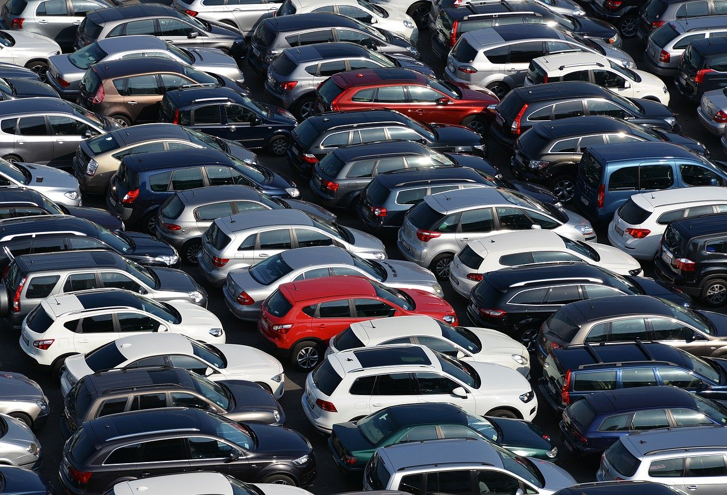
Data says 27
I
What percent of cars in Massachusetts are a neutral color (white, gray, black, or silver)?
Notes:
Image from: https://pixabay.com/photos/cars-vehicles-dimensions-7850450/

Slide 27
Data says 28
I
Gray, white, black, and silver are the most popular car colors in MA.
They make up 77% of all MA cars!
Notes:
https://www.edmunds.com/most-popular-car-colors/

Slide 28
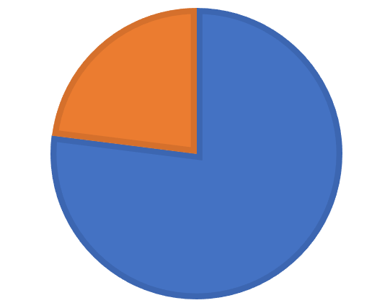
Data says 29
I
Gray, white, black, and silver are the most popular car colors in MA.
They make up 77% of all MA cars!
Notes:
https://www.edmunds.com/most-popular-car-colors/

Slide 29

Data says 30
J
What percent of the human population is right-handed?
Notes:
Image from: https://pixabay.com/photos/muslim-woman-writing-notebook-7520627/

Slide 30
Data says 31
J
About 89% of the world population is right-handed.
(About 10% are left-handed, and 1% are ambidextrous, meaning they have no dominant hand.)
Notes:
https://www.healthline.com/health/left-handers-and-health-risk

Slide 31
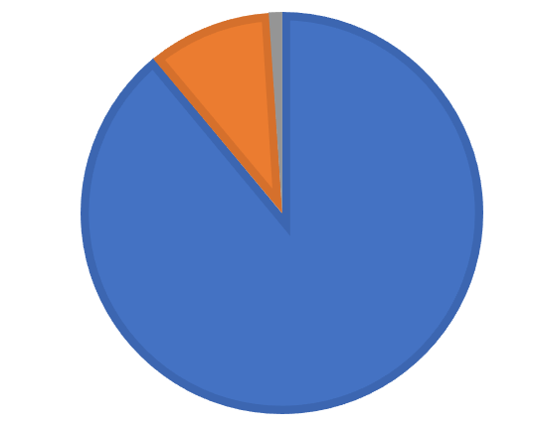
Data says 32
J
About 89% of the world’s population is right-handed.
(About 10% are left-handed, and 1% are ambidextrous, meaning they have no dominant hand.)
Notes:
https://www.healthline.com/health/left-handers-and-health-risk

