Slide 1

Comparing Fractions to One-Half
Unit 2 Activity
Stations for Remote Classroom

Slide 2
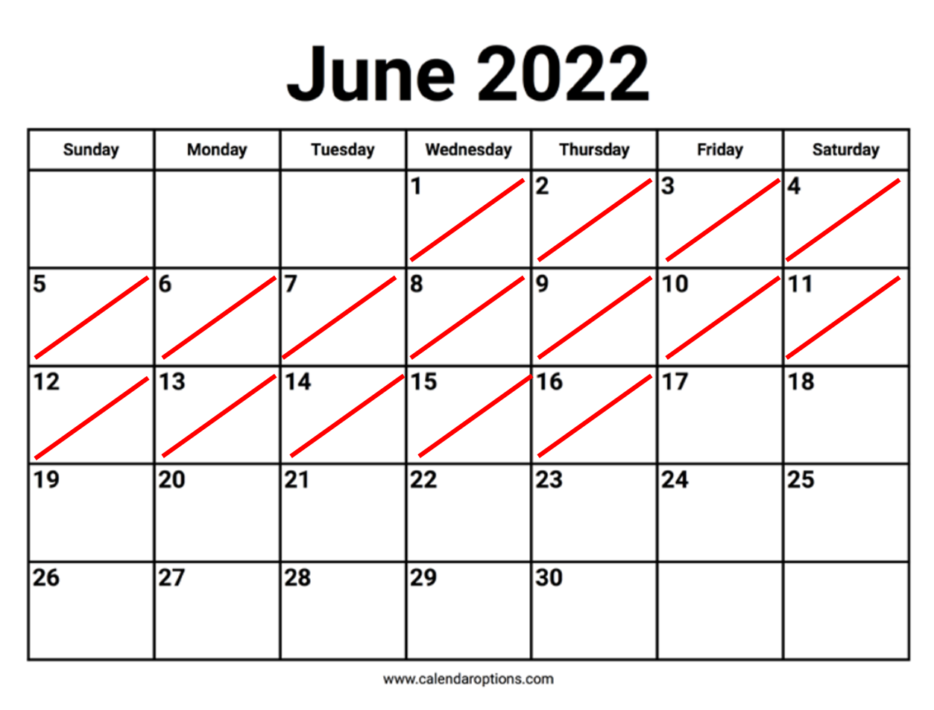
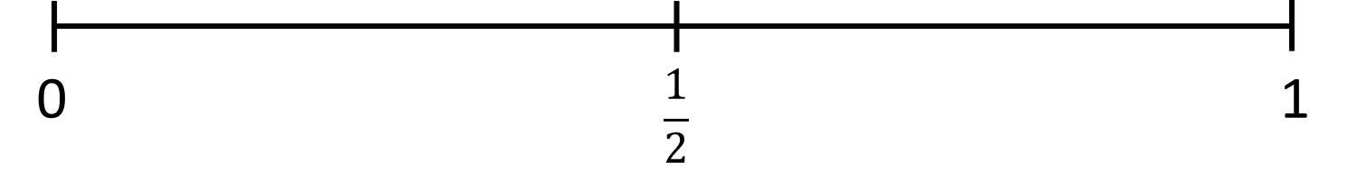
Station 1: Calendar

Slide 3
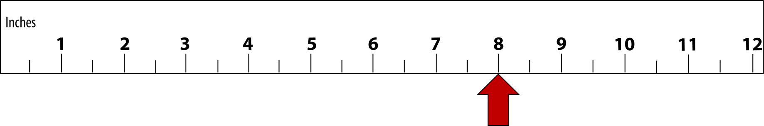
Station 2: Ruler

Slide 4
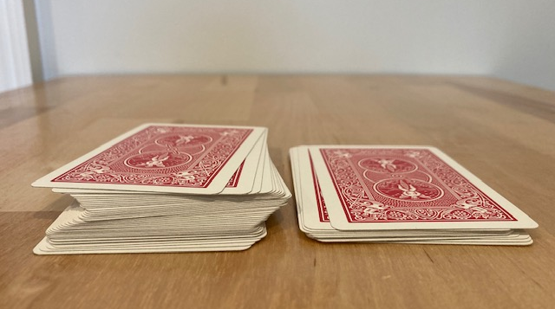
Station 3: Cut the Deck
This pile on the left contains 40 out of 52 cards.
Notes:
Image by Melissa Braaten

Slide 5
Station 4: Data about Massachusetts
(Based on data from 2023, rounded to nearest hundred thousand)
Total residents: 7,000,000
Residents under 18 years old: 1,300,000

Slide 6
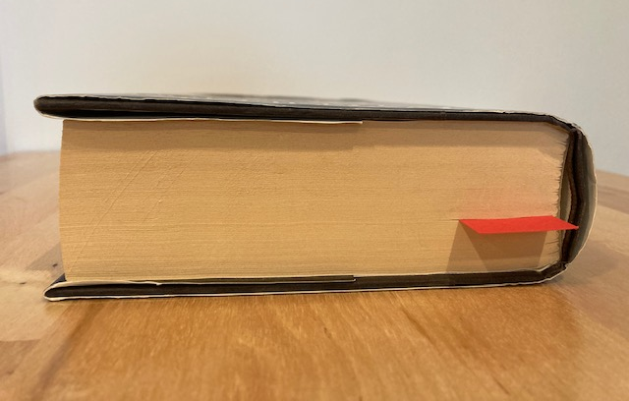
Station 5: A Bookmarked Page
The bookmark is at page 428 out of 662.
Notes:
Image by Melissa Braaten

