Slide 1
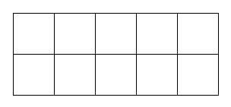

Array 1
Arrays for Fact Families
Write a fact family for this array.
____ × ____ = _____
____ × ____ = _____
____ ÷ ____ = _____
____ ÷ ____ = _____

Slide 2
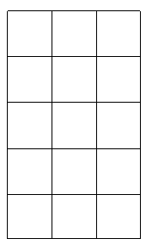
Array 2
Arrays for Fact Families
Write a fact family for this array.
____ × ____ = _____
____ × ____ = _____
____ ÷ ____ = _____
____ ÷ ____ = _____

Slide 3
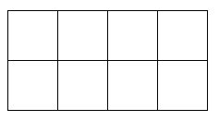
Array 3
Arrays for Fact Families
Write a fact family for this array.
____ × ____ = _____
____ × ____ = _____
____ ÷ ____ = _____
____ ÷ ____ = _____

Slide 4
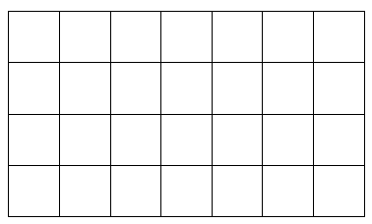
Array 4
Arrays for Fact Families
Write a fact family for this array.
____ × ____ = _____
____ × ____ = _____
____ ÷ ____ = _____
____ ÷ ____ = _____

Slide 5
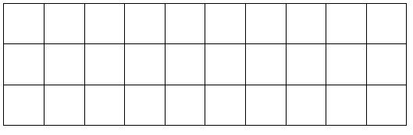
Array 5
Arrays for Fact Families
Write a fact family for this array.
____ × ____ = _____
____ × ____ = _____
____ ÷ ____ = _____
____ ÷ ____ = _____

Slide 6
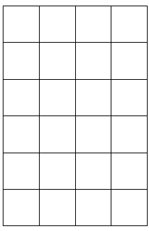
Array 6
Arrays for Fact Families
Write a fact family for this array.
____ × ____ = _____
____ × ____ = _____
____ ÷ ____ = _____
____ ÷ ____ = _____

Slide 7
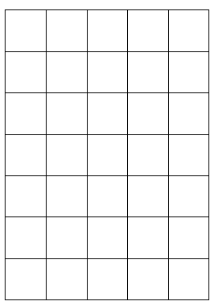
Array 7
Arrays for Fact Families
Write a fact family for this array.
____ × ____ = _____
____ × ____ = _____
____ ÷ ____ = _____
____ ÷ ____ = _____

Slide 8

Array 8
Arrays for Fact Families
Write a fact family for this array.
____ × ____ = _____
____ × ____ = _____
____ ÷ ____ = _____
____ ÷ ____ = _____

Slide 9
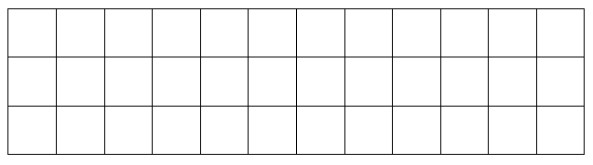
Array 9
Arrays for Fact Families
Write a fact family for this array.
____ × ____ = _____
____ × ____ = _____
____ ÷ ____ = _____
____ ÷ ____ = _____

Slide 10
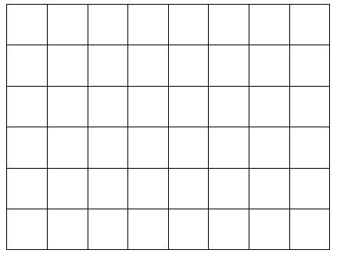
Array 10
Arrays for Fact Families
Write a fact family for this array.
____ × ____ = _____
____ × ____ = _____
____ ÷ ____ = _____
____ ÷ ____ = _____

Slide 11
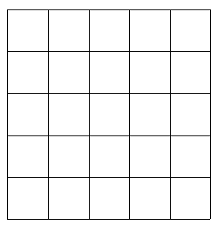
Array 11
Arrays for Fact Families
Write a fact family for this array.
____ × ____ = _____
____ × ____ = _____
____ ÷ ____ = _____
____ ÷ ____ = _____

Slide 12
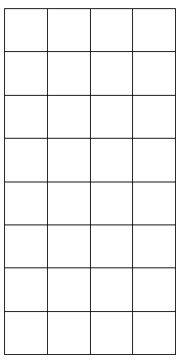
Array 12
Arrays for Fact Families
Write a fact family for this array.
____ × ____ = _____
____ × ____ = _____
____ ÷ ____ = _____
____ ÷ ____ = _____

