Slide 1
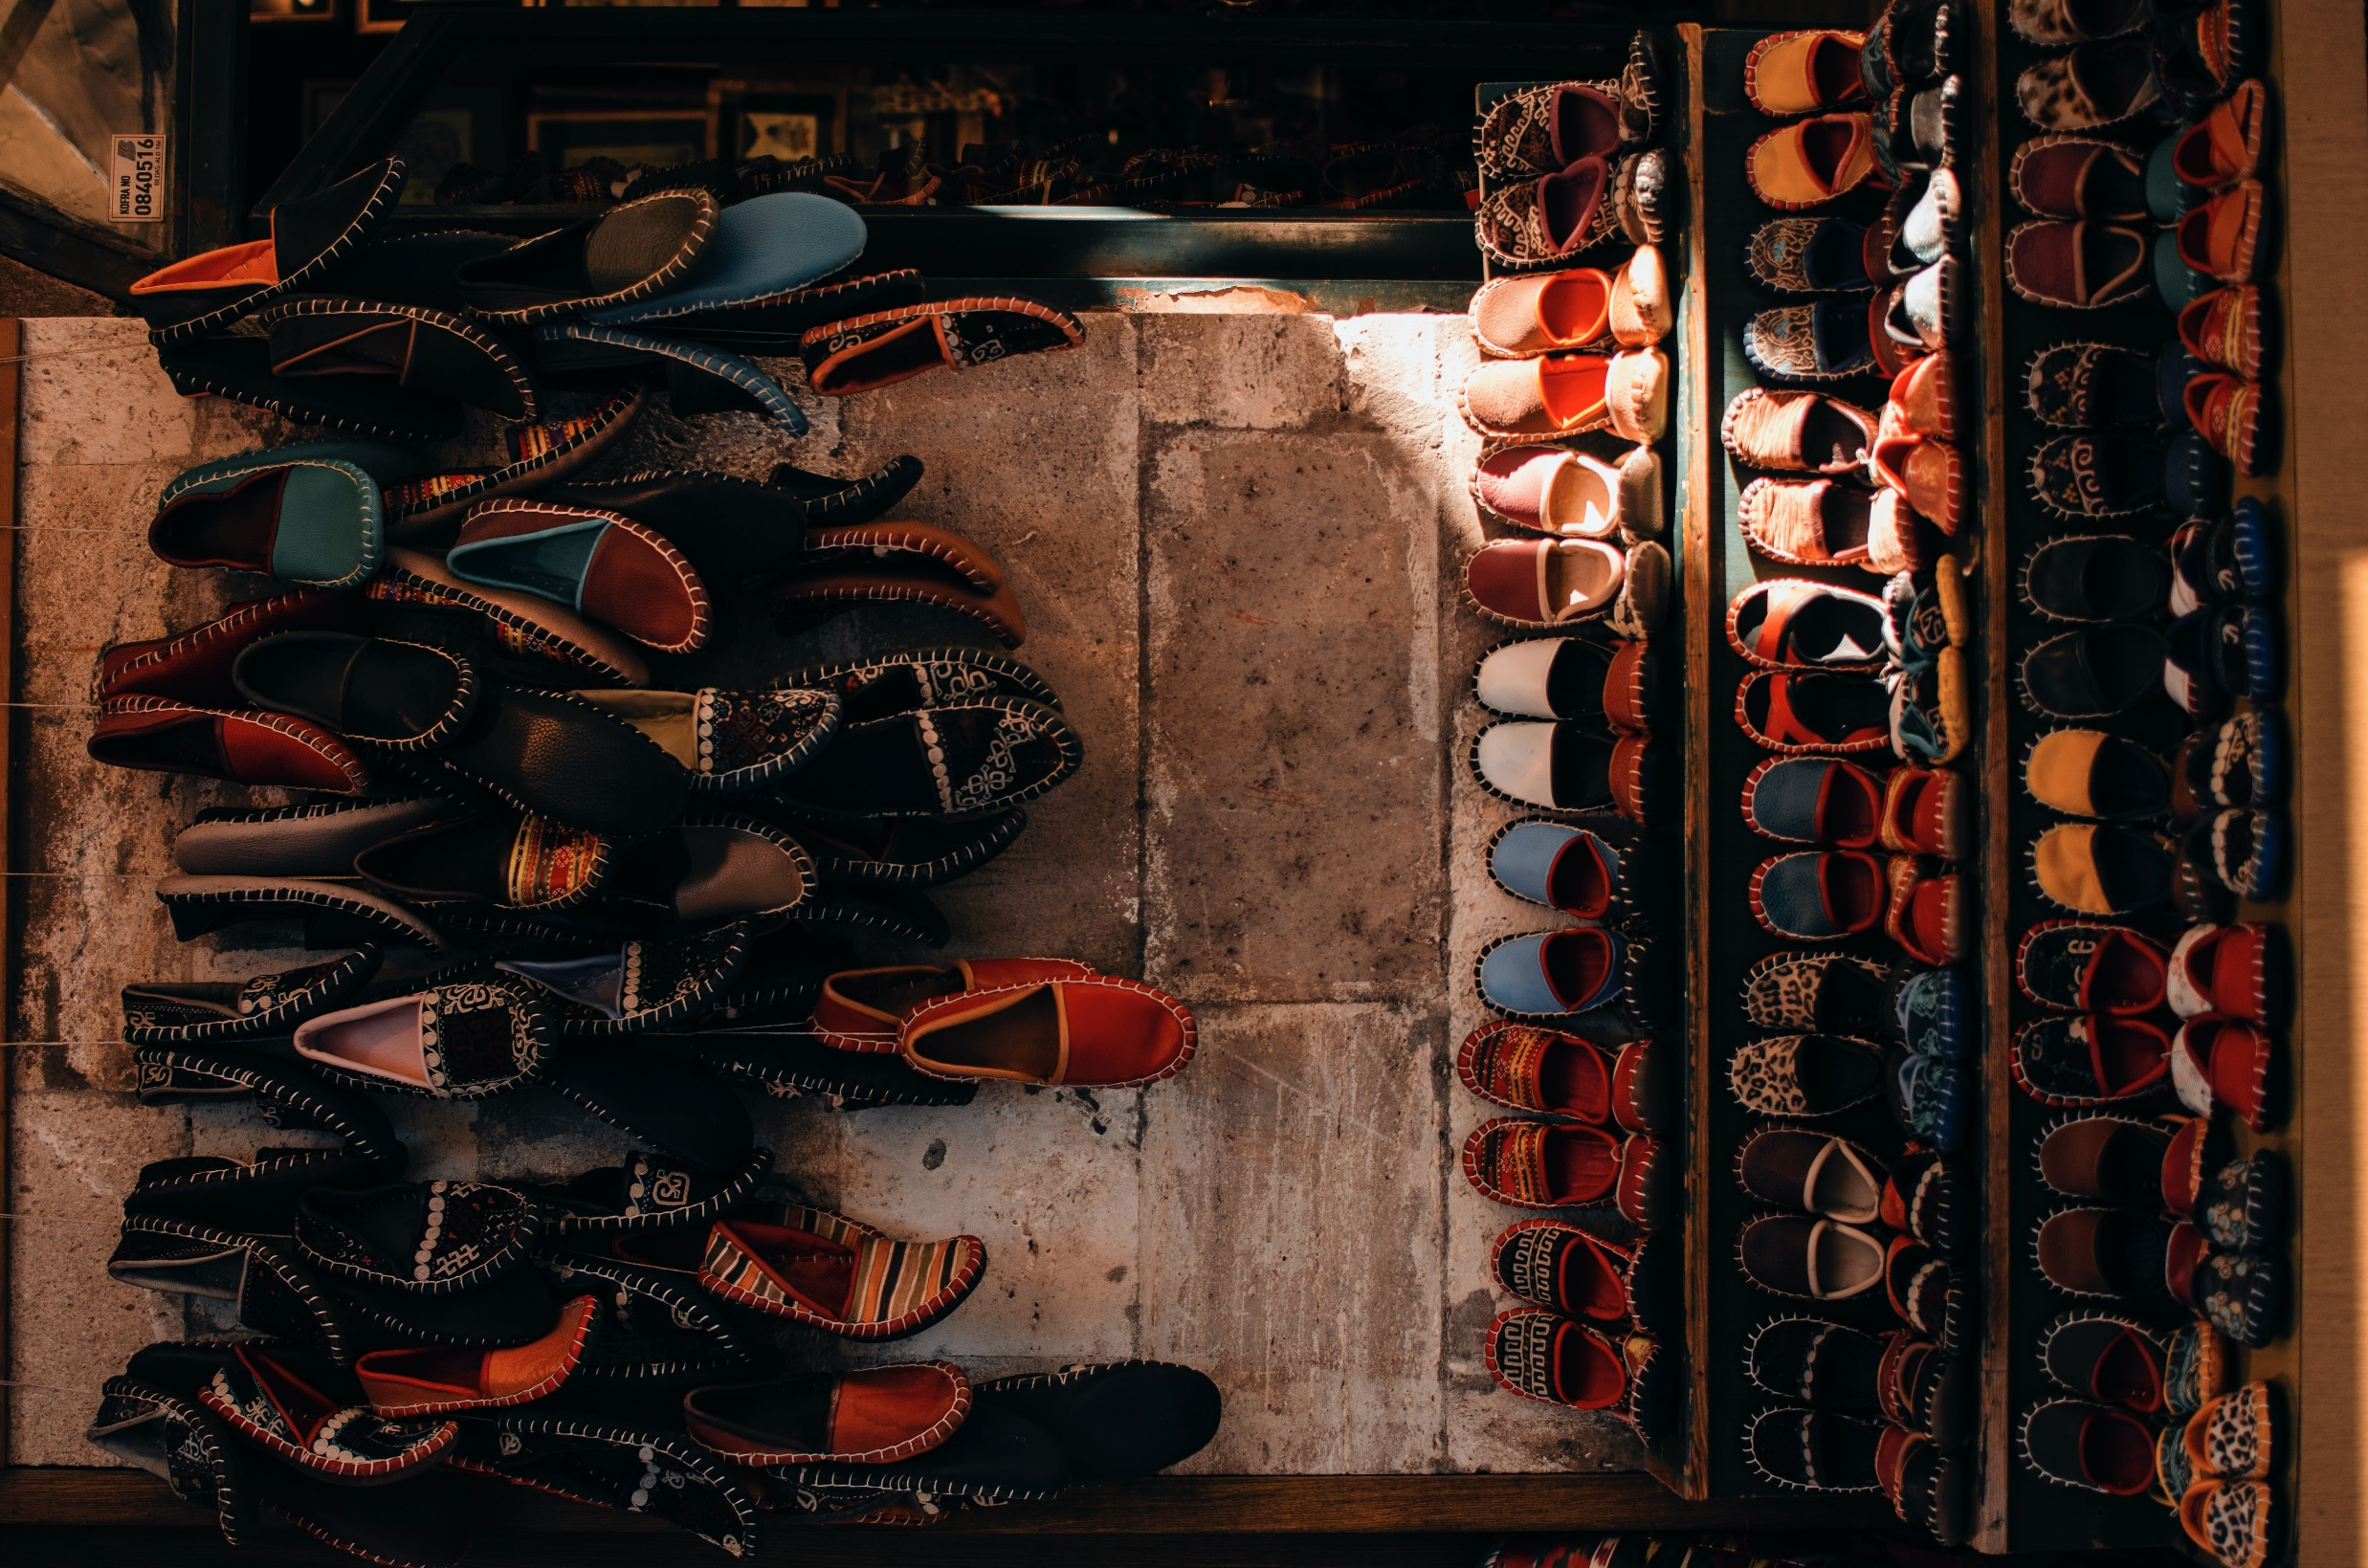
Shoe array

Slide 2
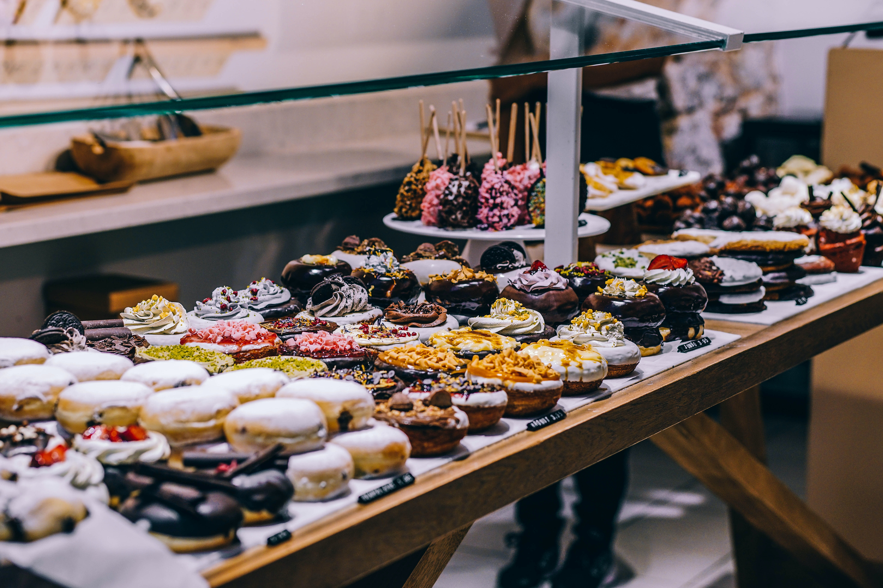
Dessert array

Slide 3
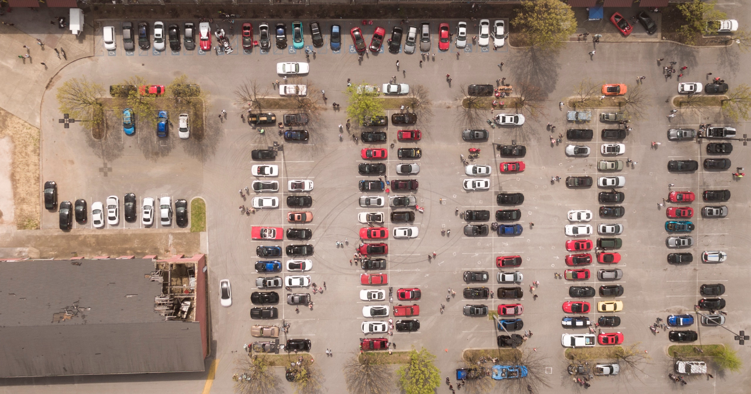
Car array

Slide 4
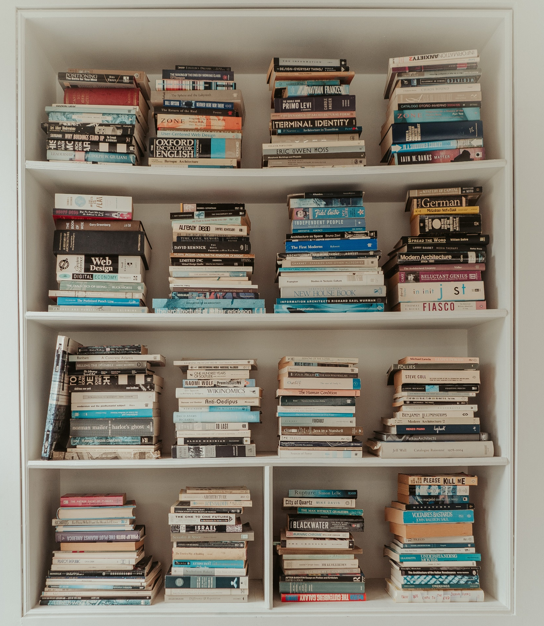
Book array
Notes:
Photo by Josh Kobayashi: https://www.pexels.com/photo/a-stack-of-books-on-the-shelf-5404459/

